Slide 1
ACCIDENTS CAN HAPPEN
WARNING
THE FOLLOWING SLIDE PRESENTATION IS GRAPHIC IN NATURE.
IT IS PRESENTED TO REMIND ALL THE SEVERITY AND CONSEQUENCES OF NOT WORKING SAFELY.

Slide 2
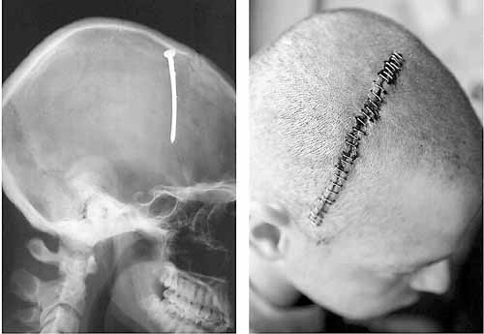
Nail in head

Slide 3
Nain in eye

Slide 4
Nain in eye x-ray

Slide 5
Severe cut to hand

Slide 6
Severe burn to hand

Slide 7
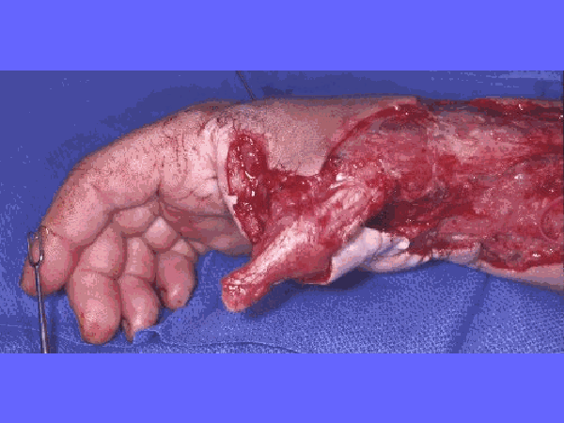
Severe burn to hand…

Slide 9
Burned clothing

Slide 10
Burned clothing…

Slide 11
Electric fire

Slide 12
Be careful opening exterior panels

Slide 13
Be careful opening exterior panels

Slide 14
Be careful opening exterior panels

Slide 15
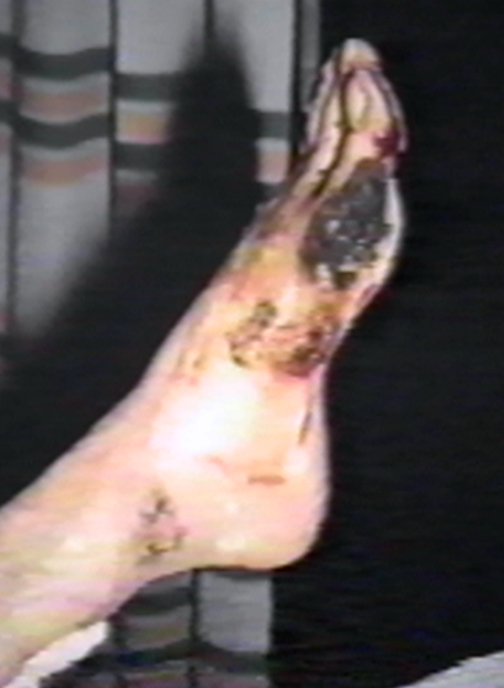
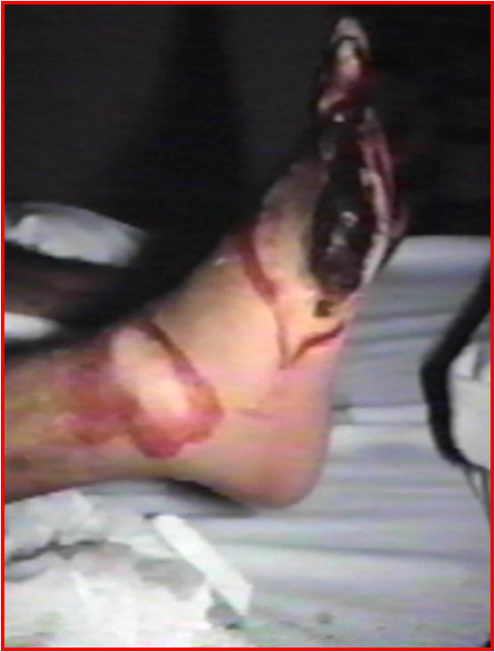
Foot burn

Slide 16
Injured hand

Slide 17
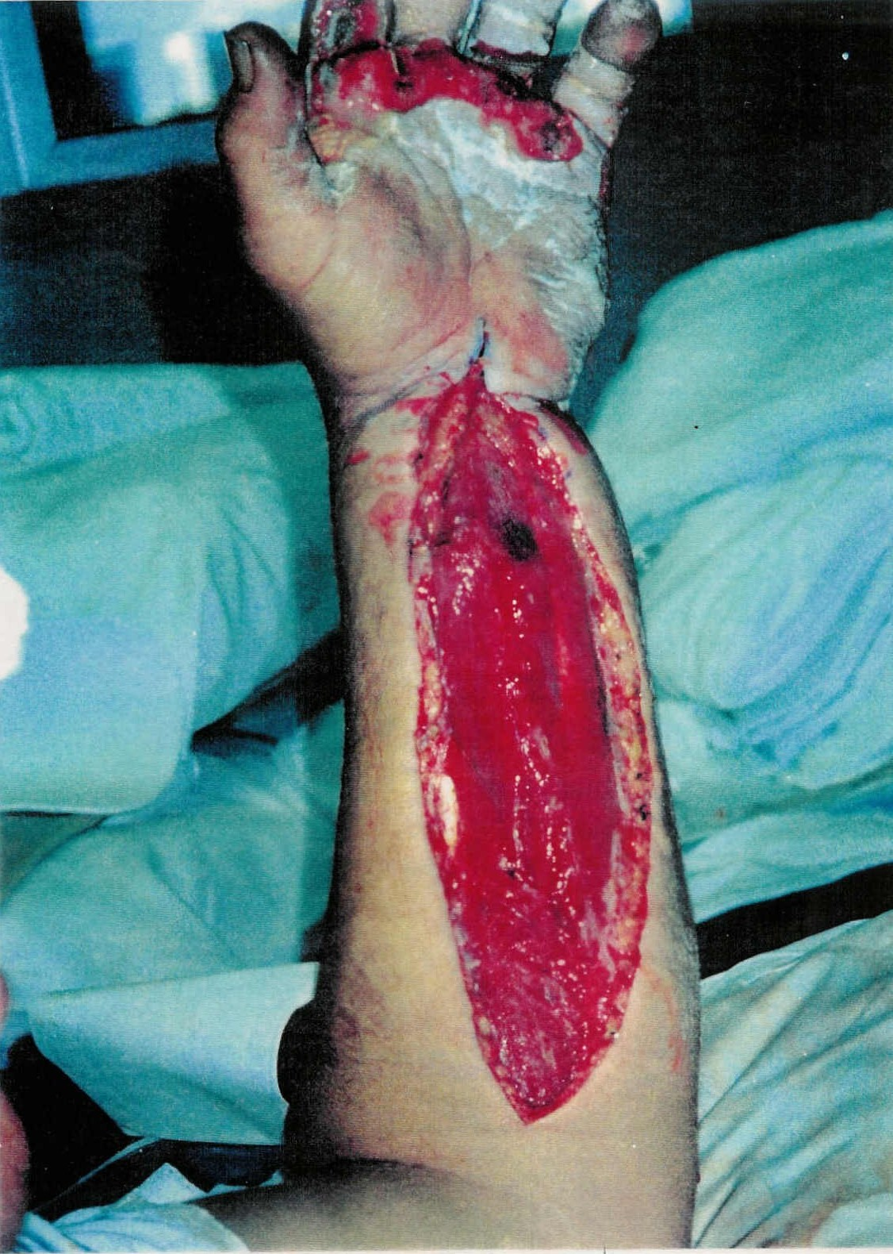
Severe injuries

Slide 18
Severe hand injury

Slide 20
ELECTRIC EXPLOSION

Slide 21
WORK SAFE
BE SAFE

