Slide 1
THE FORCE IS AGAINST YOU…
BACK SAFETY
and LIFTING

Slide 2
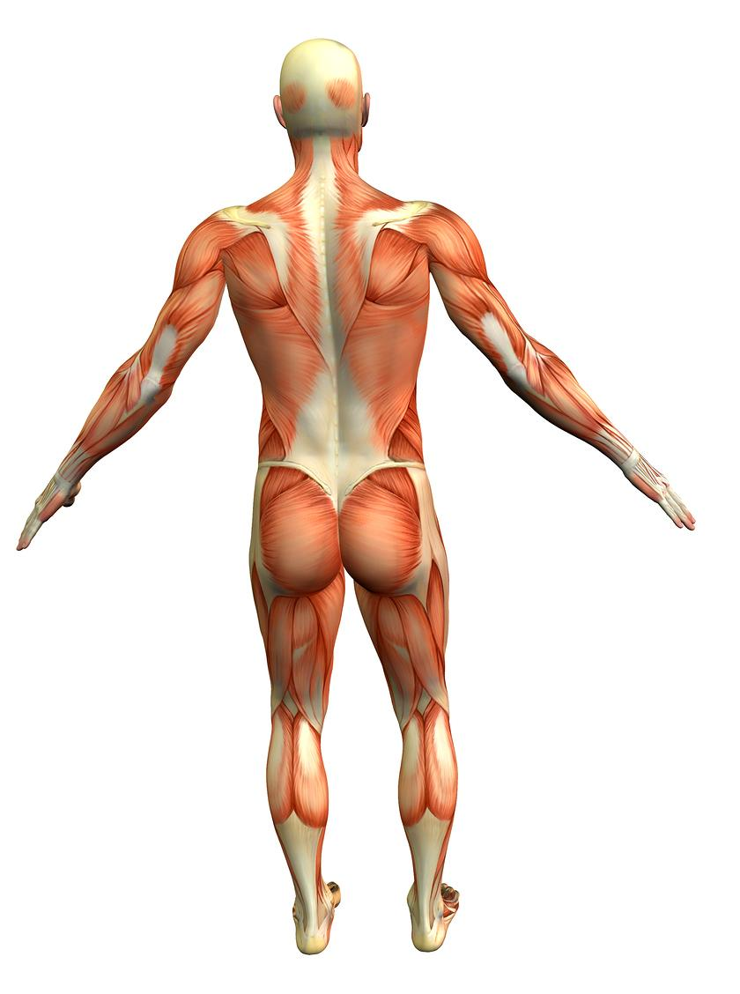
BACK INJURIES
More than 1 million workers suffer back injuries each year, accounting for 1/5 of all workplace injuries or illnesses.
  Add to that the employees’ pain and suffering.
  They are exceedingly painful, difficult to heal, and have an effect on everything you do.
After suffering one back injury, you are much more likely to experience another one later on.

Slide 3
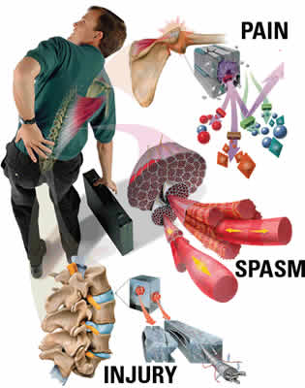
BACK INJURIES…..
It is important to learn how to avoid injuring or re-injuring your back.
You might be able to save yourself a lot of pain and a lifetime of back problems.
Do yourself a big favor by learning proper lifting techniques and the basics of back safety.

Slide 4
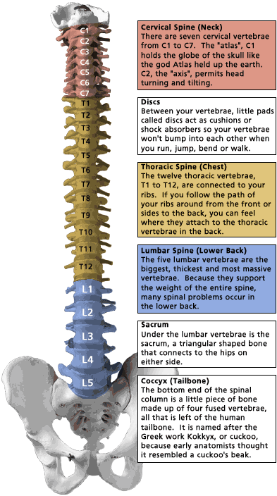
Why do they occur?
The spine’s vertebrae are held together by ligaments.
Muscles are attached to the vertebrae by bands of tissue called tendons.
Between each vertebra is a cushion known as a disc.
Openings in each vertebra line up to form a long, hollow canal.
The spinal cord runs through this canal from the base of the brain.
Nerves from the spinal cord branch out and leave the spine through the spaces between the vertebra.

Slide 5
Why do they occur?
The lower part of the back holds most of the body’s weight.
Every time you bend over, lift a heavy object, or sit leaning forward, you put stress on your spine.
Over time, the discs between your vertebrae can start to wear out and become damaged.
Every time you bend or lean over to pick something up, you put tremendous pressure on your lower back.

Slide 6
The Forces Involved
The amount of force you place on your back in lifting may surprise you!
Think of your back as a lever, with the fulcrum in the center, it only takes ten pounds of pressure to lift a ten pound object.
10 lbs
10 lbs

Slide 7
The Forces Involved
If you shift the fulcrum to one side, it takes much more force to lift the same object.
Your waist acts like the fulcrum in a lever system, on a 10:1 ratio.
Lifting a ten pound object puts 100 pounds of pressure on your lower back.
100 lbs
10 lbs

Slide 8
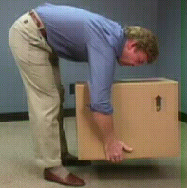
The Forces Involved
1150 lbs
When you add in the 105 pounds of the average human upper torso, you see that lifting a ten pound object actually puts 1,150 pounds of pressure on the lower back.
105 lbs
10 lbs

Slide 9
The Forces Involved
1400 lbs
If you were 25 pounds overweight, it would add an additional 250 pounds of pressure on your back every time you bend over.
130 lbs
10 lbs

Slide 10
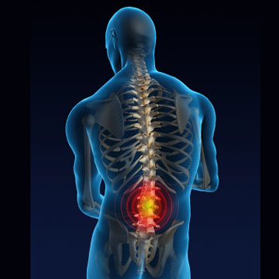
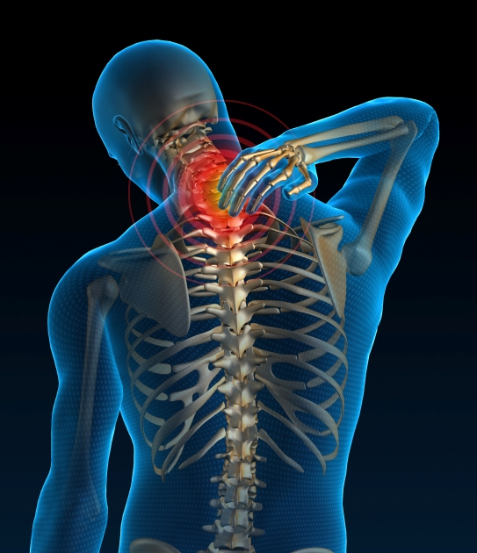
Back Safety & Lifting
CAUSES OF BACK INJURIES

Slide 11
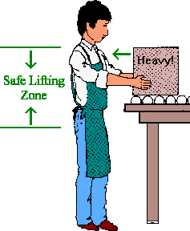
Back Injury Prevention
Avoid lifting and bending whenever you can.
Place objects up off the floor.
That way you won’t have to reach down to pick them up again.
Raise / lower shelves.
The best zone for lifting is between your shoulders and your waist.
Put heavier objects on shelves at waist level, lighter objects on lower or higher shelves.
*
SAFE LIFTING ZONE

Slide 12
  Back Safety & Lifting
Reducing exposure to known risk factors
    Repetition
    Awkward Position
    Force
    Object weight
    Load Distribution
    Object friction
    Duration

Slide 13
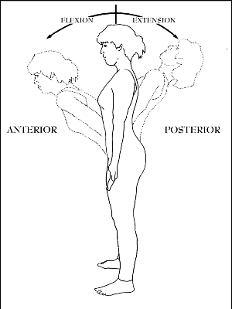
  Back Safety & Lifting
AVOID
HYPER EXTENSION (backward) movements of the back.
HYPER FLEXTION (forward) movements of the back.

Slide 14
  Back Injury Prevention
Maintain good posture
Lift objects holding them close to your body
Never “twist” when carrying, handling, or transferring a heavy object
Avoid “locking out” the knees
Use proper lifting techniques

Slide 15
4 PRINCIPLES
1) ASSESS
3) PREPARE
4) PERFORM
2) PLAN
PRINCIPLES OF
SAFE HANDLING

Slide 16
1) ASSESS
Assess the Load:
  Weight, shape, size
  Handles, packaging
  Stability
  Contents: hot, cold, hazardous
Assess the environment:
  Space constraints
  Flooring condition, levels
  Temperature, humidity, ventilation
  Tidiness, general housekeeping
Assess the task:
  Posture
  Pacing, rate of work, breaks
  Requirements for team handling
Assess Your Own Capabilities:
  Strength, height, etc.
  Health problems
  Gender, age, fitness000

Slide 17
2) PLAN
Task
  What is the most appropriate posture?
  Is there mechanical aid available?
  Is there anyone else to help?
Route
Consider start and end points
  Can any obstructions be cleared

Slide 18
3) PREPARE
Prepare the load:
  Can the load be split?
  Can the load be made more stable?
  Make sure contents are evenly distributed?
  Move the load’s center of gravity close to yours
  Cover sharp / abrasive edges
Prepare yourself and the area:
  Check space constraints
  Move obstacles
  Check final destination
  Check housekeeping
  Get a good grip on the load
  Use PPE where appropriate

Slide 19
4) PERFORM
Apply principles of biomechanics to reduce the load on the spine;
  Keep a wide base of support.
  Maintain the lumbar curve (low back) as much as possible.
  Get a good grip.
  Position feet in direction of travel.
  Use smooth controlled movements.
  Use friction to minimize force.
  Try to avoid twisting and stooping.
  Use team lifting where appropriate.

Slide 20
Proper Lifting Techniques
Grip the load
Squat down
Hug the load
PROPER LIFTING TECHNIQUES
Get close to the load
Slowly lift

Slide 21
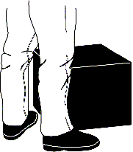
Get close to the load
  Get as close to the load as possible with your feet wide apart about shoulder width, with one foot slightly in front of the other for balance.
    Test the object’s weight before lifting
    Ask for assistance from a co-worker when appropriate.
    Have the object close to the body and put less force on the low back
    Avoid rapid, jerky movements.

Slide 22
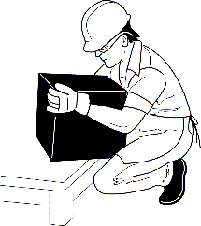
Squat down
Keep yourself in an upright position while squatting to pick up.
Squat by bending the knees and hips.
Keep the three Curves of the Back properly aligned:
  Ears, Shoulders, and Hips are in a straight line.

Slide 23
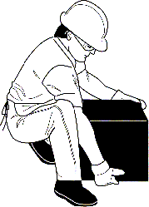
Grip the load
Tightening the stomach helps support the spine.
Do not hold your breath while tightening the muscles.
Get a firm grasp of the object before beginning the lift.
  Use both hands.
  Use whole hand, not just fingers.
  Use gloves as needed to prevent “pinched” grips or to protect the hands during lift.

Slide 24
Hug the load
Legs are the strongest muscles in the body – so use them.
Avoid back flexion.
Hold objects close to body.
Slide the object from the knee on the ground to mid-thigh.
Keep the head forward.
Hug the object to your stomach & chest.

Slide 25
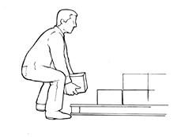
Slowly lift
Lift with the legs to allow the body’s powerful leg muscles to do the work.
Flex the knees and hips, not the back.
Avoid bending & twisting at the waist.
Try to keep the back “straight” during the lift.
Do not look down at the object during lift.
Look up to help “straighten” the position of the back for a safer lift.
Never Bend, Lift, and Twist at the same time.

Slide 26
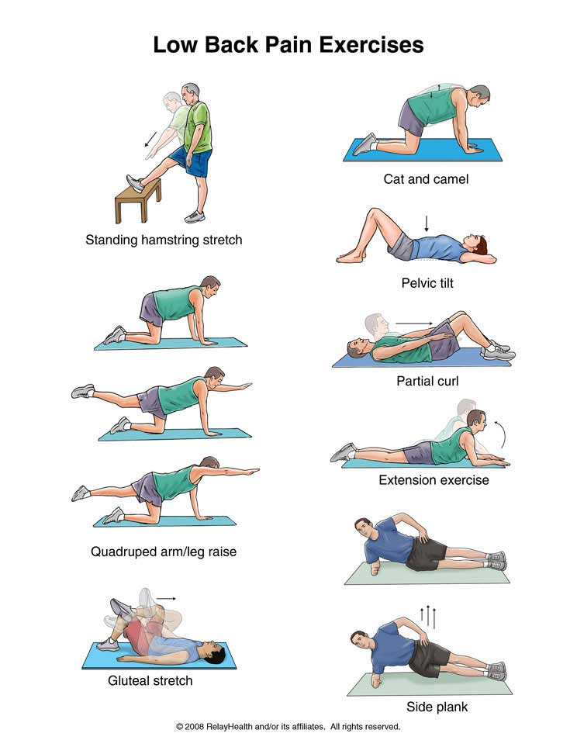
Stretching Exercises

Slide 27
Stretching Exercises

Slide 28
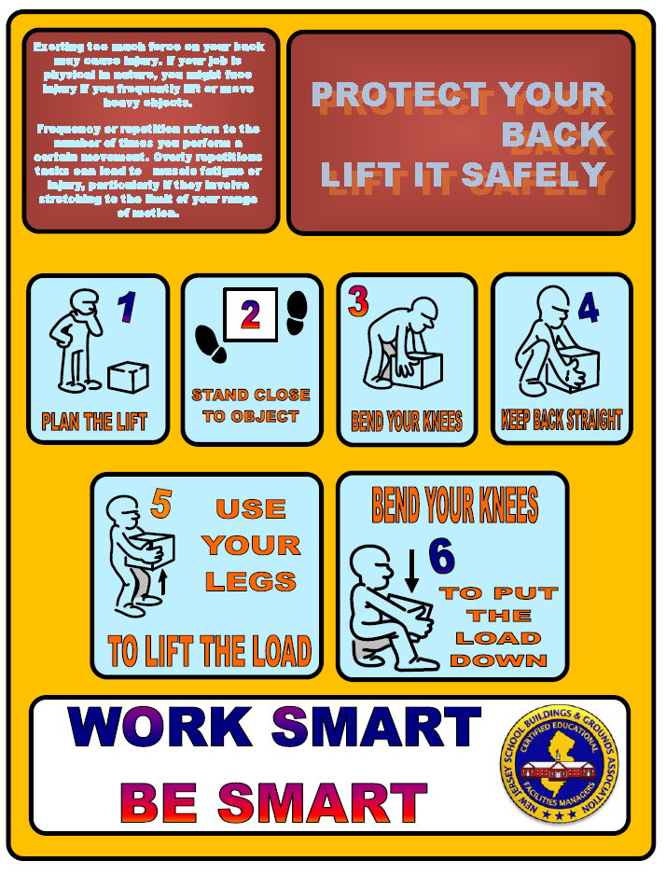

Slide 29
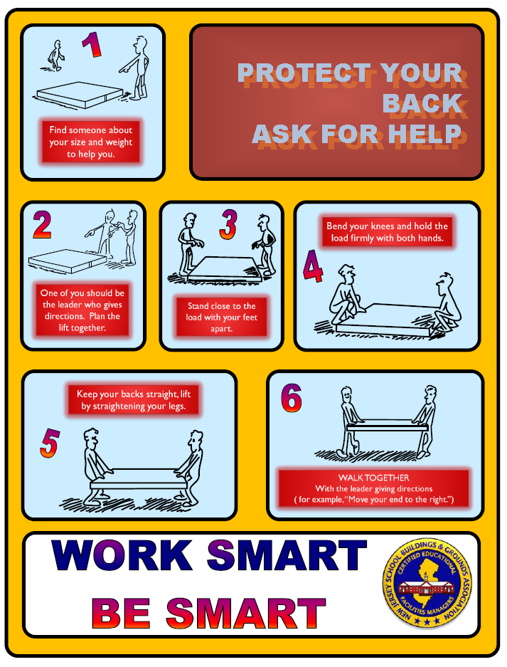

Slide 30

SUMMARY
Common Causes Of Back Injuries
  Heavy Lifting
  Twisting
  Reaching & Lifting
  Carrying & Lifting
  Awkward Positions
  Sitting or Standing
  Slips, trips, and falls
Reduce exposures to known risk factors.

Slide 31

SUMMARY
  Principles of Safe Handling
  Assess, Plan, Prepare, Perform
  Proper Lifting Techniques
  Close, Squat, Grip, Hug, Stand Slowly
  Should you exercise?---of course!!!

Slide 32
QUESTIONS

