Slide 1
Just when you thought you had seen it all!
DANGEROUS JOBS

Slide 2
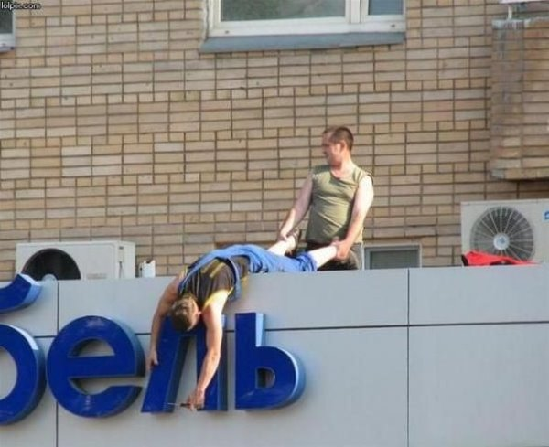
GOOD GRIP

Slide 3
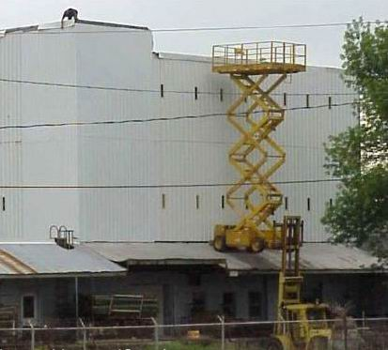
Multi Equipment use.

Slide 4
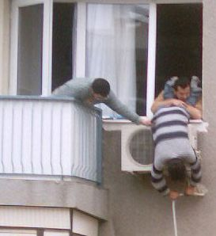
Danger…Danger. Ask what he ate the night before.

Slide 5
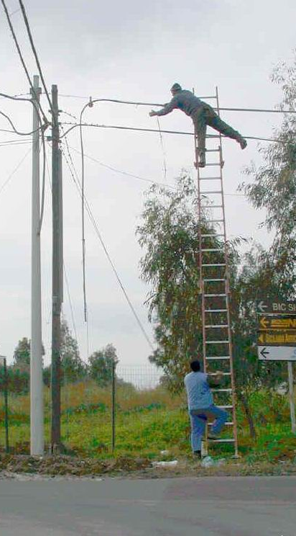
Creative use of Ladders.

Slide 6
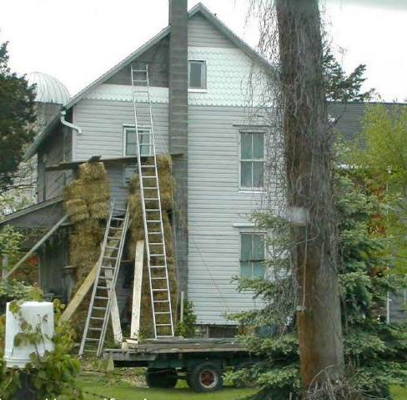
Soft Scaffold

Slide 7
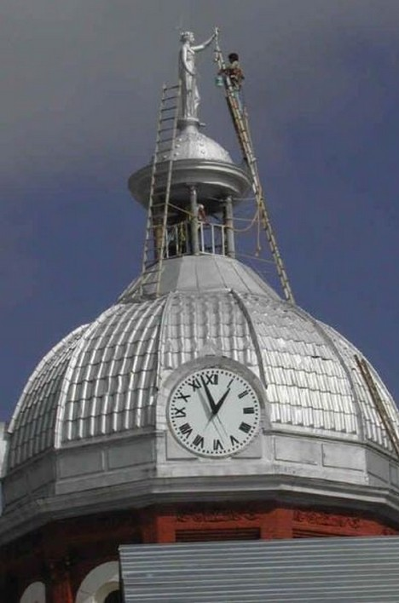
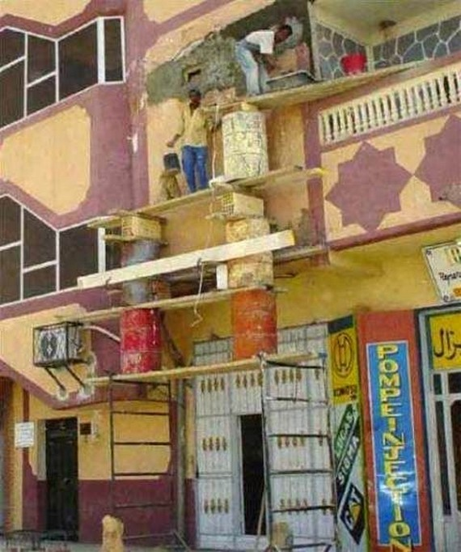
What the………………

Slide 8
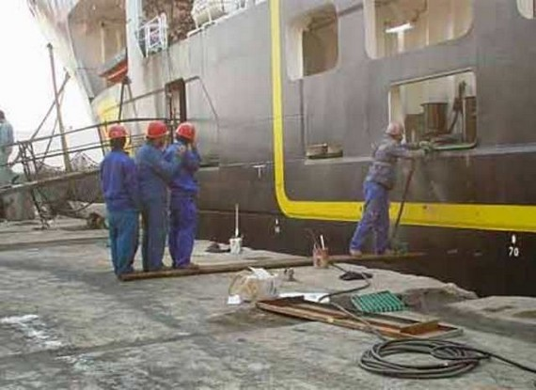
Weight differentials do work….

Slide 9
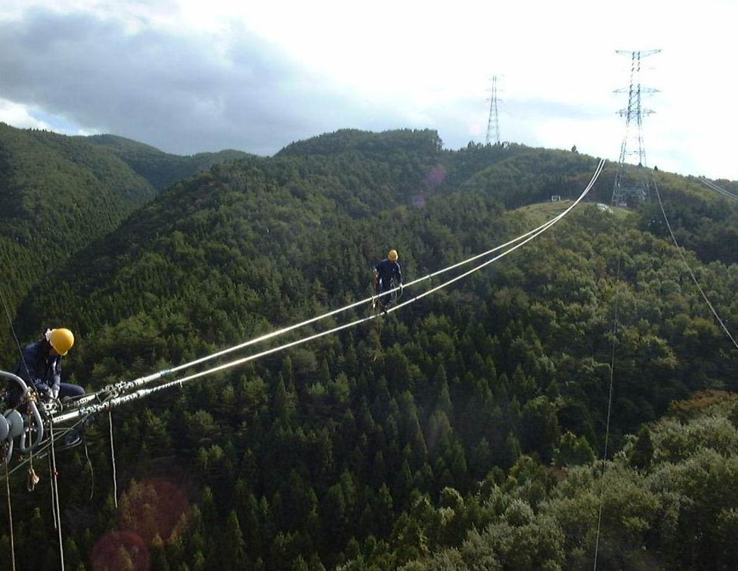
Oh boy………

Slide 10
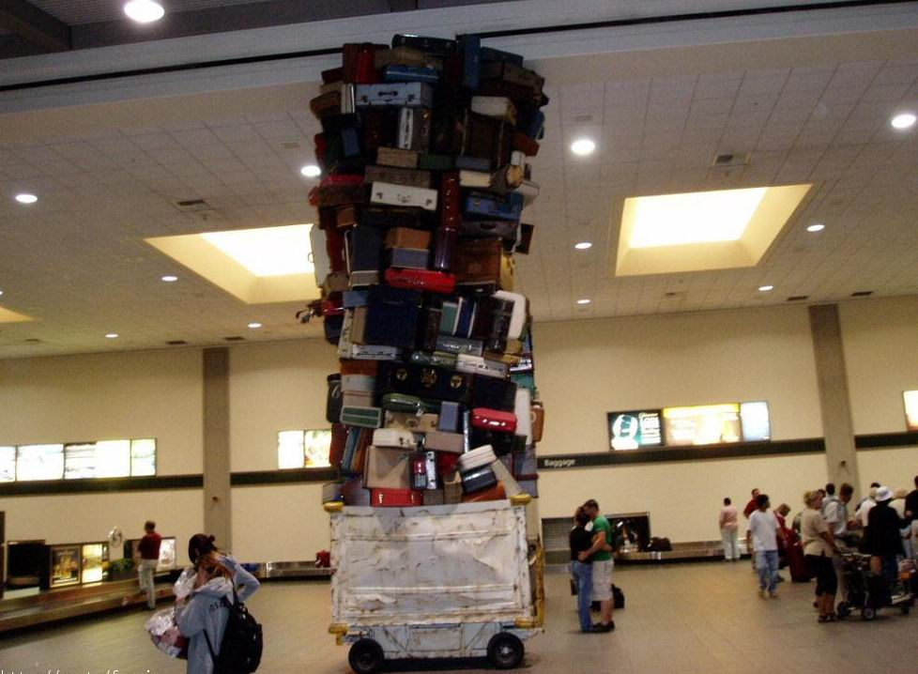
Making out next to this is TRULY LOVE.

Slide 11
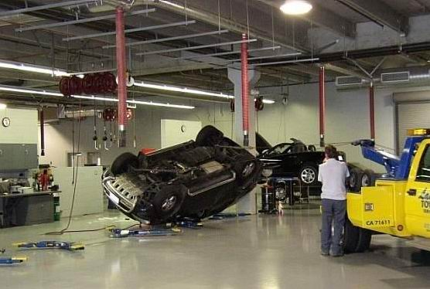
New way to work under a car.

Slide 12
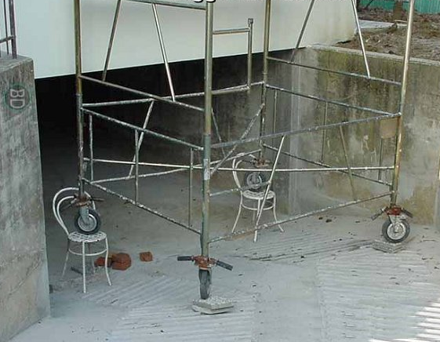
New use for chairs.

Slide 13
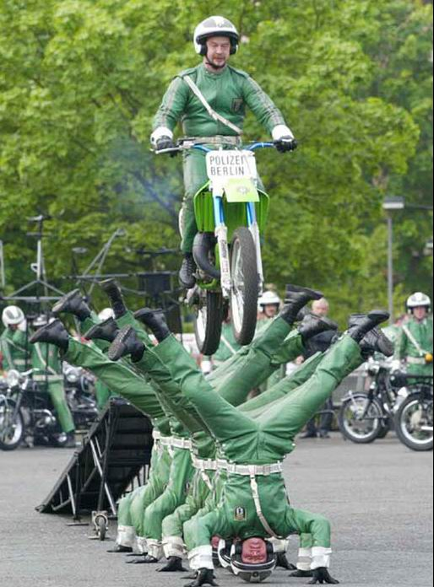
I hope they’re wearing protection.

Slide 14
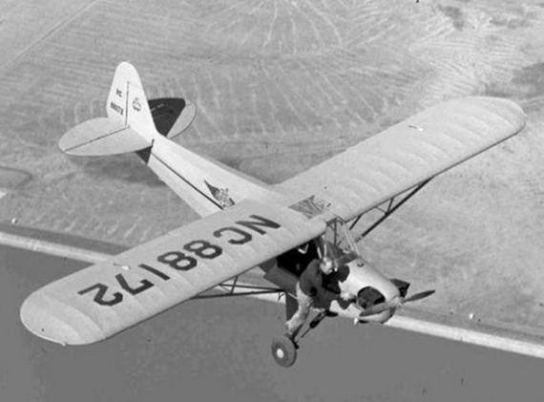
Aerial adjustments.

Slide 15
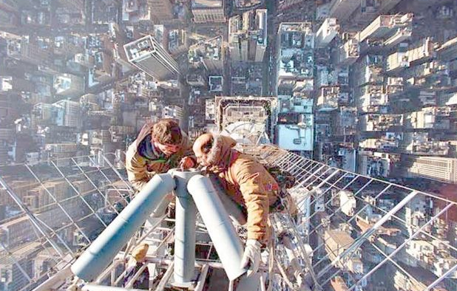
Why did the freakin’ bulb have to burn out on my shift!

Slide 16
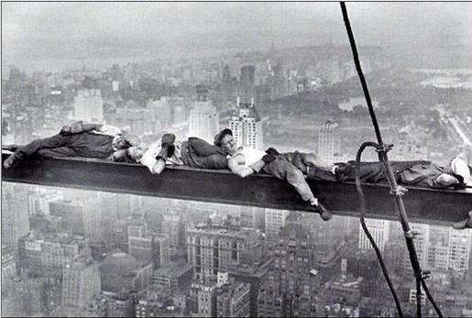
These guys better not toss and turn when they sleep.

Slide 17
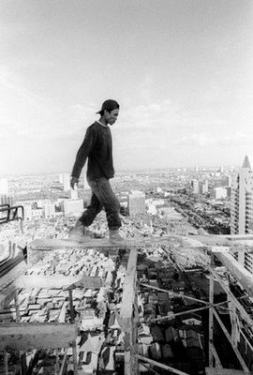
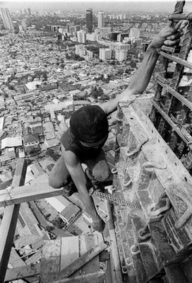
OSHA Nightmare…..

Slide 18
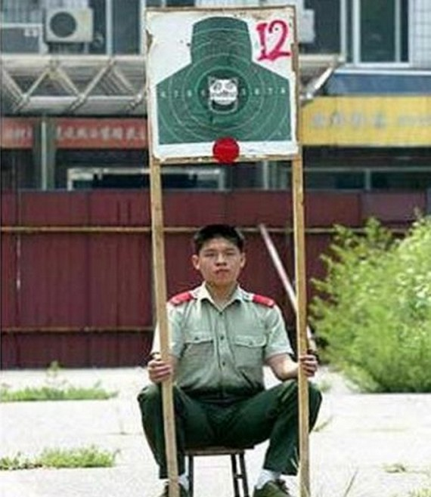
BY FAR, THE MOST DANGEROUS JOB I HAVE EVER SEEN.

Slide 19
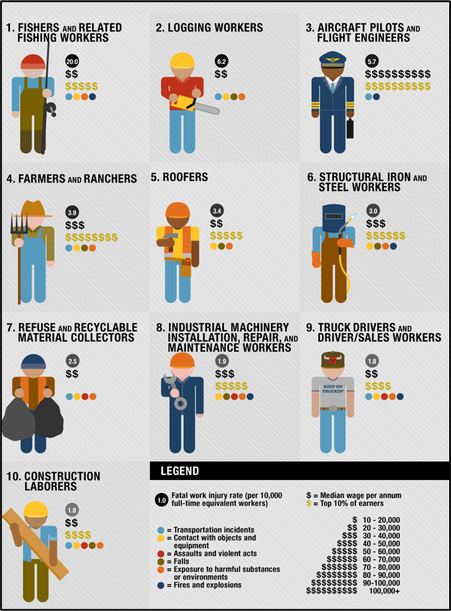
Most Dangerous

