Slide 1
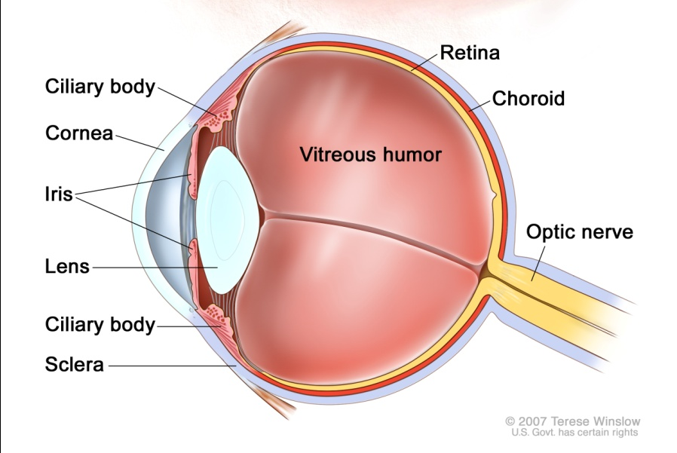

Eye Protection
Training on the use of eye protection in the workplace

Slide 2
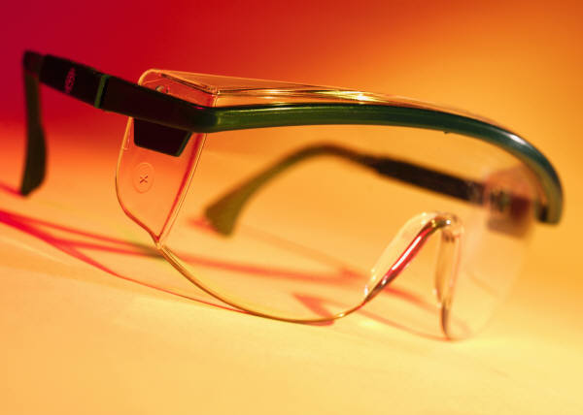
Eye Protection
Workplace eye hazards
Types of eye protection
Use and care of eye protection!
Notes:
This short training course will give you basic information on workplace eye hazards, types of eye protection and the proper use and care of eye protection. We are teaching this course to partially meet the training requirements of L & I safety regulations for employees who wear eye protection on the job. The course was developed by L & I – Division of Occupational Safety & Health (DOSH) We will also give you information or training on eye hazards specific to our worksite and on the actual eye protection you use at this workplace.

Slide 3
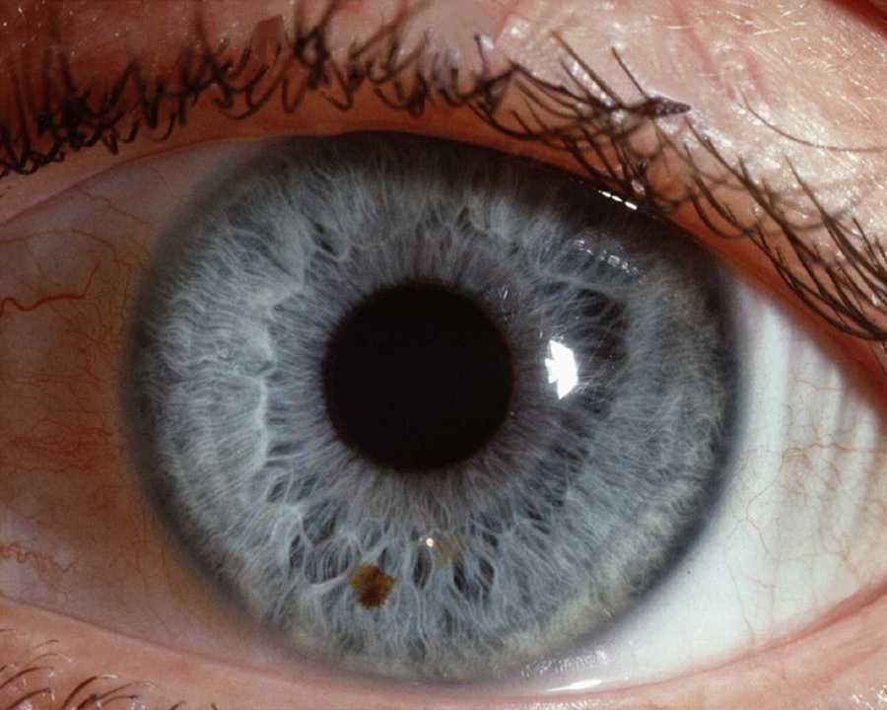


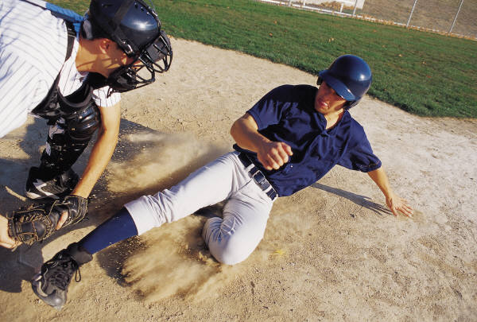
What can be more precious than your sight?
What if you could no longer see this?

Slide 4
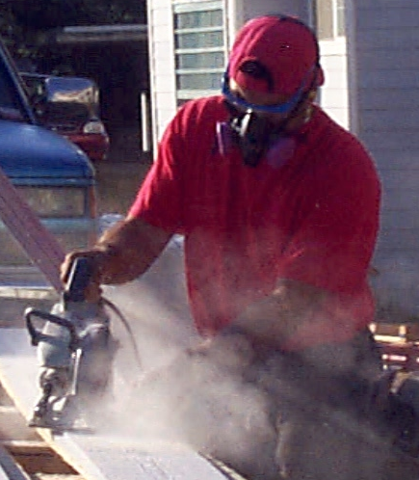
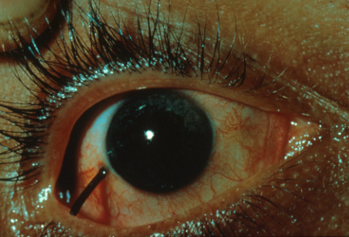

Types of Eye Hazards
Flying objects
Particles and dust
Chemicals
Harmful light radiation – ultraviolet, infrared or lasers

Slide 5
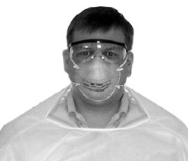
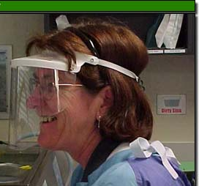
Eye Infection Hazards
Infectious agents may enter the body through the eyes, nose and mouth. The use of eye and face protection is required in the healthcare industry during procedures that may generate
body fluid splashes or sprays.
Eye protection may also be needed to protect against exposure to infectious agents in sewage treatment, composting activities, and during application of biosolids.

Slide 6
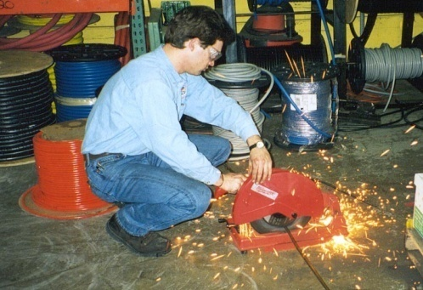
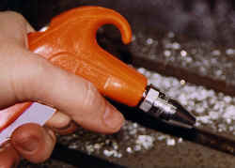
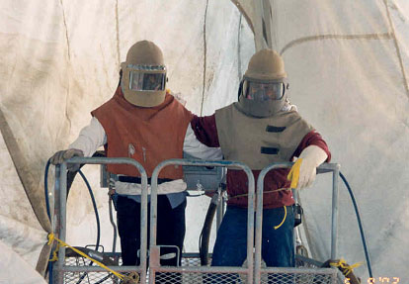
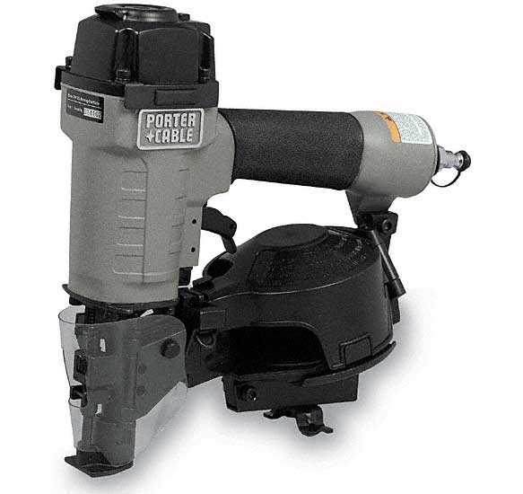
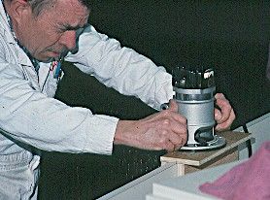
Sources of Eye Hazards
Flying objects or particles in eye
Grinding
Sanding
Blowdown
Sandblasting
Nail gun use
Woodworking

Slide 7
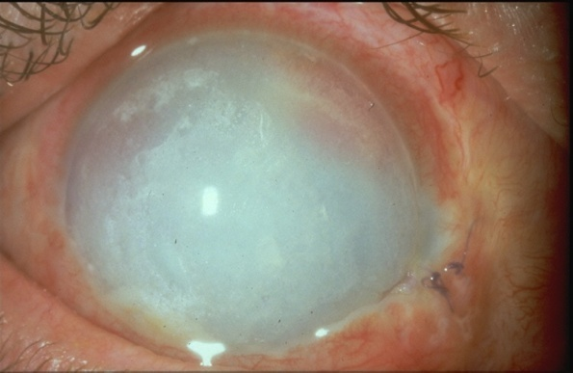
Sources of Eye Hazards
Chemical Hazards
The most dangerous chemicals to the eyes are corrosive liquids.
Examples include acids, lye, bleach, ammonia, sodium hydroxide and formaldehyde.
Other chemicals can also be extremely irritating to the eyes.
Some chemicals (pesticides, for example) can be absorbed through the eyes and make you sick.

Slide 8
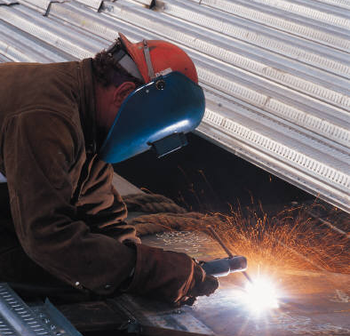
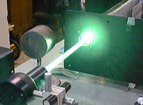
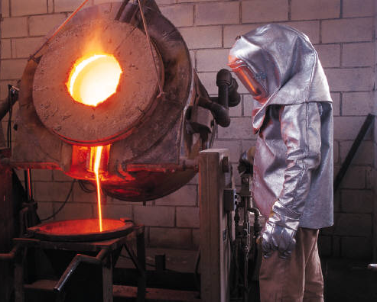
Sources of Eye Hazards
Harmful light radiation
Ultraviolet from welding
Laser
Infrared from molten metal

Slide 9
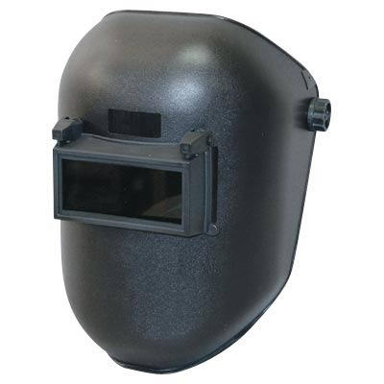
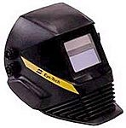
Welding Helmet Lenses
For all types of electric arc welding, a welding helmet equipped with the correct shade filter is required.
Many welders are now using
auto-darkening welding helmets.

Slide 10

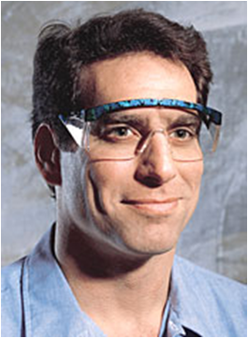
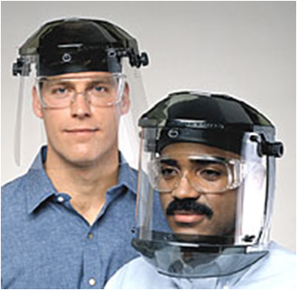
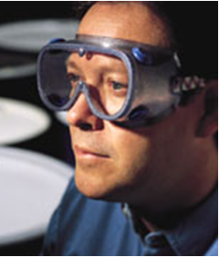
Types of Eye Protection
Three Main Types
Safety glasses
Face shields
Goggles

Slide 11
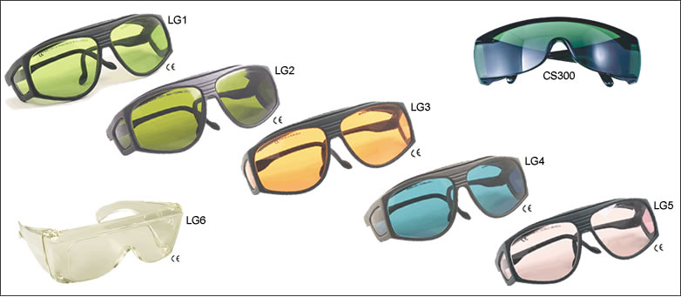
Laser Eyewear
Laser protective glasses are chosen to match the type of laser used.

Slide 12
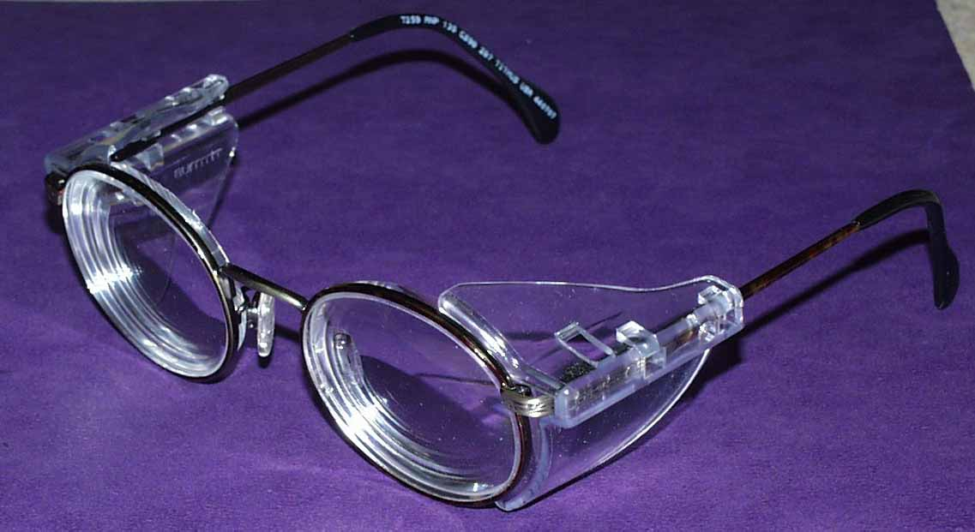
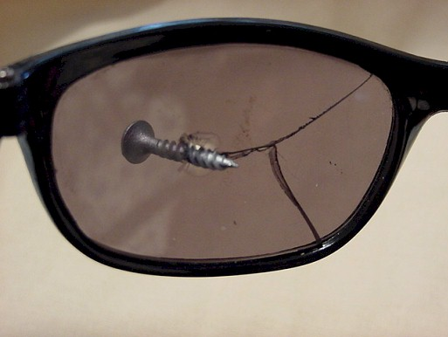

Safety Glasses
Side shields or wraparound required
Must meet ANSI Z87.1 Standards for impact resistance
Must be comfortable if worn for long periods

Slide 13

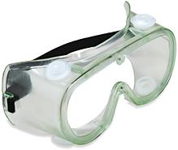
Goggles
Required if handling corrosive liquids.
Also provide protection against irritating gases and vapors.
Must be impact-resistant if used for flying object protection.
Some are vented or coated to prevent fogging.
Vents

Slide 14
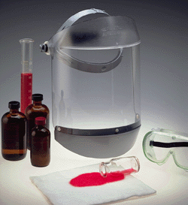
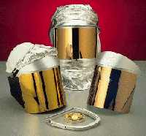
Face-shields
When are they needed?
Face-shields are necessary when a splash to the face might occur.
Worn over glasses or goggles for extra protection.
Special shields are available for infrared or ultraviolet light.

Slide 15
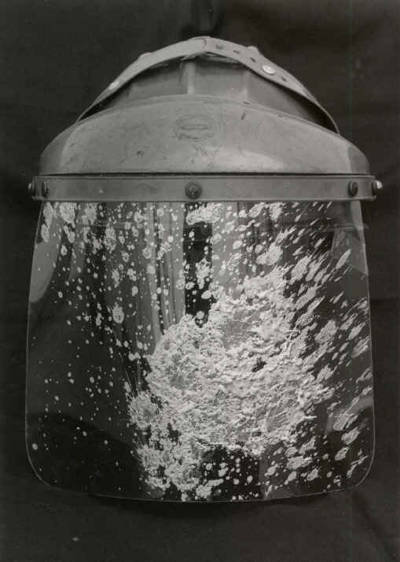
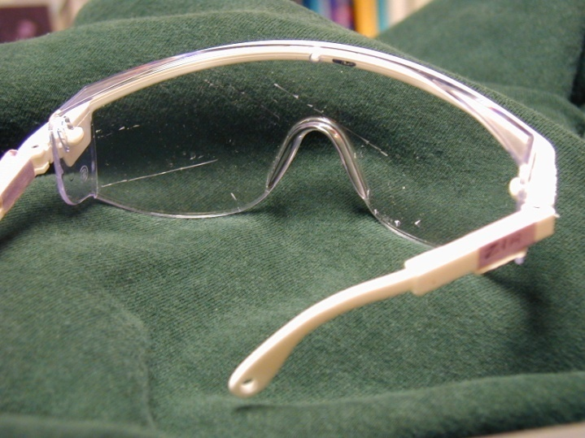
Care & Maintenance
Inspect for damage daily.
Clean as needed.
Replace if broken, cracked or if material on the lens or face-shield can’t be removed.

Slide 16
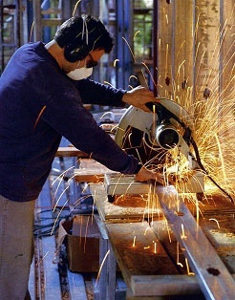
Other Protection For Eye Hazards
In addition to personal eye protection, the following can be used:
Guards, shields or screens on machines,
Welding curtains or barriers,
Other barriers during grinding, cutting, sanding,
Ventilation or hoods for handling chemicals.

Slide 17
Emergency Eyewashes
An eyewash station is required for potential eye exposure to:
Corrosives
  Acids and Caustics
Strong Irritants
  Many Solvents & other chemicals
Toxics
  Pesticides and other Chemicals

Slide 18
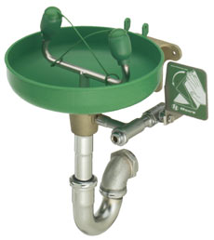

Using an Emergency Eyewash
Note where eyewash is located.
If a chemical is splashed in the eye, go immediately to the eyewash. Get help if needed.
Hold or have both your eyelids held open.
Wash your eyes for at least 15 minutes.
Seek medical attention.

Slide 19
QUESTIONS

