Slide 1

LOCK OUT/TAG OUT
The life you save, may be your own.

Slide 2
Control of Hazardous Energy
OSHA 29 CFR 1910.147
LOCKOUT - TAGOUT

Slide 3
OVERVIEW
Workers performing service or maintenance on machinery and equipment are exposed to injuries from the unexpected energization, startup of the machinery or equipment, or release of stored energy in the equipment.

Slide 4
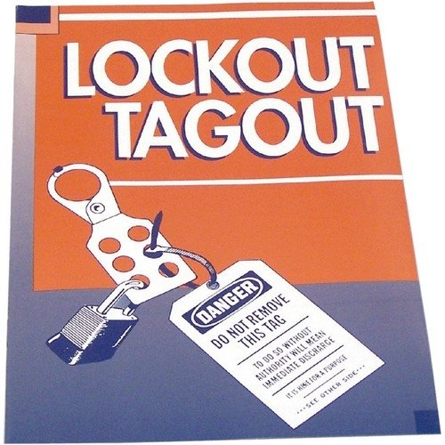
LOCK OUT – TAG OUT
Lockout is a technique used to prevent the release of hazardous energy, or to prevent the hazardous energy from escaping.
A padlock is placed on the appropriate energy isolating device that is in the off or closed position.

Slide 5
The “Fatal Five” Causes of
Lock Out/Tag Out Injuries
1
Failure to stop equipment.
Failure to disconnect from power source.
Failure to dissipate residual energy.
Accidental restarting of equipment.
Failure to clear work areas before restarting.
2
3
4
5

Slide 6
LO-TO STANDARD
The Lockout/Tagout standard requires the adoption and implementation of practices and procedures to shut down equipment, isolate it from its energy source(s), and prevent the release of potentially hazardous energy while maintenance and servicing activities are being performed.
It contains minimum performance requirements, and definitive criteria for establishing an effective program for the control of hazardous energy. However, employers have the flexibility to develop lockout/tagout programs that are suitable for their respective facilities.

Slide 7
Scope and Application
Who does this standard apply to?
  General Industry workers performing servicing and maintenance on machines and equipment and who are exposed to the unexpected energization, startup, or release of hazardous energy.

Slide 8
Definitions
Authorized Employee - one who locks out machines or equipment in order to perform the servicing or maintenance on that machine or equipment.
  Electrician, Plumber, HVAC Mechanic, Maintenance Worker.
Affected Employee - one whose job requires him/her to operate or use a machine or equipment on which servicing or maintenance is being performed under lockout, or whose job requires him/her to work in an area in which such servicing or maintenance is being performed.
  Custodian, Teacher, Kitchen Worker.

Slide 9


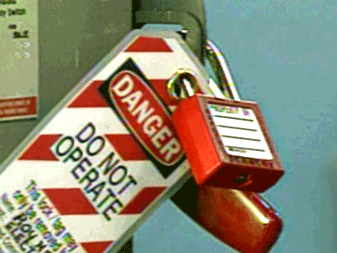
Definitions, cont…..
Energy Isolating Device - A mechanical device that physically prevents the transmission or release of energy.
Energy Control Procedure - Safety program adopted by the employer that includes energy control procedures plus provisions for inspecting the procedures and training employees for lock out/tag out.

Slide 10
ACTIVITIES COVERED
ANY SOURCE OF
MECHANICAL, HYDRAULIC,
PNEUMATIC, CHEMICAL,
THERMAL OR ANY
OTHER ENERGY.

Slide 11
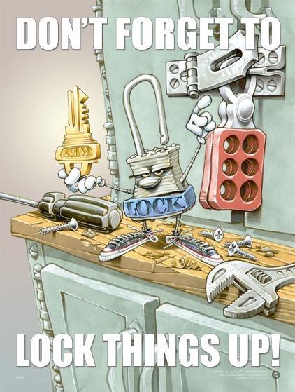

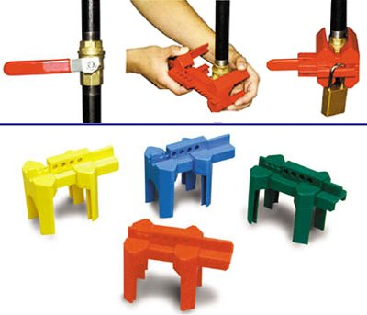


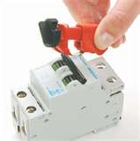

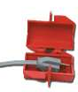
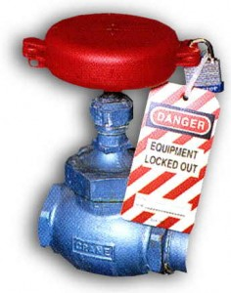
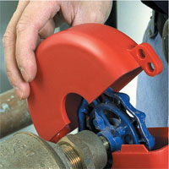
Hazardous Energy Sources
Found in the Workplace
Electrical
  Generated
  Static
Mechanical
  Transitional
  Rotational
Thermal
  Machines or Equipment
  Chemical Reactions
Potential
  Pressure
    Hydraulic
    Pneumatic
    Vacuum
  Springs
  Gravity

Slide 12
DESCRIPTION
  Constructing, installing, setting up, adjusting, inspecting, modifying, maintaining and/or servicing machines or equipment, including lubrication, cleaning or un-jamming of machines or equipment, and making adjustments or tool changes, where employees could be exposed to the unexpected energization or startup of the equipment or release of hazardous energy.
  Servicing and maintenance activities performed during normal production operations if:
    An employee is required to remove or bypass machine guards or other safety devices, or
    An employee is required to place any part of his or her body into a point of operation or into an area on a machine or piece of equipment where work is performed, or into the danger zone associated with the machine's operation.

Slide 13
Who does this standard not apply to?
  General Industry workers performing servicing and maintenance on machines or equipment who are NOT exposed to the unexpected energization or startup of the machines or equipment, or the release of hazardous energy.

Slide 14
Lockout Procedure
Alert the operator power is being disconnected.
Preparation for Shutdown
Equipment Shutdown
Equipment Isolation
Application of Lockout Devices
Control of Stored Energy
Equipment Isolation-Verification

Slide 15
Removal of Lockout
Ensure equipment is safe to operate
Safeguard all employees
Remove lockout/tagout devices.
Last person to take off lock
Follow checklist
Except in emergencies, each device must be removed by the person who put it on.

Slide 16
Temporarily
Reactivating Equipment
Remove unnecessary tools from the work area and make sure everyone is clear of the equipment
Remove lockout/tagout devices and re-energize the system
As soon as the energy is no longer needed, isolate the equipment and re-apply lockout/tagout, using the six step procedure.

Slide 17
Special Situations
Servicing lasts longer than one shift.
Contractors are performing service or maintenance at your workplace
Worker who applied lock is not available.

Slide 18
Additional Info
Never attempt lockout/tagout procedures unless you have been trained and certified by your employer under an approved Energy Control Program.
Never loan or share your lock, combination, or key with anybody else.
Always be sure all lockout/tagout devices are compatible with the environment in which they will be used i.e. corrosive, humid, etc.

Slide 19
ANY QUESTIONS?

