Slide 1
2014

Slide 2
Why is the school physical environment important?
The physical environment of school buildings and school grounds is a key factor in the overall health and safety of students, staff, and visitors.
School buildings and grounds must be designed and maintained to be free of health and safety hazards, and to promote learning.
We need to keep informed and updated about these regulations at all times.

Slide 3
Why is the school physical environment important?
Studies have shown that student achievement can be affected either positively or negatively by the school environment.
Policies must be in place in our schools and followed to ensure food protection, sanitation, safe water supply, healthy air quality, good lighting, safe playgrounds, violence prevention, worker safety and emergency response.

Slide 4
Keeping up to date on Compliance issues.
HID Lights
PCB’s in Ballasts
Latex Paint Disposal
Globally Harmonized Systems
School Sustainability
Janet's Law – AED’s

Slide 5

1) HID BULB DANGERS!

Slide 6
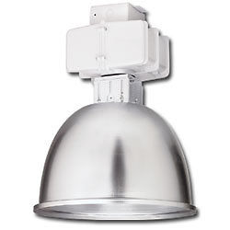
Dangers of HID Lighting
Report from 4/1/2013
Metal halide lights and other high-intensity discharge lights are frequently used in both indoor and outdoor facilities.
If not maintained properly, they can lead to eye injuries in children and workers who occupy the rooms those lights are in.

Slide 7
Dangers of HID Lighting
Report from 4/1/2013
High-intensity discharge lights are available in three basic types:
  Metal Halide,
  Mercury Vapor and
  High Pressure Sodium.

Slide 8
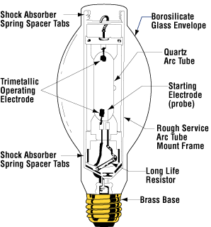
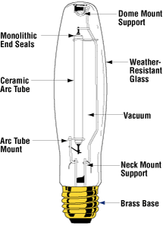
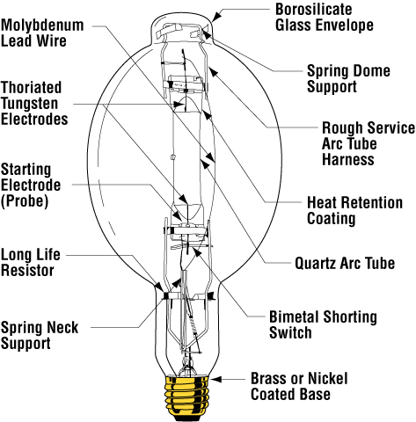
Metal Halide
Mercury Vapor
High Pressure Sodium
Mercury Vapor lamps emit light when a short arc passes through mercury vapor
Named for the sodium vapor arc that generates their light.
Metal Halide produce light when an arc passes through a capsule holding mercury vapor and chemical components called “metal halides”

Slide 9
When these lights are turned on, they can produce potentially harmful levels of ultraviolet radiation.
This is not a concern as long as the light is undamaged. However, cracked bulbs or covers can expose workers and children to harmful UV radiation, often without an individual even being aware.
Possible health effects range from skin irritation and temporary loss of vision to severe skin burns and long-term damage to the eye’s cornea, depending on the length of exposure.
The onset of symptoms and health effects from overexposure to UV radiation is often delayed.

Slide 10
HID Lighting Inspections
To protect against HID light hazards, your Operations Department should train workers in the following items:
  Know where these light sources are located in their work area and how the lights can become hazardous.
  Be familiar with how to report observations of broken glass and cracked bulbs and covers, as well as incidents in which lights may have been struck with equipment or other objects.
  Be aware that the lights may still work even when damaged.

Slide 11
SAFETY CONCERNS
Know how to take proper safety precautions when inspecting or replacing lights.
    Properly disconnect the power when removing bulbs
    Always check exposed electrical contacts with an appropriate sensor before making contact.
    If lights are not SELF EXTINGUISHING, check for cracks in bulb.
    Check for cracks in plastic fixture shields that surround the interior of the light fixture.

Slide 12
TITLE 21--FOOD AND DRUGS
CHAPTER I--FDA
DEPT OF HEALTH AND HUMAN SERVICES
SUBCHAPTER J--RADIOLOGICAL HEALTH
PART 1040 -- PERFORMANCE STANDARDS FOR LIGHT-EMITTING PRODUCTS
Sec. 1040.30 High-intensity mercury vapor discharge lamps.
LOOK FOR THIS LABEL!
"WARNING: This lamp can cause serious skin burn and eye inflammation from shortwave ultraviolet radiation if outer envelope of the lamp is broken or punctured. Do not use where people will remain for more than a few minutes unless adequate shielding or other safety precautions are used. Lamps that will automatically extinguish when the outer envelope is broken or punctured are commercially available."
The current National Electric Code advises a full enclosure with a heavy glass or plastic shield for Type R lamps to reduce the potential for breakage and thus lessen the potential of damaged bulbs releasing unshielded UV-light.

Slide 13
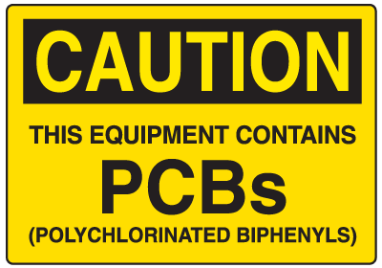
2) PCB’s in School’s

Slide 14
PCB-Containing FLBs in School Buildings
Recent reports from schools in New York and New Jersey show that FLB failures are not uncommon.
From September 2012 to August 2013, 130 schools in New York and New Jersey reported FLB failures that may have released PCBs.

Slide 15
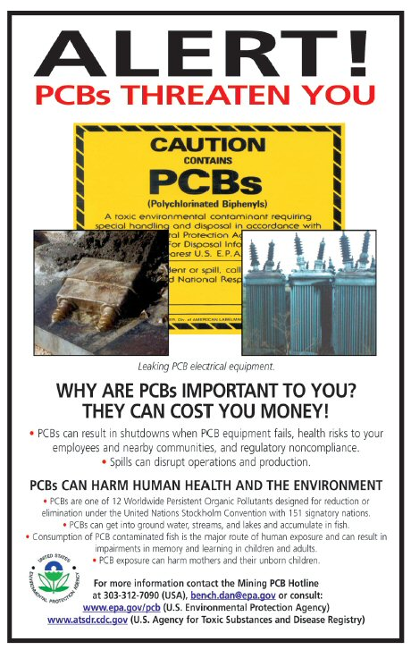

Slide 16
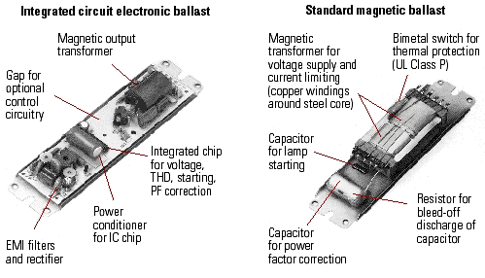
Ballast PCB’s

Slide 17
Exposure to PCBs from FLBs in Schools
The most likely way that people are exposed to PCBs from FLBs is through breathing PCB-contaminated air or touching PCB-contaminated materials after a FLB leaks or catches fire.
Where they remain in place, leaking FLBs could continue to release PCBs over several years and generate elevated levels of PCBs in air that students and teachers breathe. PCBs are persistent, bio-accumulative toxicants.
This means that they are most harmful when exposure accumulates over a prolonged period of time.

Slide 18
Exposure to PCBs from FLBs in Schools
Steps should be taken so children and teachers do not continually spend time in an area with elevated PCB levels in their air.
While students and teachers do not need to be evacuated from the building, the affected area, classroom, hallway, cafeteria, or auditorium should be off-limits during cleanup and decontamination.
EPA developed Public Health Levels to help in determining if you have an inhalation exposure concern.

Slide 19
Identifying FLBs that May Contain PCBs
The following criteria are provided to help identify FLBs that may contain PCBs:
  FLBs manufactured before July 1, 1979 may contain PCBs.
  FLBs manufactured between July 1, 1978 and July 1, 1998 that do not contain PCBs must be labeled "No PCBs".
  If an FLB is not labeled "No PCBs", it is best to assume it contains PCBs unless it is known to be manufactured after 1979.
  FLBs manufactured after 1998 are not required to be labeled.

Slide 20
Identifying FLBs that May Contain PCBs
If the FLB does contain PCBs, they are located inside the small capacitor located within the FLB or in the potting material (a black, tar-like substance that encapsulates the internal electrical components).
There would be approximately 1 to 1.5 ounces of PCBs in the capacitor itself and lower amounts in the potting material.
If a FLB fails or overheats, the capacitor may break open and both its oil and the potting material may be released from the FLB.

Slide 21
Determining Whether
PCB-Containing FLBs are
Present in Your School Buildin
If any of the statements below apply to your school, its FLBs probably contain PCBs and have exceeded their useful lifetime:
  Your school was built before 1979; and
  Your school has not had a complete lighting retrofit since 1979; or
  Your school still has T12 magnetic FLBs.

Slide 22
Any building built before 1979 is likely to have PCB-containing FLBs if it has not undergone a complete lighting retrofit (all light fixtures in the school were upgraded).
In some cases, PCB-containing FLBs that were manufactured before the 1979 ban were stored and later used in some fluorescent light fixtures installed or repaired after 1979.

Slide 23
Thus, some schools built after 1979 that have not undergone a complete lighting retrofit could have PCB-containing FLBs.
To determine whether your school has PCB-containing FLBs, conducting a visual inspection of the FLBs in a representative number of light fixtures (not just the bulbs) is recommended.

Slide 24

3) Latex Paint Disposal

Slide 25
Latex Paint
Since latex paint is not hazardous, it can be solidified and put out for regular refuse collection.
It is important to solidify latex paint to avoid environmental or water contamination problems.

Slide 26


Slide 27
Solidifying Latex Paint
Remove container lid(s) and place open container (s) in a safe, well-ventilated area away from children and pets.
Depending on amount of paint, this can take up to several days for liquids to evaporate.
If you have a large amount of paint to dispose of, pour liquid paint into a container with kitty litter or another absorbent material like sawdust.
When paint is ‘dry’, it may be disposed of in regular trash.
Replace lids and dispose of in regular trash.

Slide 28
Disposal of wash water containing only Latex Paint Residue
Wash water that contains only latex paint residue from the clean-up of brushes, rollers, spray equipment or minor spills is generally regarded as non-hazardous.
This wash water may be poured down a sink or drain that is connected to a sanitary sewer leading to a water-treatment plant.

Slide 29
Although not considered hazardous, wash water cannot be poured into the ground, a body of water or a storm drain.
Any of these actions may be considered illegal industrial discharges and are subject to stiff fines and penalties.
Always check your local codes and/or Public Works Director for disposal of anything into Storm Drains.

Slide 30
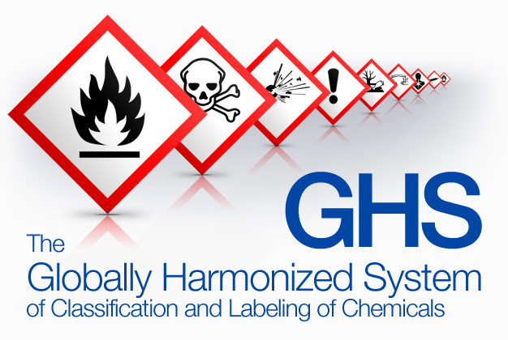
4) Globally Harmonized Systems
Your need to know what’s new in Hazard Communications

Slide 31
Major Changes Proposed
In 2012 OSHA revised the HazCom Standard to be consistent with the Globally Harmonized System (GHS)
Globally Harmonized System (AKA – GHS)
Will have changes to;
  Hazard Classification’s
  Labels
  Pictograms
  Safety Data Sheets (formally MSDS)
  Information and Training

Slide 32
1. Hazard Classification
Provides specific criteria for classification of health and physical hazards, as well as classification of mixtures
Signal Words are either;
  DANGER
  or
  WARNING

Slide 33
2. Labels
Chemical manufacturers and importers will be required to provide a label that includes a harmonized signal word, pictogram, and hazard statement for each hazard class and category.
Precautionary statements must also be provided.

Slide 34
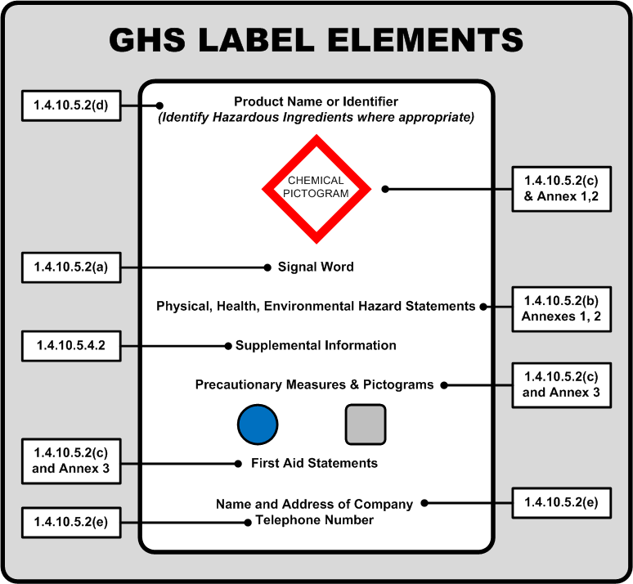

Slide 35
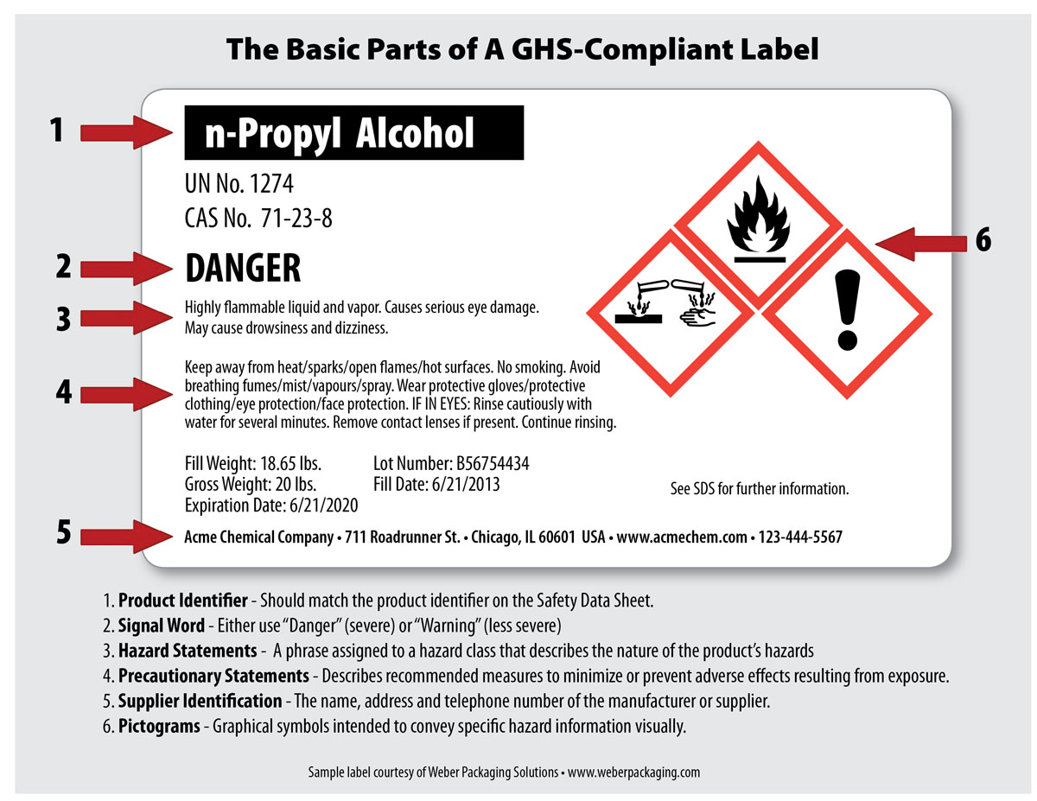
NJRTK LABELS ARE STILL REQUIRED!

Slide 36
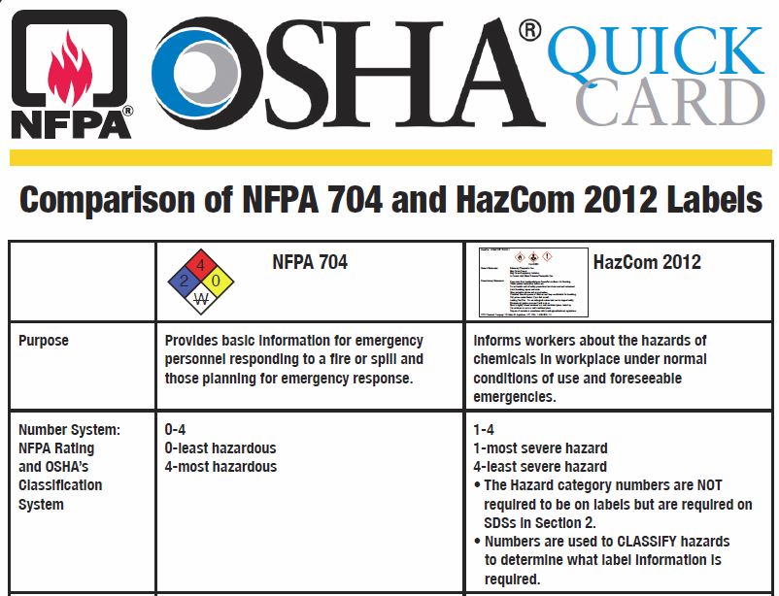
Understand the Difference
“IMPORTANT”
CHECK THE DIFFERENCE

Slide 37
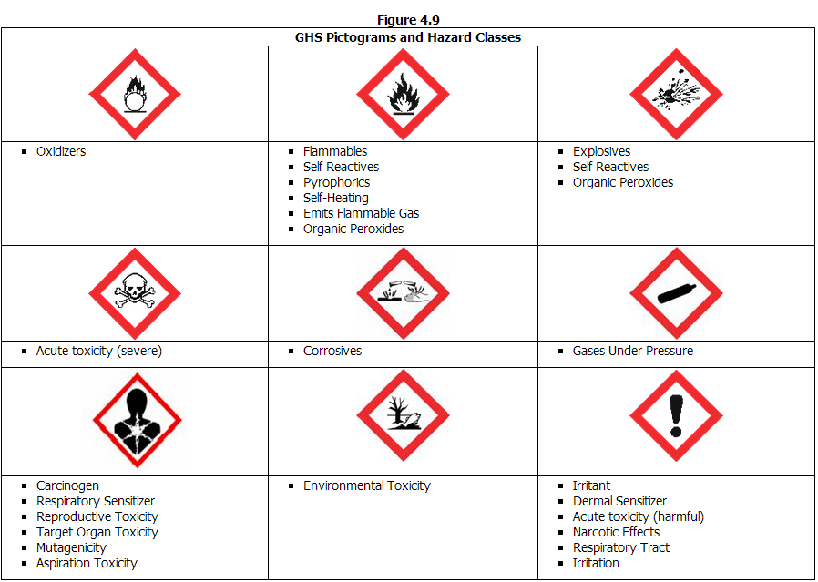
  3. Pictograms

Slide 38
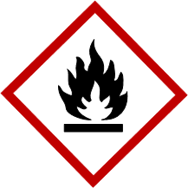

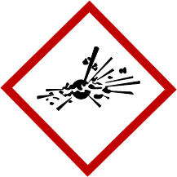
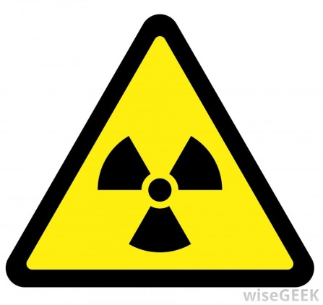
Physical Hazards
Flammables
Combustibles
Oxidizers
Explosives
Reactive
Radioactive

Slide 39
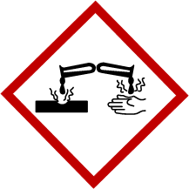
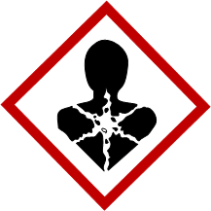

Health Hazards
Irritants
Corrosives
Asphyxiates
Anesthetics
Allergic Sensitizers
Carcinogens
Mutagens
Teratogens

Slide 40
4. Safety Data Sheets
Will now have a specified 16-section format
  The 16 Section format is basically the ANSI Format
  The OSHA Format was only 8 Sections and previously was the MINIMUM REQUIRED INFO.
Sections 11-15 Are not enforced by OSHA but are still important.
  These discuss Aquatic toxicity, Soil resilience and other topics governed by different agencies.

Slide 41
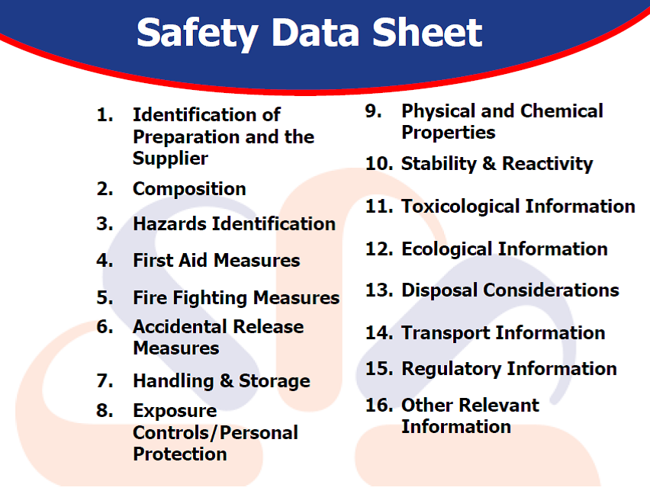

Slide 42
  5. Information and Training
Even though NJ has not adopted the GHS, you will start seeing products that will have labels and Safety Data Sheets that will be in compliance with the Law.
You will now have the knowledge of what the GHS dictates and be able to understand the new Law and be in a better position to protect yourself and occupants of your school building.

Slide 43
TRAINING
The GHS does not address training.
However, the proposed HCS will require that workers are trained within two years of the publication of the final rule to facilitate recognition and understanding of the new labels and safety data sheets.

Slide 44


Slide 45
6) School Sustainability
Sustainable Jersey for Schools, scheduled to launch in October 2014, will be a voluntary certification program for New Jersey public schools.
To become certified, schools will be required to complete and submit a balanced package of sustainability actions.

Slide 46
The program will:
Advance and support sustainable practices in schools.
Identify concrete actions that schools can implement to become certified.
Provide a comprehensive package of tools, guidance materials, training and financial incentives to support and reward progress.

Slide 47
Why participate?
Sustainable practices:
  Result in healthier schools
  Reduce operating costs and free up money for the classroom
  Contribute to student success

Slide 48
Program Development
School districts in New Jersey are already on the path to building a more sustainable future.
Schools throughout the state are conducting energy audits, completing building retrofits, and implementing energy efficiency projects to significantly reduce utility costs.

Slide 49
Health and Wellness
Schools are addressing health and wellness by converting to green cleaning products, providing healthy lunches, using school gardens as active learning laboratories, improving indoor air quality by using no VOC paints and flooring and promoting "walking school busses" to encourage physical activity and to save transportation costs.

Slide 50
S.T.E.M.
STEM (Science, Technology, Engineering and Math) and sustainability education curriculum components are being incorporated in schools across the state to prepare students for meaningful employment and lifelong learning.

Slide 51
Task Forces
To create the Sustainable Jersey for Schools program we are using a transparent, participatory process that operates through topic specific task forces.
The task force structure provides a collaborative framework that brings together leaders from school districts, state agencies, universities, government, non-profit associations and businesses to define sustainability standards.
The task forces are developing a menu of actions that will be worth points in the certification program.

Slide 52
Sustainable Jersey for Schools Task Forces
*Animals in the Community School *Arts/Culture School Community Partnership and Outreach
Sustainability Curriculum/Student Learning
Diversity and Equity
*Energy and Greenhouse Gas Health and Wellness
Green Design
*Land Use and Transportation Leadership and Capacity Building
Operations and Maintenance
*Waste Management
(*Subcommittee of Municipal Task Force)

Slide 53
Operations and Maintenance
8 Best Practice and Policy Procedures;
  HVAC Maintenance
  Classroom Cleaning
  Energy Efficiency
  Green Cleaning Equipment
  Green Cleaning Supplies
  Green Purchasing Policy
  Integrated Pest Management

Slide 54
1. HVAC Maintenance
Regular scheduled maintenance of heating, ventilation and air conditioning (HVAC) systems have shown to improve efficiency while also saving energy.
Good housekeeping allows the HVAC system of a school to perform as designed to provide proper air filtration.
Properly maintained HVAC systems can consistently provide schools with good thermal and ventilation control while reducing the risk of biological contamination from dust and other particles built up in the system.

Slide 55
2. Classroom Cleaning
A Classroom Cleanup Policy will ensure that all classrooms throughout the District or School are allergy and asthma safe.
Each classroom is uniquely decorated and managed so establishing a protocol for daily cleanup in addition to cleanup for classroom parties and art projects will ensure a standard Indoor Air Quality throughout the school.
Establishing what products and supplies are allowed in classrooms also protects students from potential exposure to harmful toxins due to unregulated cleaning and art supplies.

Slide 56
3. Moisture and Mold
This action includes steps on identifying and correcting common mold and moisture problems, how to clean mold, and steps schools can take to reduce moisture and mold growth.
Mold can grow within drywall, wood, paper, carpet, and foods.
When excessive moisture accumulates inside the building or on building materials, mold growth will often occur. In addition to classrooms, labs and offices, lunch rooms, libraries, gyms and locker rooms may be sources of dust and mold.

Slide 57
3. Moisture and Mold…..
Monitoring moisture levels is the key to controlling mold and often time’s moisture issues remain undiscovered or addressed.
There is no practical way to eliminate all mold and mold spores in the indoor environment; cleaning mold upon discovery and controlling moisture will keep the school environment as mold free as humanly possible.

Slide 58
4. Energy Efficiency
For this Action, Districts or Schools will select products with the ENERGY STAR labels when purchasing appliances or equipment for school operations.
ENERGY STAR, a joint program of the U.S. Environmental Protection Agency (EPA) and the U.S. Department of Energy.
It aims to reduce costs and protect the environment through energy efficient products and practices for homes and buildings.
Appliances that carry the ENERGY STAR label are significantly more energy efficient than other products.

Slide 59
5. Green Cleaning Equipment
Green purchasing, also known as environmentally preferable purchasing (EPP), is the coordinated purchasing of goods and services to minimize impacts on human health and the natural environment.
Alternatives exist for almost every product used by Schools that are less hazardous, save energy and water, and reduce waste.

Slide 60
5. Green Cleaning Equip…..
Selecting Environmentally Preferable Products for School Cleaning Equipment is a simple yet essential way to make progress toward implementing a comprehensive Green Purchasing policy.
Green Cleaning Equipment will help schools clean more efficiently to ensure allergy and asthma friendly environments by improving Indoor Air Quality and eliminating harmful cleaning products.

Slide 61
6. Green Cleaning Supplies
Green cleaning products offer effective performance while minimizing effects on health, environment, and worker safety.
For this action, schools will select environmentally preferable cleaning products for facilities.
Schools can also save money by using green cleaning products while improving Indoor Air Quality and reducing pollution and adverse health effects.
Communication with vendors and service providers will be necessary to express the District or School’s desire for these products.

Slide 62
7. Green Purchasing Policy
Green Purchasing, also known as environmentally preferable purchasing (EPP), is the coordinated purchasing of goods and services to minimize impacts on human health and the natural environment.
Alternatives exist for almost every product used by schools that are less hazardous, save energy and water, and reduce waste.
A simple first step is to purchase products made from recycled content that are themselves recyclable.

Slide 63
7. Green Purchasing …..
Green Purchasing moves beyond recycled materials and also takes into consideration:
  The raw materials, including energy and water, used to manufacture products.
  The production process itself.
  The packaging and distribution method.
  The distance of transport and proximity of production.

Slide 64
7. Green Purchasing …..
Districts are encouraged to commit to environmentally preferable purchasing by enacting an official policy.
This Green Purchasing Policy should outline standards and procedures for selecting products based on environmental criteria.
To establish a Green Purchasing Program, start small and build on success!
Green Purchasing actions will assist District Schools in improving purchasing practices and finding more environmentally friendly products and services.
Green Purchasing Programs have been carried out successfully by municipalities, businesses, universities, and the federal government.

Slide 65
8. Integrated Pest Management
Integrated Pest Management (IPM) is a system of pest management that uses multiple approaches to pest control to minimize pesticide use, production costs, damage to the natural environment, erosion of the natural landscape and human health issues.
IPM optimizes eco-friendly pest management techniques such as natural predators, improved sanitation, physical barriers, traps, and organic products.
The primary goal is to significantly reduce or eliminate the use of pesticides. Points will be awarded for techniques above and beyond the standard already required in schools.
Schools should initially inspect the property for pests, establish an updated IPM plan (such as fertilizing athletic fields with compost instead of fertilizer or implementing a soil testing schedule) and regularly monitor the successes and challenges of the schools IPM program.
The Schools Facilities Management and Administration should also regularly attend trainings and keep necessary certifications up to date.

Slide 66
8 Steps to Sustainability
These 8 steps are just the Operations part of School Sustainability.
The rest of the package is just as important.
Institute them and make your school better.

Slide 67
Ever Changing Regulations
Stay on top of all the ever changing regulations that make our schools safe for children and all other occupants.
Keep Informed
Stay Informed

Slide 68
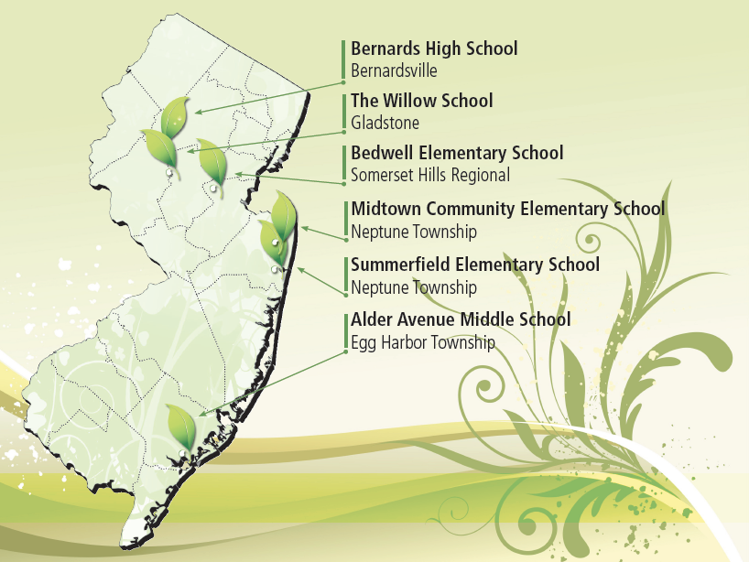
Add your school to the list.

Slide 69

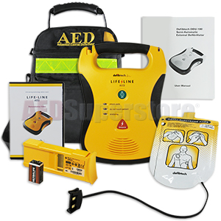
Janet’s Law

Slide 70
Janet’s Law
Janet’s Law requires that all public and private K-12 schools in New Jersey have an automatic external defibrillator (AED) on site.
Not only does the law require that every school have an AED properly installed by September 1, 2014, it also requires that schools have an emergency plan in place and staff members who have received CPR/AED training.

Slide 71

The 5 W’s of Janet’s Law

Slide 72
The 5 W’s of Janet’s Law
Who
  Janet Zilinski was an 11 year old cheerleader died from cardiac arrest. This caused the initial wave of support for AED defibrillators to be placed at school grounds.
Does anyone need to be trained to use the AED or be certified in CPR?
  “A school district or nonpublic school shall be deemed to be in compliance with this requirement if a State-certified emergency services provider or other certified first responder is on site at the event or practice”
  This means a coach, athletic trainer, or any other licensed staff member.

Slide 73
The 5 W’s of Janet’s Law
What
  An AED must be placed onsite in an unlocked location with an appropriate sign to identify it.
  It should be accessible during the school day and any other time an athletic event, including practices is taking place. The defibrillator needs to be “within reasonable proximity of the school athletic field, as applicable

Slide 74
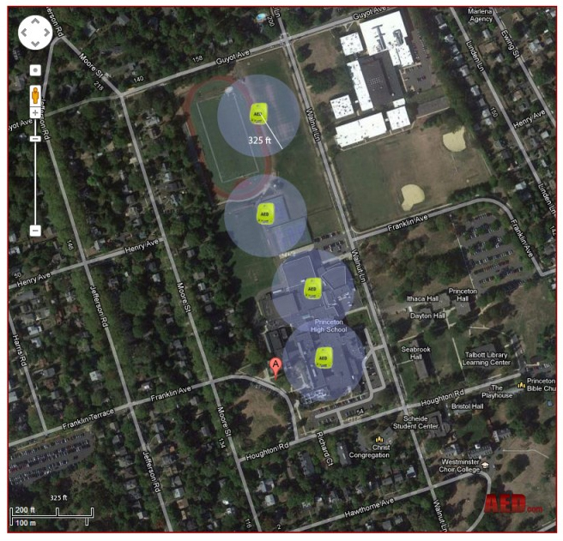
The 5 W’s of Janet’s Law
WHERE
Reasonable proximity can be defined as any AED that can be retrieved and used within 90 seconds.
For every minute that passes the chance of survival decreases 10 percent.
Assuming the average person runs 5 miles per hour, in a lifesaving situation, an AED would need to be placed in a known position approximately 325 feet away from the epicenter of the SCA event to make sure the person is shocked in 90 seconds.

Slide 75
The 5 W’s of Janet’s Law
When
  Your school needs to have these measures in place by September 1, 2014.
Why
  That’s easy; AEDs save lives. -

Slide 76
Testing and Maintenance
The defibrillators need to be tested and maintained according to the manufacturers operational guidelines.
If an AED is used, the proper reports must be made.
Janet’s Law about onsite AED defibrillators on school grounds also mandates that schools “shall establish and implement an emergency action plan for responding to a sudden cardiac event including, but not limited to, an event in which the use of an automated external defibrillator may be necessary.” -

Slide 77
Janet’s Law Emergency Action Plan Guidelines
Your school’s emergency action plan must contain these items:
  A List of at least 5 faculty members with CPR/AED certifications from a qualified source.
  Detailed procedures on Sudden Cardiac Arrest (SCA) events.
    Calling 911.
    Starting CPR
    Get and Use an AED.
    Assisting rescue responders on finding the sudden cardiac arrest victim.

Slide 78


Slide 79
NJSBGA is your KEY…
to COMPLIANCE.

Slide 80

