Slide 1
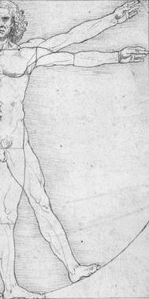
ERGOMINICS
Healthy Schools
Facilities Environment

Slide 2
“ERGONOMICS”
The term "ergonomics" is derived from two Greek words:
"ergon," meaning work, and
"nomoi," meaning natural laws.
Ergonomists study human capabilities in relationship to work demands.

Slide 3
Ergonomics
Ergonomics is the science of fitting workplace conditions and job demands to the capabilities of workers.
Computer use by school staff and students requires good ergonomics.
Frequent and heavy lifting as well as pushing, pulling, or carrying of heavy objects among custodians and food-service workers is also an ergonomic problem in schools.
Bus drivers are exposed to prolonged awkward postures and vibration.
The level of risk depends on how long a person is exposed to these conditions, how often they are exposed, and the level of exposure.

Slide 4
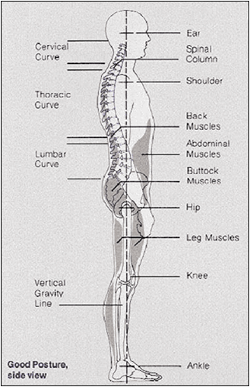
WSMD’s
Poor ergonomics can lead to Work-Related Musculoskeletal Disorders (WMSDs), which are musculoskeletal disorders caused or made worse by the work environment.

Slide 5
WSMD’s
WMSDs can cause severe and debilitating symptoms such as pain, numbness, and tingling;
reduced worker productivity;
lost time from work;
temporary or permanent disability;
inability to perform job tasks;
and an increase in workers compensation costs.
Musculoskeletal disorders of any cause are among the most prevalent medical problems, affecting 7% of the population and accounting for 14% of physician visits and 19% of hospital stays.

Slide 6
School Ergonomics Program Guidelines, Cornell University, 2000
With the number of computers in classrooms increasing every day, many schools are beginning to institute ergonomics programs to show students, teachers, and parents how to reduce the risks of computer-related injuries.
This document is part of such an ergonomics program, in the form of guidelines that have been developed for the parents of school children.

Slide 7
Keyboarding:
http://ergo.human.cornell.edu/MBergo/intro.html
Risks of keyboarding
How to prevent injury: Ideal posture and ideal workstation setup
How taking breaks is important
Exercises to decrease muscle fatigue and reduce injury
How to improve existing, less-than-ideal workstations
Laptops
Are ergonomic products worth obtaining?
The truth about the most popular ergonomic products
Children's special concerns
View "before" and "after" photos of reconfigured workstations
Websites for more information

Slide 8
Ideal posture and ideal workstation setup.
Many people spend thousands and thousands of dollars on their computers, software, and games and then completely disregard the workstation where they sit day in and day out.
But that would be like buying a Ferrari and then buying the cheapest tires possible!
It just won’t work in the long run and it’s the person who’s going to end up hurting, literally.

Slide 9
Furniture and Equipment
Stable work surface. One that is adjustable in height may be good to have when adults and very young children are sharing the same workstation.
Comfortable, ergonomic, adjustable chair with at least chair height and back support adjustment mechanisms. If the back tension of the chair does not adjust, make sure that the lower back is firmly supported. Armrests that pivot and are height and width adjustable are also a good idea. Remember that while most adjustable features are not absolutely essential, they do assure that many people of different sizes will feel comfortable in the chair.
Height-adjustable, negative slope keyboard tray is best for keeping the elbows at a >90 degrees and for allowing the wrists to remain in a neutral position.

Slide 10
NOTE:
Desktop keyboards and those placed on conventional, articulating keyboard trays (those on a positive slope) do not fully allow the elbows and wrists to remain in neutral posture and actually encourage wrist extension.
Height-adjustable, gliding mouse platform that allows the mouse to be positioned close to the side of the body, above the keyboard tray (so that the arm does not have to reach to the side).
It does not matter exactly what type of keyboard and pointing device you use as long as whatever you use feels comfortable, fits your hands, and allows you to work in a neutral hand and body posture.

Slide 11
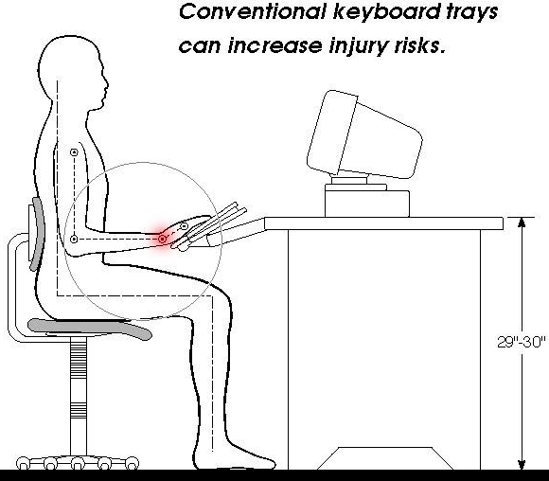
Improper Keyboarding

Slide 13
Normal Work Area
The normal work area corresponds to the space and objects that can be reached by a person while sitting in front of a computer, without having to twist the body or reach far.
Make sure that everything you need is within this area, including books, documents, tools, a telephone, etc.
Be sure that the desk has a surface large enough to support all of your materials, even the ones that you are not currently using.

Slide 14
Normal Work Area
If typing from a book or document, make sure that it is placed in a document holder that is placed near the screen, in order to avoid head twisting.
The body should be centered on the alphanumeric part of the keyboard.
Most keyboards are asymmetrical in design (the alphanumeric keyboard is to the left and a numeric keypad to the right).
If the outer edges of the keyboard are used as landmarks for centering the keyboard and monitor, the user’s hands will be deviated because the alphanumeric keys will be to the left of the user's midline.

Slide 15
Computer Monitor Position
Monitor that is height and angle adjustable works best.
Monitor should be placed directly in front of the user and facing the user, not angled to the left or right (to discourage neck twisting).
Your eyes should be in line with a point on the screen that is 2 to 3 inches below the top of the monitor. If the monitor is above or below this height, your neck will be raised or lowered and the result will be neck pain.
Monitor should be at a comfortable distance for viewing, which is usually around an arm’s length (sit back, raise your arm, and your fingers should touch the screen)

Slide 16
Lighting
It should not be too bright or too dark.
Always use light even though a computer screen is self-illuminating there should not be a large contrast between the screen and the area surrounding it.
Indirect lighting (that which illuminates the walls and ceilings), in combination with a task light, works best.

Slide 17
There should be no glare falling on the screen.
If there is, reposition the workstation with regard to the light sources (natural or artificial).
Be careful not to just move the monitor, resulting in a poor viewing angle.
If repositioning alone does not work, use a good quality glass anti-glare screen.
If left uncorrected, glare will cause discomfort, eyestrain, and headaches.
Avoid very glossy work surfaces and furnishings, such as mirrors and shiny metal, which will contribute to glare.

Slide 18
Remember IAQ
Workstation should be located in a well ventilated area, with adequate heating and cooling in order to minimize discomfort.

Slide 19
Children’s Special Concerns
Although children have the same needs of adults when it comes to keyboarding, they also have some unique needs:
A child, especially a very young one, may not be very aware of the position of his/her extremities in space (notice that occasionally young children draw distorted pictures of people).
That is, it is very unlikely that a child will keep track of whether his/her wrists are positioned at less than 15? deviation.
Therefore, it is especially important for the adult to notice and try to correct the child’s posture.

Slide 20
Children’s Special Concerns
Children, especially the younger ones, have smaller hands than adults.
A conventional keyboard may be too large for him/her.
There is computer hardware available on the market today that is especially designed for children’s small hands.
For example, look for Little Fingers keyboards at or search on the web for similar types of products.

Slide 21
Little Fingers Keyboards

Slide 22
Children’s Special Concerns
Sometimes children like to use trackballs instead of mice because their small hands find them easier to handle. A small mouse may be just as good.
Being able to adjust chairs, monitors, desks, etc., is very important for children to know how to do in order to be comfortable.
Be sure that they understand and are physically strong enough to do so (some mechanisms are even difficult for adults).
Adjustability is absolutely essential when students share computer workstations.

Slide 23
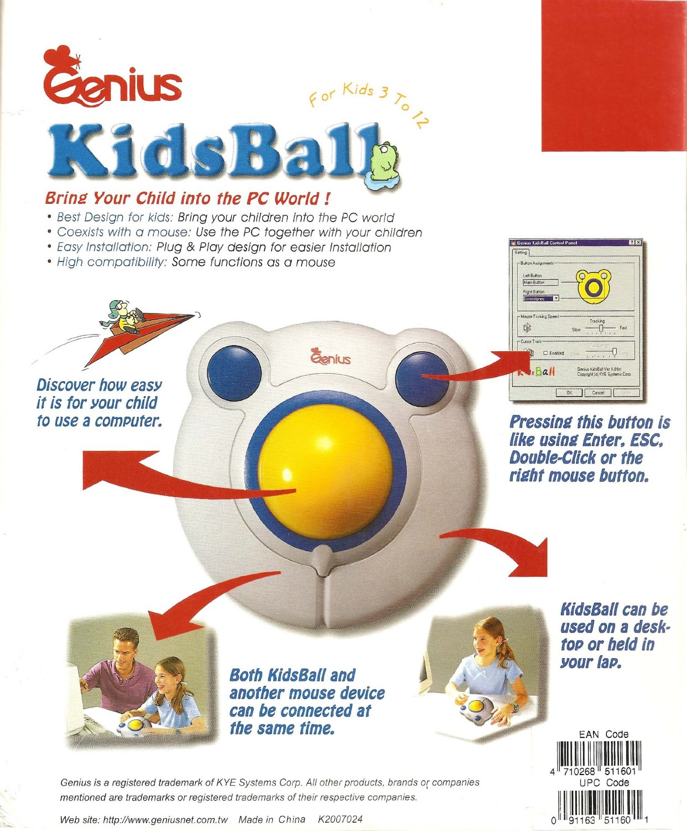
Trackballs
Sometimes children like to use trackballs instead of mice because their small hands find them easier to handle.
A small mouse may be just as good.

Slide 24
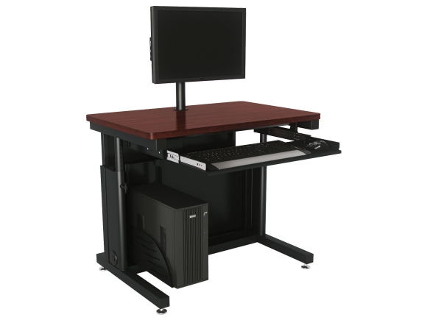
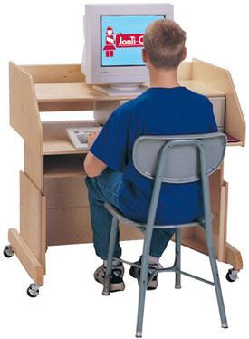
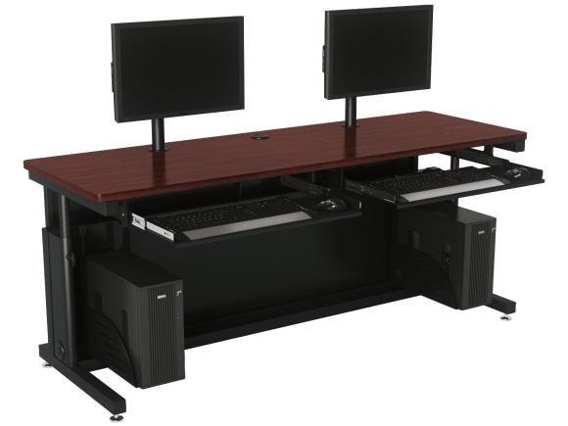
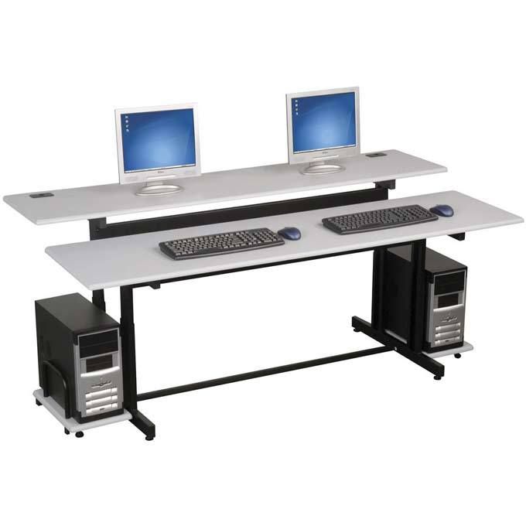
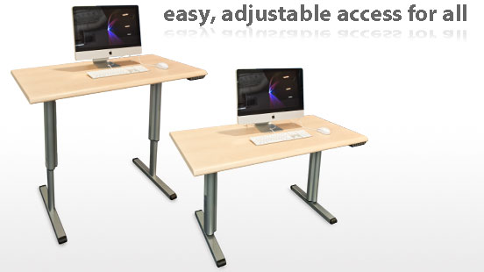
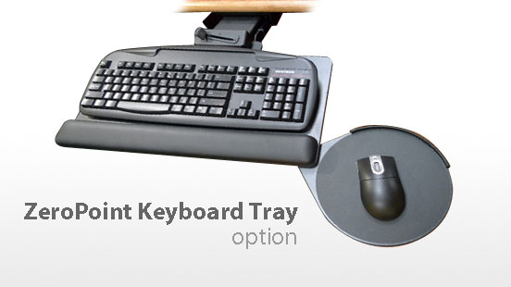
Know what’s available!

Slide 25
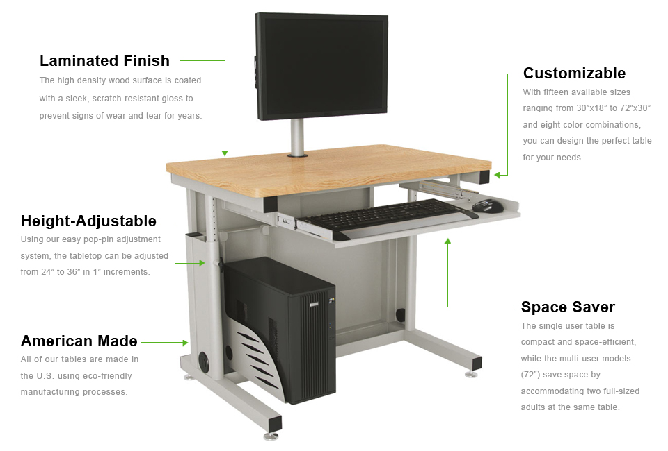

Slide 26
Be involved, Stay involved!
As the Supervisor of Building and Grounds, make sure you are involved with planning correct classroom designs and purchasing of computer desks.
Know all there is about Childhood Ergonomics to protect children from injuries.
Know what is available in desks and other equipment for their classrooms.
They don’t know it now but they’ll Thank You in the future.

