Slide 1
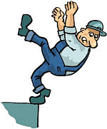
FALL HAZARDS
Working Safely
on Roofs and Ladders
NJSBGA
APPROVED
TRAINING

Slide 2
TRAINING PROGRAM
The employer shall provide a training program for each employee who might be exposed to fall hazards.
The program shall enable each employee to recognize the hazards of falling and shall train each employee in the procedures to be followed in order to minimize these hazards.
The School Board shall keep a record and Certification of this training.

Slide 3
Retraining
When the employer has reason to believe that any affected employee who has already been trained does not have the understanding and skill required to work on a flat roof in their School District, the employer shall retrain each such employee.

Slide 4
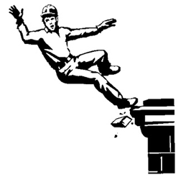
Fall
Hazards
Falls are one of the greatest hazards on construction sites and in the building maintenance fields.
Falls are the most common cause of death and injuries for workers, as they account for more than 33% of all construction deaths.

Slide 5
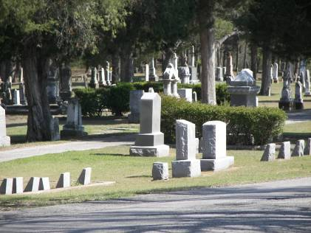
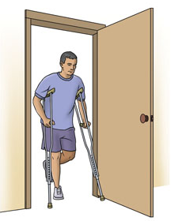
Fall Hazards Statistics
Each year workers die from falls.
Overall, 6,858 construction workers died from fall injuries between 1992 and 2010, about 360 deaths annually.
From 2008 to 2010, the largest number of fatal falls (579 deaths) in construction occurred among Specialty Trade Contractors
In 2010, falls led to 18,130 nonfatal injuries resulting in days away from work.

Slide 6
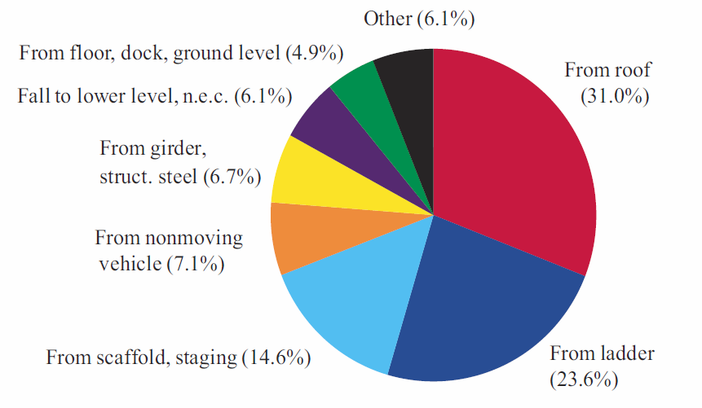
Causes of Fatalities from Falls 2008-2010 Total
(All Types of Workers)

Slide 7

Plainly speaking…..
Work with
“SAFETY”
on your mind at
“ALL TIMES”.

Slide 8
Fall Hazards Definition
Fall hazards are present at most worksites and many workers are exposed to these hazards on a daily basis.
A fall hazard is anything at your worksite that could cause you to lose your balance or lose bodily support and result in a fall.
Any walking or working surface can be a potential fall hazard.

Slide 9
Working Height Risks
Any time you are working at a height of four feet or more, you are at risk.
OSHA generally requires that fall protection be provided at four feet in general industry, five feet in maritime and six feet in construction.
However, regardless of the fall distance, fall protection must be provided when working over dangerous equipment and machinery.
The importance of fall protection cannot be stressed enough.

Slide 10
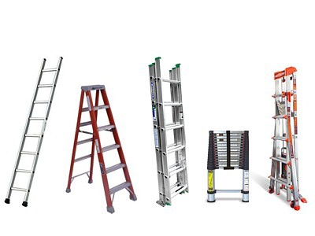
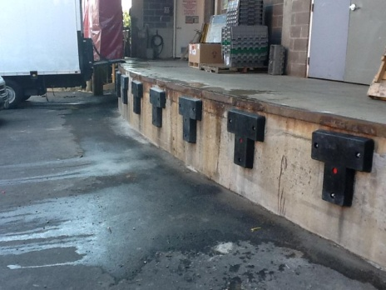
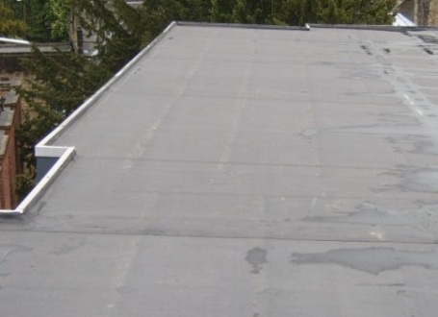
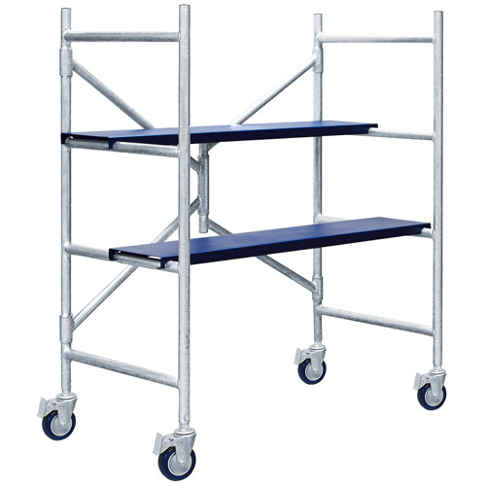
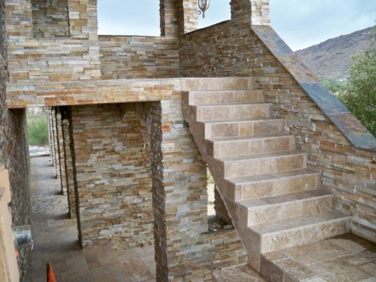
Major Fall Hazards
Fall hazards can be found everywhere.
Building structures
Exterior areas
Scaffolds
Stairs
Ladders

Slide 11
Building Structures
Working on Flat Roofs
People tend to feel safer on flat roofs compared to pitched roofs.
This feeling of comfort can be a false sense of safety.
Have you ever heard of workers literally walking over the edge?

Slide 12
Subpart M - Fall Protection
1926.501
Duty to have Fall Protection
1926.501(a) General.
  “This section sets forth requirements for employers to provide fall protection systems.
  All fall protection required by this section shall conform to the criteria set forth in 1926.502 of this subpart.”

Slide 13
PLAN the WORK
WE MUST PLAN THE WORK
  Recognize potential hazards
  Select appropriate systems
  Provide proper construction and installation of safety systems.
  Select appropriate work procedures
  Communicate the plan
  Provide proper training
  Evaluate

Slide 14
Roof Safety
1926.501(a)(2)
  “The employer shall determine if the walking/working surfaces on which its employees are to work have the strength and structural integrity to support employees safely.
  Employees shall be allowed to work on those surfaces only when the surfaces have the requisite strength and structural integrity.”

Slide 15
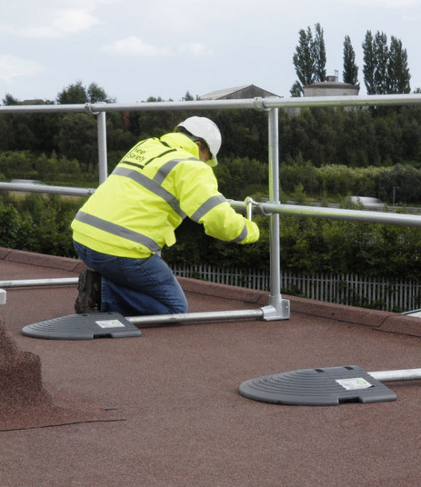
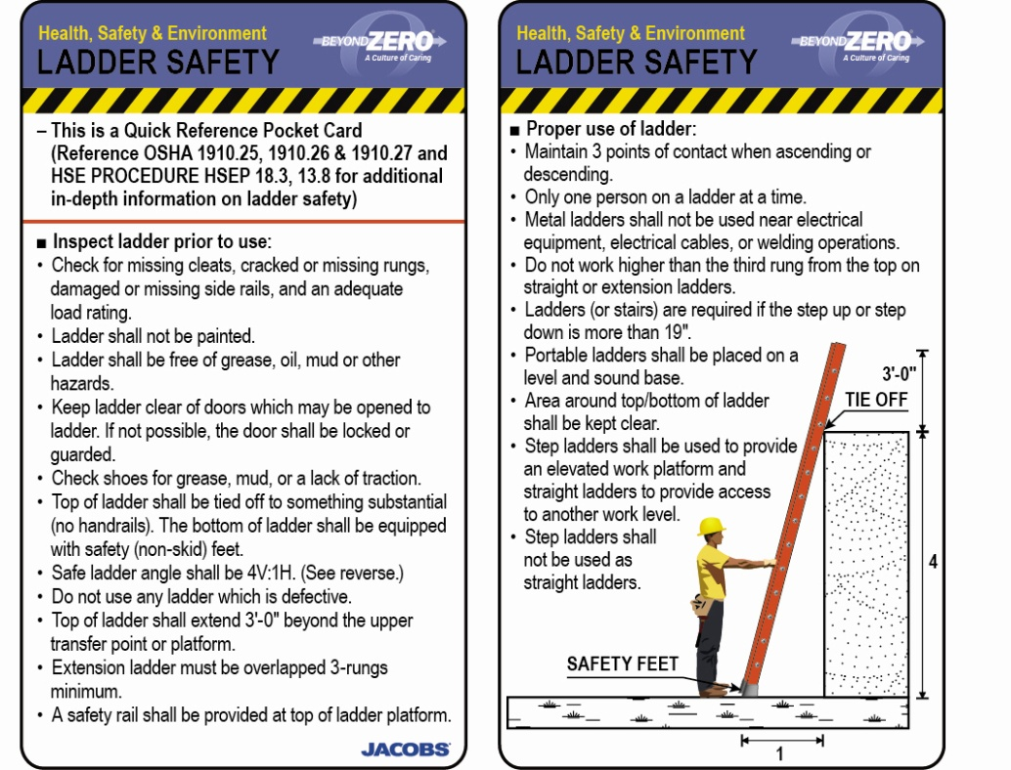
Today’s Training
In today's Training Session, we will concentrate on Working Safely on Flat Roofs and Ladders Safety.

Slide 16
Flat Roofs Seem Safe
If flat roofs seem safe, then why do workers walk or fall off?
Don’t let this false sense of safety get you in trouble.
Remember, Gravity can cause serious injuries or even kills and that falls are preventable.
Do what it takes to prevent falls when working on school roofs.

Slide 17
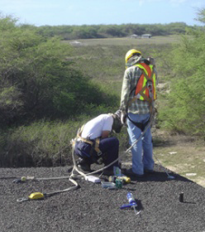
SAFETY ON THE
FLAT ROOF
Flat roofs give workers a false sense of safety.
Unprotected edges are very dangerous.
A worker can fall over the edge by simply tripping over a pipe or material, being blown by wind or when accidentally struck by materials or by other workers.

Slide 18
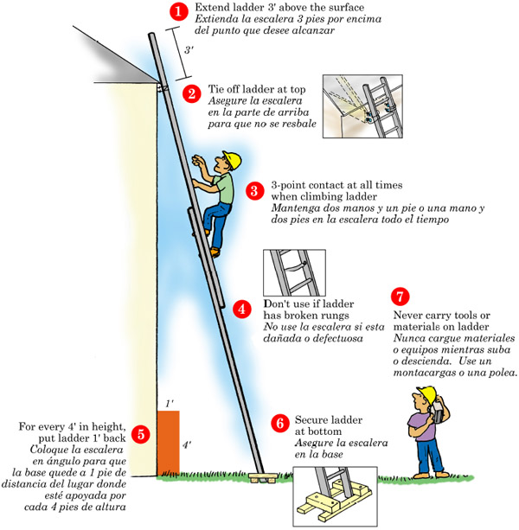
LADDER SAFETY
3
When climbing a ladder, it is safest to utilize Three Points-of-Contact because it minimizes the chances of slipping and falling from the ladder. At all times during ascent or descent, the climber must face the ladder and have two hands and one foot, or two feet and one hand in contact with the ladder cleats and/or side rails. In this way, the climber is not likely to become unstable in the event one limb slips during the climb.

Slide 19
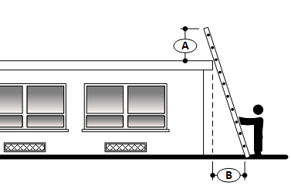
Getting on the Roof
Ladder Set Up
Ladders must extend 36” above the support edge.
The proper angle for setting up a ladder is to place its base a quarter of the working length of the ladder from the wall or other vertical surface

Slide 20
LADDER SAFETY
Three Points-of-Contact
It is important to note that the climber must not carry any objects in either hand that can interfere with a firm grip on the ladder, otherwise, Three Points-of-Contact with the ladder cannot be adequately maintained and the chance of falling is increased in the event a hand or foot slip occurs.
Factors contributing to falls from ladders include;
  haste,
  sudden movement,
  lack of attention,
  the condition of the ladder (worn or damaged),
  the user’s age or physical condition, or both,
  and the user’s footwear.

Slide 21
LADDER SAFETY
Reduce fall chances
Although the user’s weight or size typically does not increase the likelihood of a fall, improper climbing posture creates user clumsiness and may cause falls.
Reduce your chances of falling during the climb by:
  wearing slip-resistant work shoes with arch support and heavy soles to prevent foot fatigue;
  cleaning the soles to maximize traction;
  using towlines, a tool belt or an assistant to convey materials so that the climbers hands are free when climbing;
  climbing slowly and deliberately while avoiding sudden movements;
  keeping the center of your belt buckle (stomach) between the ladder side rails (or within the width of the cleats) when climbing and while working. Do not overreach or lean while working so that you don’t fall off the ladder sideways.

Slide 22
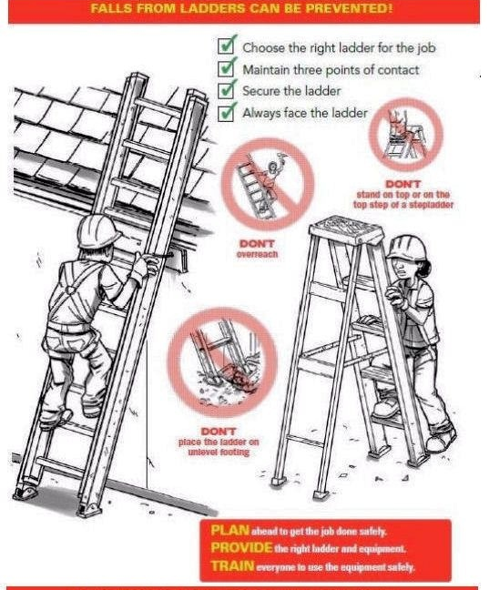

Slide 23
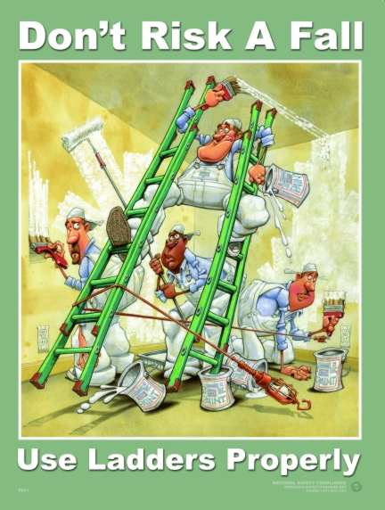

Slide 24
1926.501(b)(10)
Work on Low-slope Roofs.
Except as otherwise provided in paragraph (b) of this section, each employee engaged in roofing activities on low-slope roofs, with unprotected sides and edges 6 feet or more above lower levels shall be protected from falling by;
  guardrail systems,
  safety net systems,
  personal fall arrest systems, or
  a combination of warning line system and guardrail system,
  warning line system, and safety net system, or
  warning line system and personal fall arrest system, or
  warning line system and safety monitor system.

Slide 25
1926.501(b)(10)
Work on Low-slope Roofs.
Working on roofs 50-feet or less in width, the use of a safety monitoring system alone (i.e. without the warning line system) is permitted.”

Slide 26
Guardrail Systems
“Guardrail systems and their use shall comply with the following provisions.”
  “Top edge height of top rails, or equivalent guardrail system members, shall be 42 inches plus or minus 3 inches above the walking/working level. When conditions warrant, the height of the top edge may exceed the 45-inch height, provided the guardrail system meets all other criteria of this paragraph.”

Slide 27
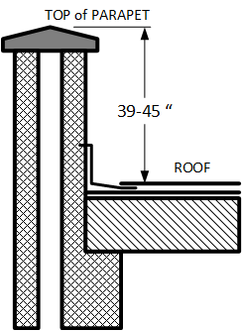
Parapets
A parapet must be 39-45 inches in height to be considered an adequate guardrail.

Slide 28
Holes in Roofs
1926.502(i) Covers.
  “Covers for holes in floors, roofs, and other walking/working surfaces shall meet the following requirements.”
1926.502(i)(2)
  “All other covers shall be capable of supporting, without failure, at least twice the weight of employees, equipment, and materials that may be imposed on the cover at any one time.”

Slide 29
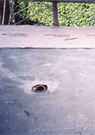
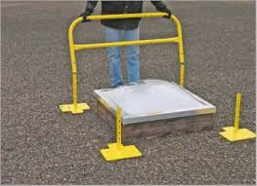
Protecting Openings
Cover or protect skylights–they are considered holes!
Cover holes 2” or larger, secure and identify covers.
  Hole covers must support two times the expected load.

Slide 30
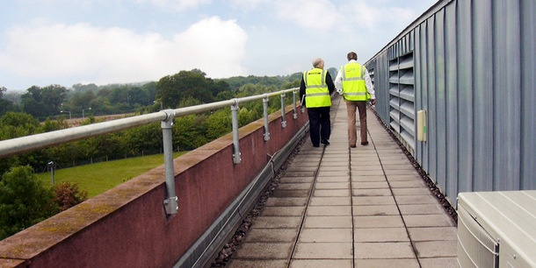
Safety Extenders
Mounting a railing directly to the top or side of a roof parapet is a cost-effective way of providing rooftop perimeter fall protection.
This penetrating railing solution mounts directly to the roof parapet and not into the roof membrane.

Slide 31
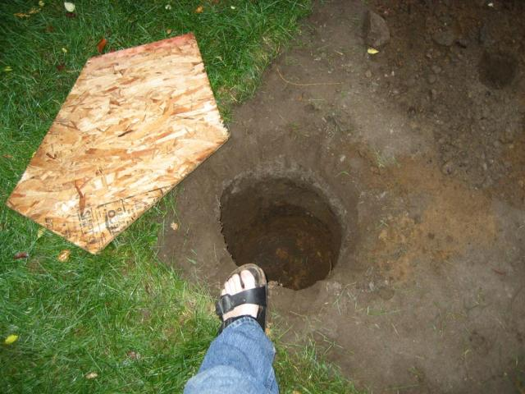
Building Structures
Work conditions 6 feet or more above a lower level require the use of fall protection:
Unprotected edges
Leading edges
Excavations
Loading Docks
Stairs

Slide 32
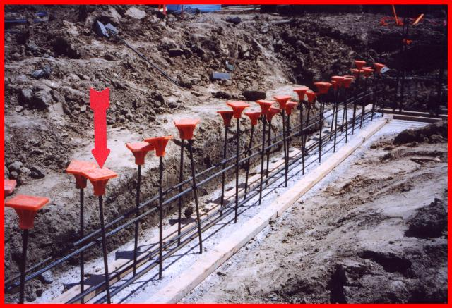
Regardless of Height
Regardless of height, fall protection must be used when working above:
Dangerous equipment
Sharp objects
Piercing objects

Slide 33
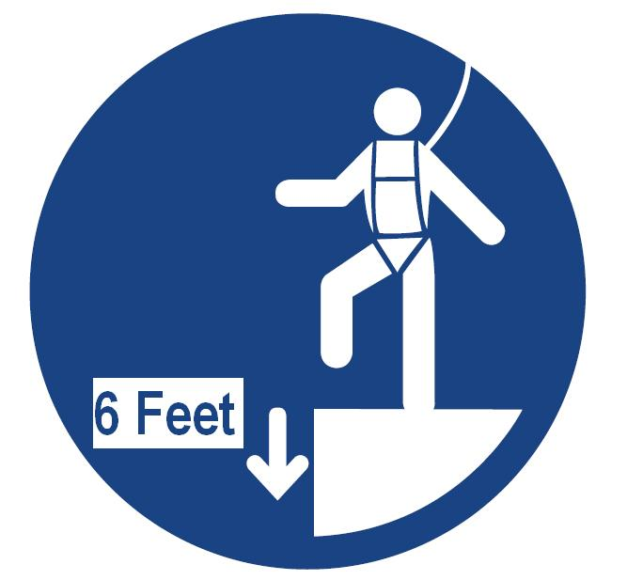
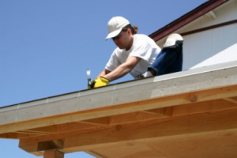
Fall Protection
When working at a height of 6’ above the lower level you must use fall protection.
  This worker is not utilizing a personal fall arrest system.

Slide 34
Exterior Excavations
All open excavations and pier holes must be guarded or protected.

Slide 35
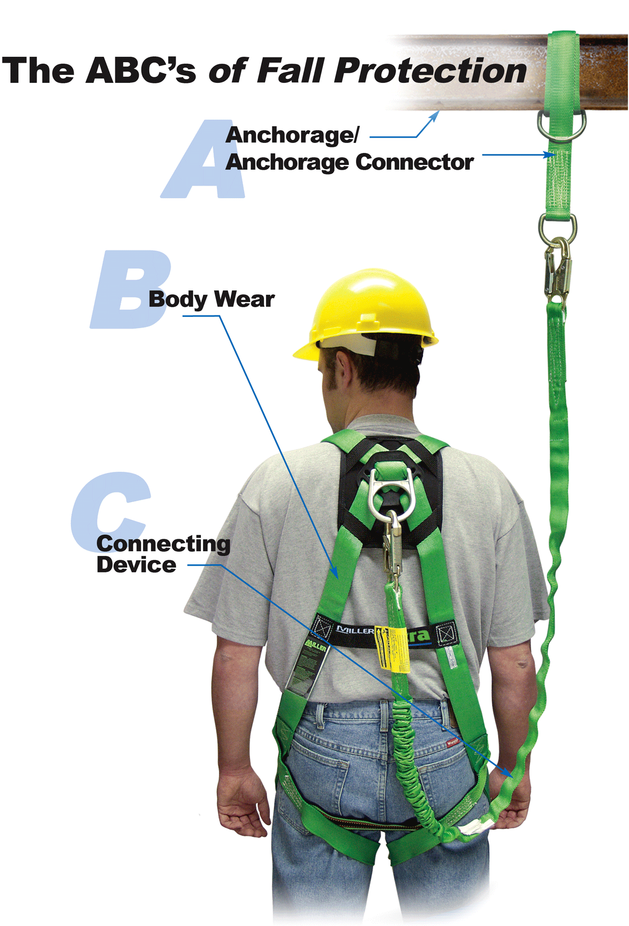
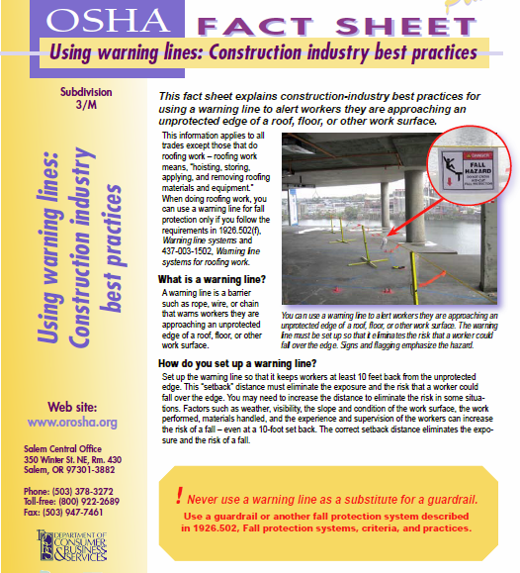
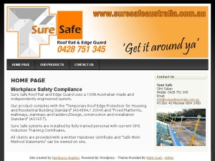
Safety Systems
Guardrail Systems
Fall Arrest Systems
Warning Lines

Slide 36
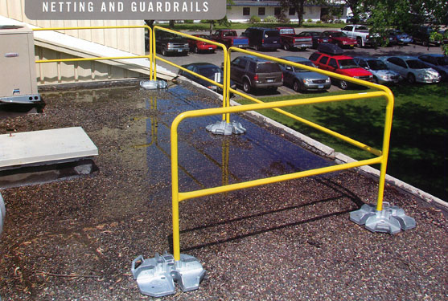
Guardrail Systems

Slide 37
1926.502(b)(3)
“Guardrail systems shall be capable of withstanding, without failure, a force of at least 200 pounds applied within 2 inches of the top edge, in any outward or downward direction, at any point along the top edge.”
  1926.502(d)(23) “Personal fall arrest systems shall not be attached to guardrail systems, nor shall they be attached to hoists except as specified in other subparts of this part.”

Slide 38
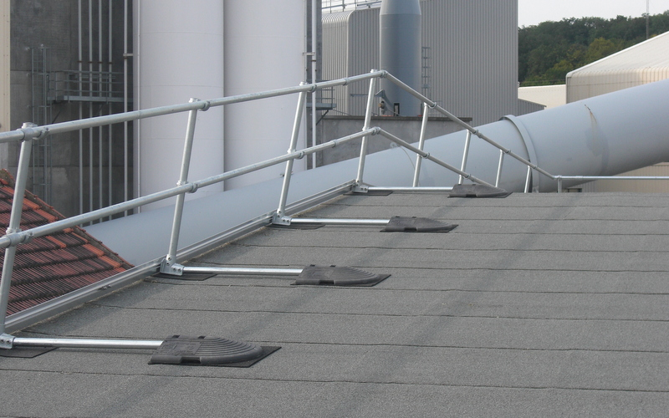
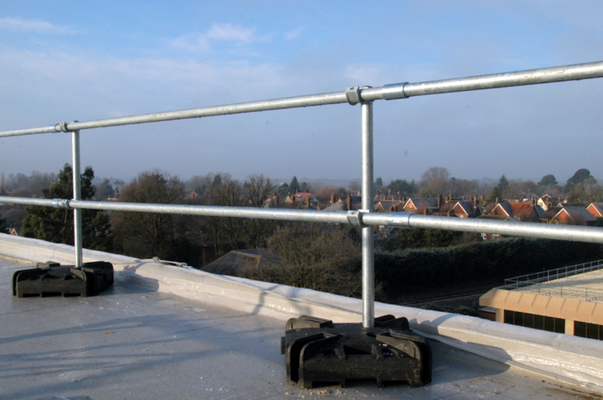
Guardrail Systems
Non-penetrating systems for roofs.
Guardrail systems include a complete railing system with a top rail 42" high that can withstand a 200# outward force and a middle rail that can withstand a 150# outward force.

Slide 39
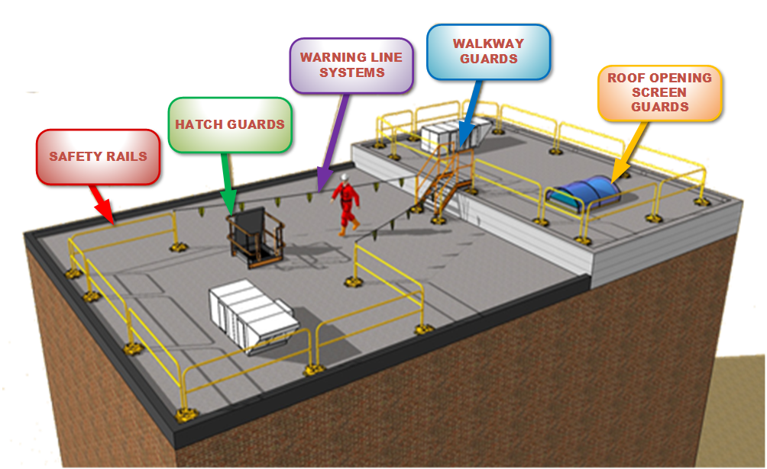
Protection Required on All Openings and Edges.

Slide 40
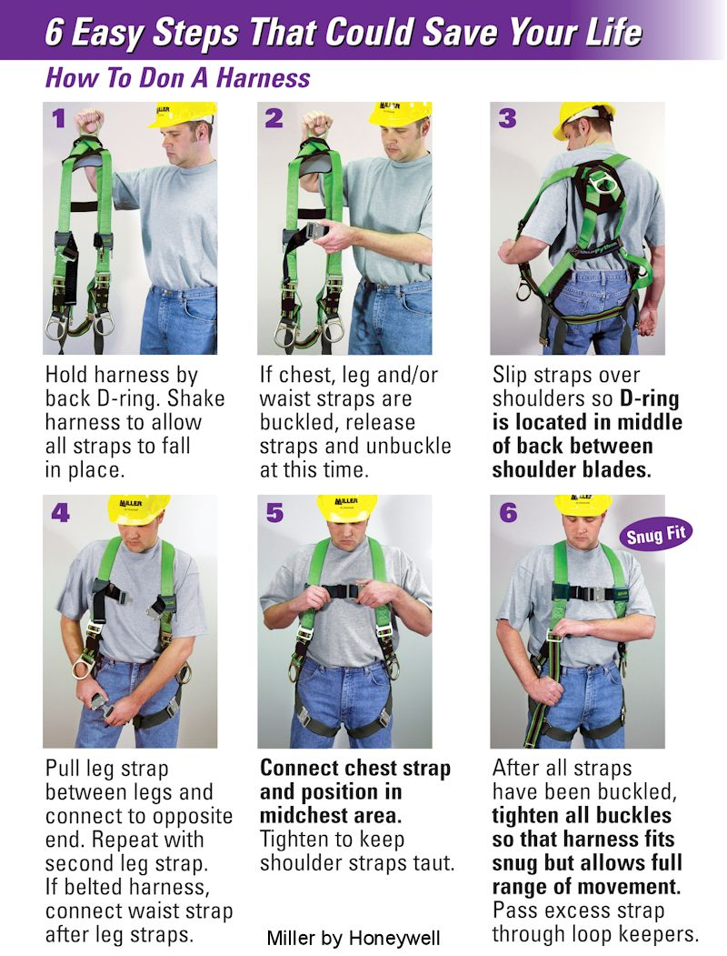
Fall Arrest System

Slide 41
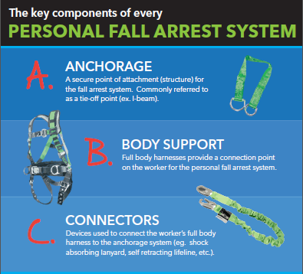
ABC’S

Slide 42
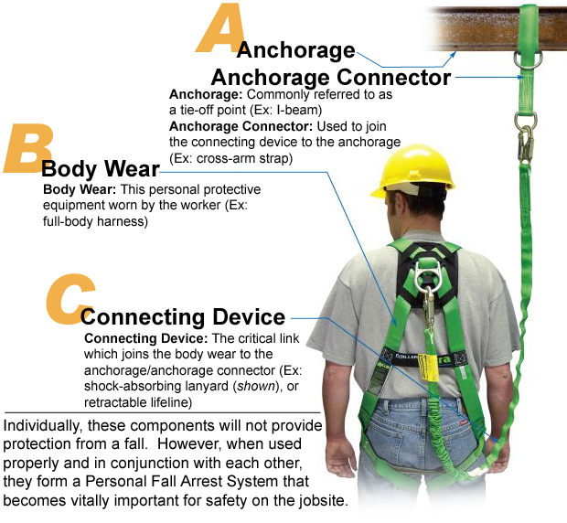
Personal fall arrest systems include body harnesses, a shock absorbing lanyard or retractor that safety limits free falls to 6', and a 5000# anchorage for each man.

Slide 43
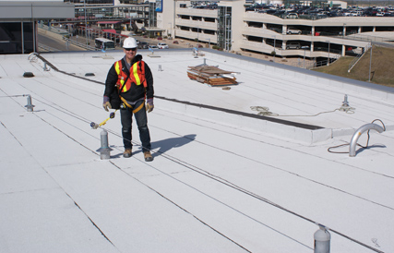
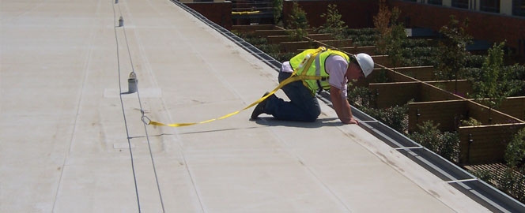
Fall Arrest Roof Anchors

Slide 44
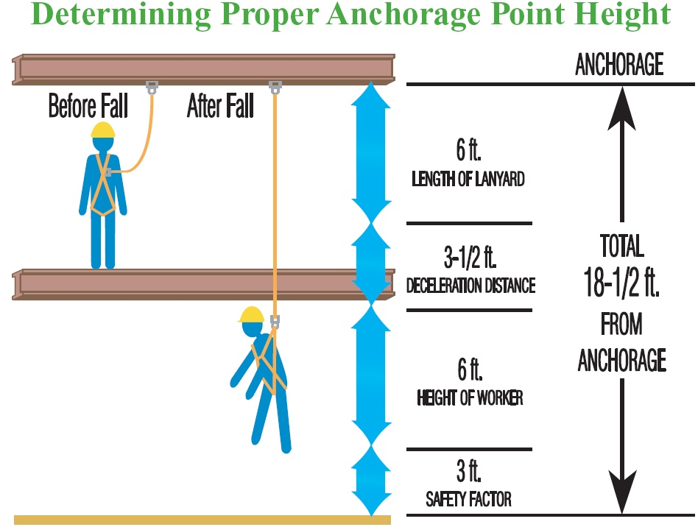
Determining Proper Anchorage Points

Slide 45
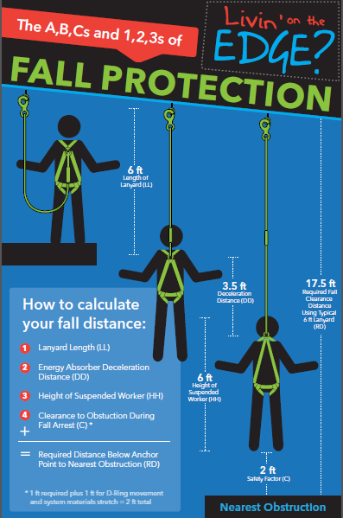
Calculating Fall Distance

Slide 46
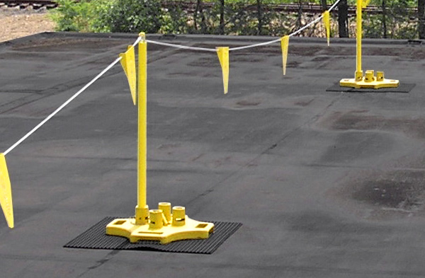
Warning Lines Systems

Slide 47
WARNING LINE SYSTEMS
What Is A Warning Line System?
  A warning line system is a means of fall prevention that protects workers by roping off a work area with a flagged line at about waist level.
  The line is intended to warn workers when they are dangerously near the edges by providing a visible warning.
  There is also minor physical resistance to constrain workers.

Slide 48
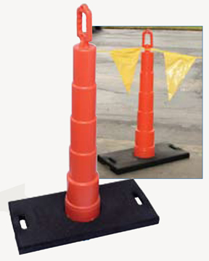
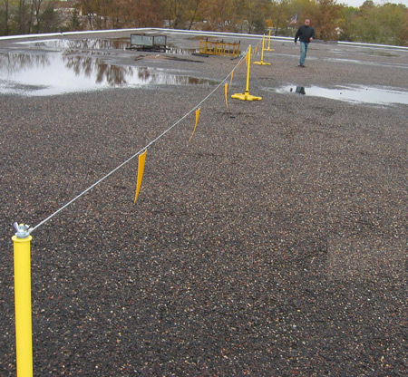
Warning Lines Systems
Warning line systems rope off edges with stands and flag lines 6 feet from edges and use a safety monitor for work within 6 feet of the edge.

Slide 49
Warning Line Systems
Warning line systems and their use shall comply with the following provisions:
  The warning line shall be erected around all sides of the roof work area.
  When mechanical equipment is not being used, the warning line shall be erected not less than 6 feet from the roof edge.”
  When mechanical equipment is being used, the warning line shall be erected not less than 6 feet from the roof edge which is parallel to the direction of mechanical equipment operation, and not less than 10 feet from the roof edge which is perpendicular to the direction of mechanical equipment operation

Slide 50
Warning Line Systems
Warning lines shall consist of ropes, wires, or chains, and supporting stanchions erected as follows:”
  The rope, wire or chain shall be flagged at not more than 6-foot intervals with high-visibility material:”

Slide 51
Some guidelines:
A warning line system is used for relatively large, open elevated areas.
The warning line warns workers to stay a safe distance away from fall hazards, such as a leading edge or roofline.
These systems consist of ropes, wires, or chains.
The material selected must have a minimum tensile strength of 500 pounds. However, it is not meant to support the weight of someone leaning or falling against it.
The warning line must be flagged every 6 feet or less with high-visibility material so that workers can easily see the line.

Slide 52
more guidelines…..
The warning line must be not less than 34 inches above the working surface at the lowest sag point, and no more than 39 inches above the surface at the high point.
The line must be erected around all sides of a roof work area, at least 6 feet from the edge.
Stanchions must not tip over easily – they should be able to resist a force of at least 16 pounds after being rigged with the warning line.
Workers must be trained to stay out of the unprotected area beyond the warning line.
Work that must be done outside the warning line requires another kind of fall arrest system to be put in place.

Slide 53
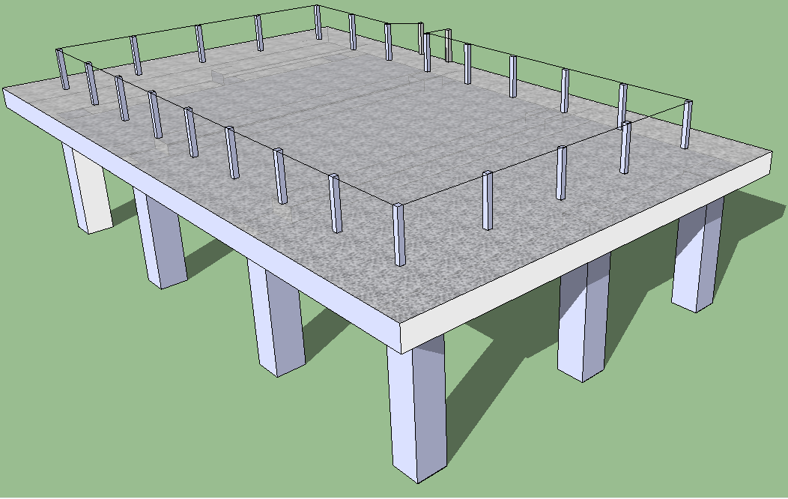
WARNING LINE LAYOUT
WARNING LINES
ACCESS
POINT
ROOF
WORK
AREA
WARNING LINES MUST BE CLEARLY MARKED AND 6 FEET FROM EDGE OF ROOF AT ALL OPEN AREAS OVER 5 FEET HIGH AND A MINIMUM OF 39 TO 42 INCHES HIGH.

Slide 54
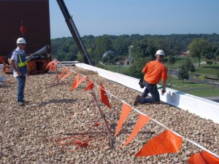
SAFETY MONITORS

Slide 55
OSHA
1926.501(b)(10)
A combination of a warning line system and safety monitoring system can be used for roofing work on low-slope (4:12 or less) roofs.
Or, on roofs 50-feet (15.25 m) or less in width, the use of a safety monitoring system without a warning line system is permitted.

Slide 56
Safety Monitoring Systems
The employer shall designate a competent person to monitor the safety of other employees and the employer shall ensure that the safety monitor complies with the following requirements.
The safety monitor shall be competent to recognize fall hazards.
The safety monitor shall warn the employee when it appears that the employee is unaware of a fall hazard or is acting in an unsafe manner:
The safety monitor shall be on the same walking/working surface and within visual sighting distance of the employee being monitored:
The safety monitor shall be close enough to communicate orally with the employee, and;
The safety monitor shall not have other responsibilities which could take the monitor’s attention from the monitoring function.

Slide 57
Safety Monitor
Workers can use a safety monitor system in conjunction with a warning line system with a low slope roof (4:12 vertical to horizontal, or less), under 50 feet or less in width.
The safety monitor must be a competent person and have no other duties that could interfere with their responsibility.
They are required to work on the same level as the work being performed, and close enough to workers for direct monitoring (visual) and for verbal communication.

Slide 58
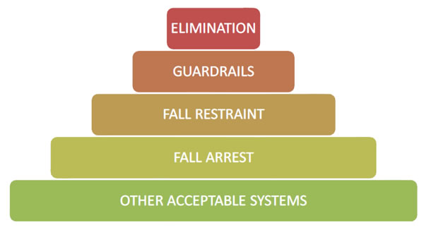
How to protect workers from fall hazards:
The most effective way to protect workers from falls is to eliminate the fall hazard. If this is not feasible, the employer is required to use at least one of the following:

Slide 59
Other forms of fall protection systems include:
Guardrail Systems – 1926.502(b),
Safety Net Systems – 1926.502(c),
Warning Line Systems – 1926.502(f),
Controlled Access Zones – 1926.502(g),
Safety Monitor Systems – 1926.502(h),
Hole Covers – 1926.502(i).

Slide 60
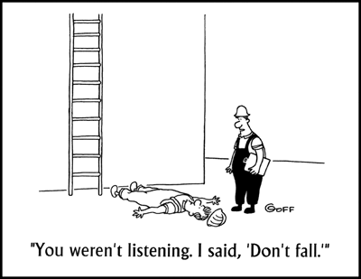
This is not Training.

Slide 61


Slide 62
