Slide 1
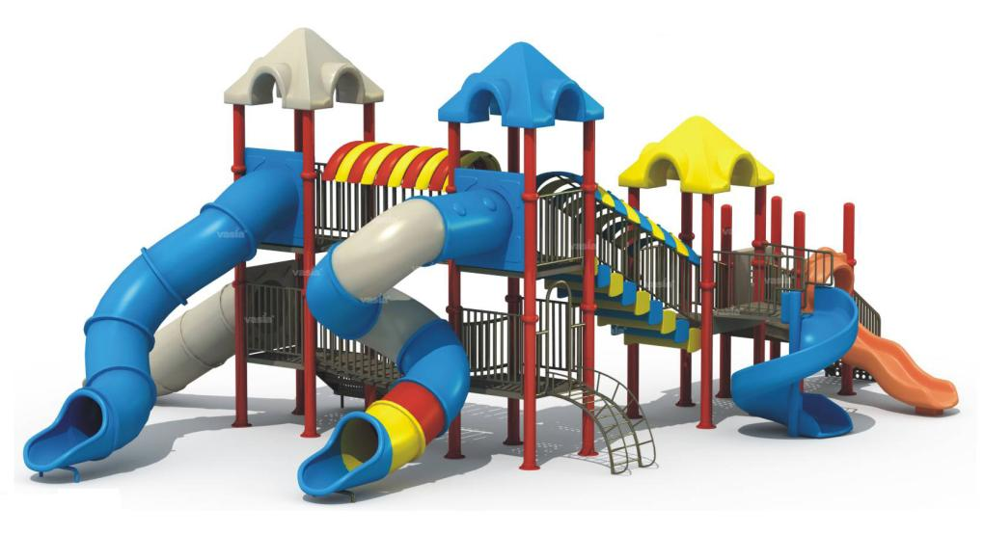
PLAYGROUND
SAFETY
“INJURY FREE IS THE KEY!”

Slide 2
The Playground Injury Problem
Each year, Emergency Departments treat about 200,000 children15 years old and younger for playground related injuries.
The American Academy of Orthopedic Surgeons estimates 527,000 children are treated in hospitals, Emergency departments, doctors offices, and ambulatory surgery centers.

Slide 3
The Playground Injury Problem...
45 percent of the playground injuries that take place are severe:
  fractures,
  concussions,
  dislocations.
75 percent of the non-fatal injuries take place on public playgrounds like those in schools and parks.
70 percent of the deaths that take place on playgrounds happen on home playgrounds.

Slide 4

The Playground Injury Problem...
Falls to the surface cause 70 percent of the injuries on playgrounds.
Entanglement of clothing, strings and ropes are the number one cause of deaths on playgrounds.
Other dangers include:
  Head entrapment in equipment openings
  Impact by moving swings
  Tripping on loose equipment

Slide 5
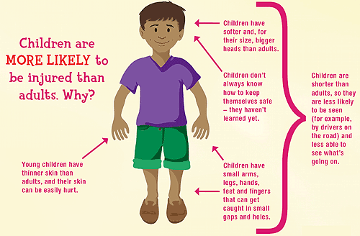
The Playground Injury Problem...
Head and face injuries are most common in children under 4 years old.
Arm and hand injuries are most common among children 5 -14 years of age.

Slide 6

Playground injuries are Preventable!

Slide 7
Follow the SAFE model.
SAFE
S
  SUPERVISION & SURVEY
A
  AGE APPROPRIATE & DESIGN
F
  FALL SURFACE CUSHIONING
E
  EQUIPMENT MAINTENANCE
* Adapted from the National Program for Playground Safety

Slide 8
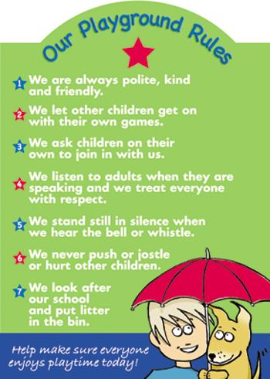
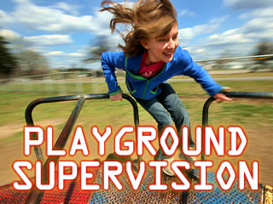
Supervision
Playground rules should be posted.
To properly supervise children they need to be seen.

Slide 9
Survey
Before children are allowed to play in playgrounds Look for Safety Hazards:
  Look for broken glass, litter, pieces of metal and other sharp objects.
  In summer, check metal equipment to make sure it is not hot.
Make sure there are no tripping hazards like:
  tree stumps
  exposed concrete
  missing rubber tiles
  pot holes

Slide 10
Age Appropriate
Children develop different skills at different ages.
Equipment designed for children 5-12 is too big for children ages 2-5.
Platforms elevated more than 20 inches above the ground need guardrails or protective barriers for ages 2-5 year olds and those higher than 30 inches need barriers for 5-12 year olds.

Slide 11
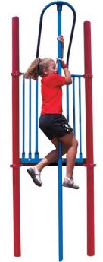
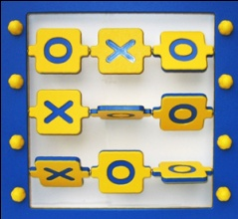
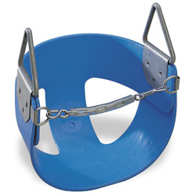
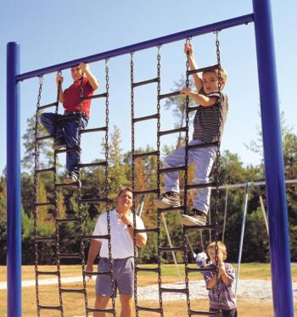
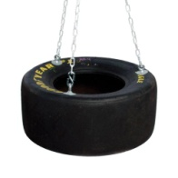
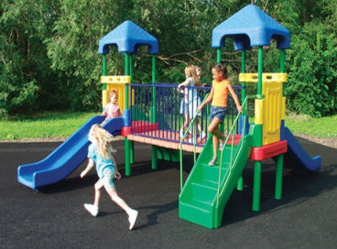
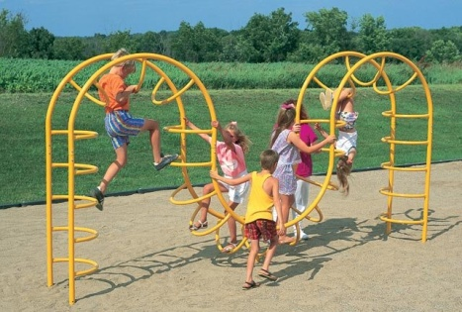
Age Appropriate
For 2-5 year olds consider:
  Activity Panels
  Swings
  Tot Swings
  Small slides
  Lower Platforms
For 5 -12 year olds consider:
    Swings
    Tire Swings
    Horizontal Ladders
    Chain Climbers
    Free Standing Arch Climbers
    Sliding Poles

Slide 12
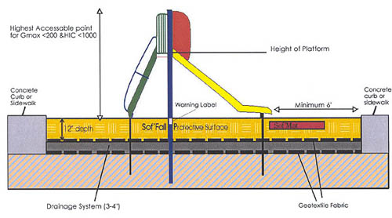
Fall Surface
Surfacing must be provided under all equipment and there must be at least a 6 foot fall zone around all equipment.

Slide 13
Fall Surface
Never use materials such as asphalt, blacktop, grass, packed dirt, or rocks under playground equipment.
Falls from one foot onto a concrete surface can cause a concussion.
Falls from eight feet onto dirt is the same as a child hitting a brick wall traveling 30 miles per hour.

Slide 14
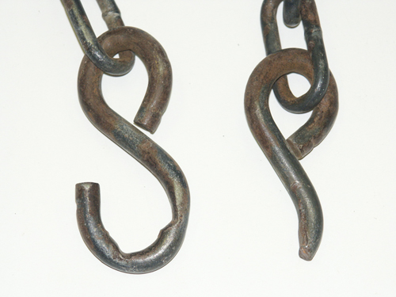
Equipment Maintenance
Check to make sure that equipment is:
  anchored safely into the ground
  well maintained
  free of broken parts
  has no noticeable gaps less than 3 1/2 inches or more than 9 inches.
Check to make sure that the equipment is free of:
  dangerous hardware like protruding bolts and improperly closed s-hooks.
  sharp points or edges
  Splinters
  cracks or holes

Slide 15
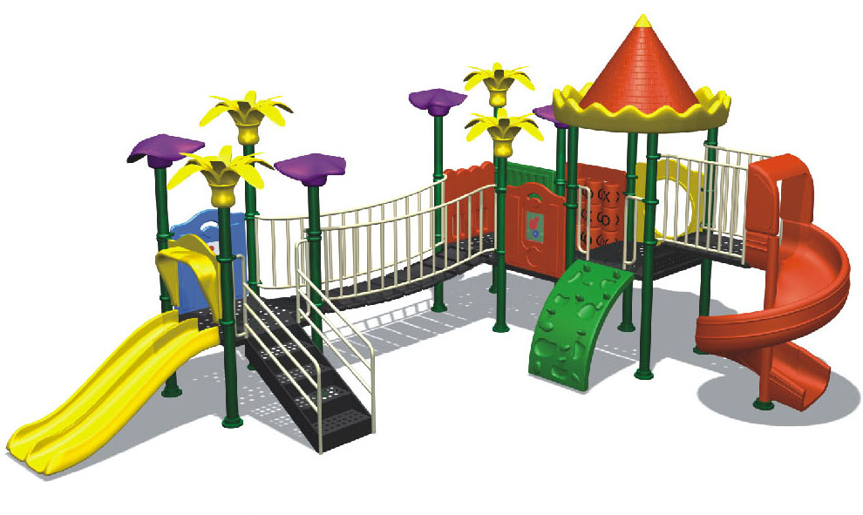
Why are Safe Playgrounds Important?

Slide 16
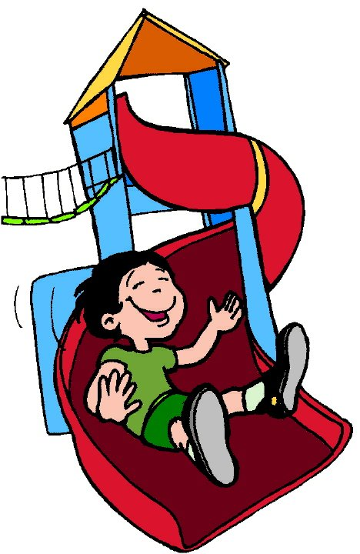
Play is the work of children
Imagination is stimulated.
Elevation assists with developing different perspectives.
Play is how children learn about objects and social relations.
Slides and climbing equipment assist with the development of motor skills.
Quality of play is affected by the environment in which children play.
Play is the vehicle for the infant/child to be able to make sense of the world. (Piaget)

Slide 17
Why is Outdoor Play important?
Children learn about cause and effect, physical mastery and manipulation.
Children avoid obesity through physical activity
Children learn how to get along with other children.

Slide 18
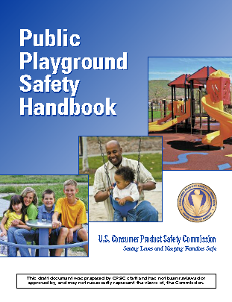
PLAYGROUNDS LAW
NJ PUBLIC LAW 1999 CHAPTER 50 DESIGNATED THE US CONSUMER PRODUCTS SAFETY COMMISSION “HANDBOOK FOR PLAYGROUND SAFETY” THE RECOGNIZED STANDARD OF CARE.
NJ PLAYGROUND SUB CODE 5:23-11.1 ADOPTS THESE GUIDELINES AND REQUIRES THAT ALL PUBLIC PLAYGROUNDS COMPLY WITH THE RESILIENT SURFACING STANDARDS BY 2004 AND THE EQUIPMENT STANDARDS BY OCTOBER 2007.

Slide 19
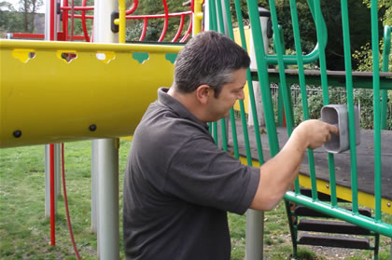
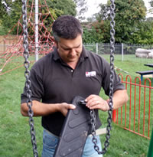
INSPECTION
FOR EACH PIECE OF EQUIPMENT, THE FREQUENCY OF THOROUGH INSPECTIONS WILL DEPEND ON THE TYPE OF EQUIPMENT, THE AMOUNT OF USE, AND CLIMATE.
DETAILED INSPECTIONS SHOULD GIVE SPECIAL ATTENTION TO MOVING PARTS.
INSPECTIONS SHOULD BE CARRIED OUT IN A SYSTEMATIC MANNER BY TRAINED PERSONNEL.

Slide 20
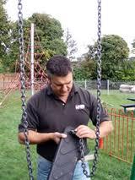
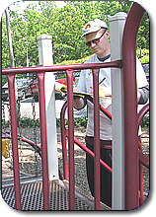
EQUIPMENT
EQUIPMENT SHOULD BE INSPECTED FREQUENTLY FOR ANY POTENTIAL HAZARDS, CORROSION OR DETERIORATION.
THE PLAYGROUND AREA SHOULD BE CHECKED FREQUENTLY FOR BROKEN GLASS OR OTHER DANGEROUS DEBRIS.
LOOSE FILL SURFACE SHOULD BE INSPECTED TO INSURE DISPLACED OR COMPACTED.
THE USE OF CHECKLISTS IS SUGGESTED.

Slide 21
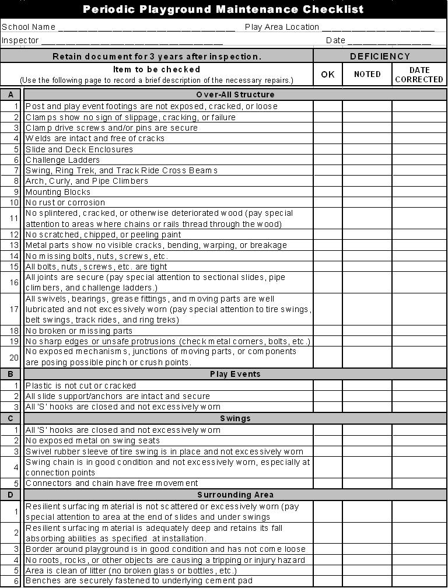

Slide 22
MAINTENANCE
INSPECTIONS ALONE DO NOT CONSTITUTE A COMPREHENSIVE MAINTENANCE PROGRAM.
MAINTENANCE RECORDS SHOULD BE DATED AND SIGNED.
INADEQUATE MAINTENANCE HAS RESULTED IN INJURIES.
THE MANUFACTURERS MAINTENANCE INSTRUCTIONS AND RECOMMENDED INSPECTION SCHEDULES SHOULD BE STRICTLY FOLLOWED.
A COMPREHENSIVE MAINTENANCE PROGRAM SHOULD BE DEVELOPED FOR EACH PLAYGROUND.

Slide 23
REPAIRS
ANY DAMAGE OR HAZARDS SHOULD BE REPAIRED IMMEDIATELY IN ACCORDANCE WITH THE MANUFACTURES INSTRUCTIONS FOR REPAIR OR REPLACEMENT.
BASED ON THE MANUFACTURERS RECOMMENDATIONS REGARDING MAINTENANCE SCHEDULES FOR EACH PIECE OF EQUIPMENT, A MAINTENANCE SCHEDULE FOR THE ENTIRE PLAYGROUND CAN BE CREATED.

Slide 24
SURFACE MATERIALS
SURFACE MATERIAL NEEDS BE MAINTAINED AT PROPER DEPTH AS OUTLINED IN THE STANDARD AND MANUFACTURES RECOMMENDATION.
  The surface under and around playground equipment can be a major factor in determining the injury causing potential of a fall.
A fall onto a shock absorbing surface is less likely to cause a serious injury than a fall onto a hard surface.
Because head impact injuries from a fall have the potential for being life threatening, the more shock absorbing a surface can be made, the greater is the likelihood of reducing severe injuries.

Slide 25
INJURIES
However, it should be recognized that some injuries from fall will occur no matter what playground surfacing material is used.

Slide 26
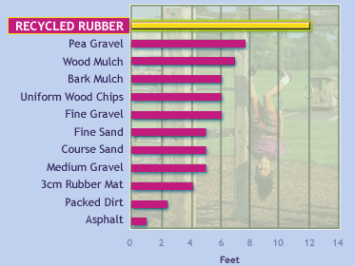
MATERIALS CHART

Slide 27
GUIDELINES
OTHER AREAS OF CONCERN
HARDWARE
METAL SURFACES
GENERAL HAZARDS
SHARP POINTS, CORNERS, EDGES
PROTRUSIONS, PROJECTIONS
ENTRAPMENT
ANGLES
TRIPPING HAZARDS
SUSPENDED HAZARDS
STAIRWAYS, LADDERS, HANDRAILS
RUNGS AND HANDGRIPS
PLATFORMS, GUARDRAILS, BARRIERS

Slide 28
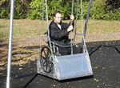
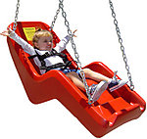
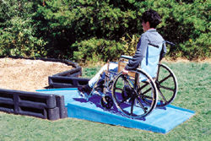
And don’t forget…..
ADA Compliance!

Slide 29

RECORD KEEPING
RECORDS OF ACCIDENTS SHOULD BE MAINTAINED TO TRACK ACCIDENTS.
“INJURY FREE IS THE KEY”

Slide 30
OBTAIN A COPY OF THE HANDBOOK FOR PUBLIC PLAYGROUND SAFETY TO INSURE COMPLIANCE

Slide 31
For Further Information
  Consumer Product Safety Commission
  www.cpsc.gov
  1-800-638-2772
  National Program for Playground Safety
  www.PlaygroundSafety.org
  1-800-554-PLAY
  National Recreation and Park Association
  www.nrpa.org
  1-800-626-NRPA

