Slide 1
Safety Is Everybody's Business

Slide 2
Why Worry about Safety?
Why do you need to be concerned about safety?
Loss
Pain
WC
Hurt
DOL
EPA
$$$$$

Slide 3
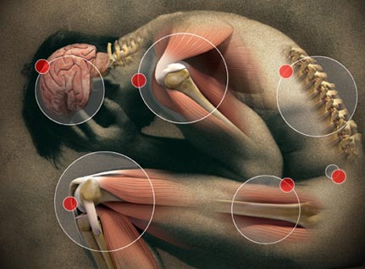
Getting hurt is not fun.
Not All Pain is Gain,
Nobody likes getting hurt,
Healthy employees are more productive employees,

Slide 4
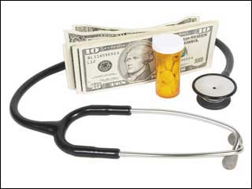
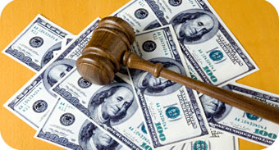
Cost of Accidents
Direct Costs;
Medical Costs (including worker’s comp).
Indemnity Payments.
Indirect Costs;
Time Lost (by worker and supervisor).
Schedule delays.
Training new employees.
Cleanup time / equipment repairs.
Legal fees.

Slide 5
Cost of Accidents…
The Iceberg Effect
On average, the indirect costs of accidents exceed the direct costs by a 4:1 ratio

Slide 6
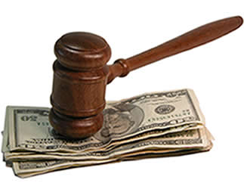
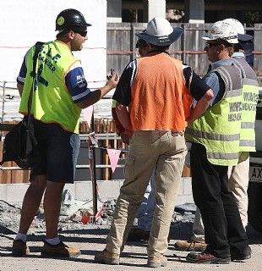
Legal Issues and Liability
As a result of safety violations:
You can be named in a lawsuit.
Criminal charges may be filed against you.
You can be cited by an enforcement agency.
You can be fined by an enforcement agency.
Your workplace can be shut down by an enforcement agency.

Slide 7
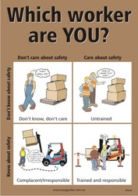
So how do you protect yourself?

Slide 8
Understanding Accident Causes
Accidents are caused by:
Unsafe conditions
Unsafe acts

Slide 9
Accident Causes
Unsafe Conditions
Easiest to correct
very cost effective
Easiest to prevent
Safety audits
Safety inspections
Maintenance schedules for equipment
Encouraging employee reporting
Good housekeeping

Slide 10
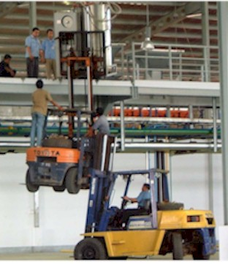
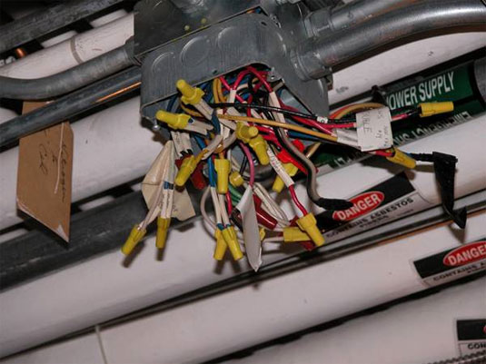
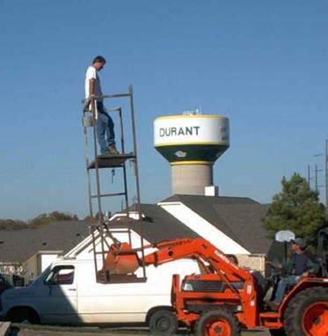
Accident Causes
Unsafe Acts
Most difficult to address
Changing behavior isn’t easy
Best prevented by developing a “safety culture.”

Slide 11
Safety Cultures
Establish accountability for safety
Define safety responsibilities

Slide 12
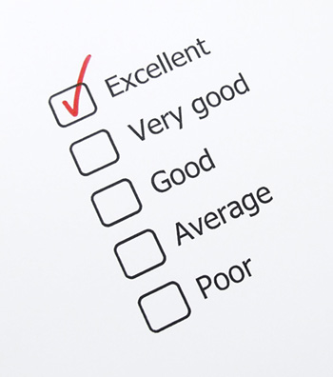
Establishing Accountability: Performance Evaluations
Employees should be evaluated on their safety performance.
Doing a job correctly includes doing it safely.
Add to all Job Descriptions;
“Must follow all general and safety policies and procedures as established by the Department and School District.”

Slide 13
Establishing Accountability
Charge back systems.
Safety goals;
Accident costs
Equipment damage
Lost time
Accident rates
First aid #s
Workers comp #s
Loss ratios (including automobile rates)
Safety Activities
Safety meetings, inspections, using PPE

Slide 14
Defining Responsibilities
Employee responsibilities include:
Recognizing safety hazards
Reporting safety hazards
Maintaining good housekeeping
Working safely
Using personal protective equipment (PPE)
Making the most of safety training

Slide 15
Defining Responsibilities
Employer responsibilities include:
Providing access to information
Haz Com - MSDSs, written program
Bloodborne Pathogens – written program
Lab Safety – chemical hygiene plan

Slide 16
Defining Responsibilities
Employer responsibilities (cont.)
Providing personal protective equipment
From OSHA 1910.132: “Protective equipment, including personal protective equipment for eyes, face, head, and extremities, protective clothing, respiratory devices, and protective shields and barriers, shall be provided, used, and maintained in a sanitary and reliable condition wherever it is necessary by reason of hazards of processes or environment, chemical hazards, radiological hazards, or mechanical irritants encountered in a manner capable of causing injury or impairment in the function of any part of the body through absorption, inhalation or physical contact.”

Slide 17
Defining Responsibilities
Employer responsibilities (cont.)
Providing training
Hazard Communications
Annual & within first 30 days of employment, also when new hazards are introduced
Quarterly safety training (required by state)
Special programs
Laboratory
Bloodborne pathogens
Respirators
Forklifts

Slide 18
Defining Responsibilities
Employer responsibilities (cont.)
OSHA General Duty Clause: “Each employer
Has the general duty to furnish each employee with employment and places of employment free from recognized hazards causing or likely to cause death or serious physical harm.
The specific duty of complying with safety and health standards promulgated under the act.”

Slide 19
So what does all this mean?
It means that safety is everybody’s business.
From the moral aspect to the legal aspect, we all benefit from a safe work environment.

