Slide 1


Safety & Health Programs

Slide 2
Benefits
Effective Safety and Health Programs
  Reduce work related injuries and illnesses
  Improve morale and productivity
  Reduce workers’ compensation costs

Slide 3
Major Elements
Worksite analysis
Safety and health training
Hazard prevention and control
Management commitment and employee involvement

Slide 4
Management Commitment
and Employee Involvement
These are complementary elements;
MANAGEMENT COMMITMENT
Provides motivation and resources.
EMPLOYEE INVOLVEMENT
Allows workers to develop and express commitment to safety and health.

Slide 5
Policy and Goals
Clearly state a worksite safety and health policy.
Establish and communicate a clear goal and objective for the safety and health program.
Involve top management in implementing the program.

Slide 6
Employee Involvement
SAFETY & HEALTH
Encourage employees to get involved in the program and in decisions that affect their safety and health.
COMMUNICATIONS
Communicate responsibility for all program aspects.

Slide 7
Responsibility
Parties responsible for the safety and health program must have authority and resources.
Managers, supervisors, and employees must be held accountable for meeting their responsibilities.
Program operations must be reviewed at least annually, to evaluate, identify deficiencies, and revise, as needed.

Slide 8
Worksite Analysis
Examine the worksite and identify:
-- existing hazards;
-- conditions and operations where changes might occur to create hazards.
Management must actively analyze the work and the worksite to anticipate and prevent harmful occurrences.

Slide 9



Comprehensive Survey
Conduct a comprehensive baseline survey for safety and health.
Job Hazard Analysis.
Who may help you:
-- OSHA/PEOSH Consultation Program
-- Insurance companies
-- Consultants

Slide 10

Safety and Health Inspections
Conduct regular (usually weekly) site inspections.
Establish daily work area inspection procedures.
Develop and use a checklist.
Provide a reliable system for employees, without fear of reprisal, to notify management about apparent hazardous conditions and to receive timely and appropriate responses.

Slide 11

Additional Worksite Analysis
Investigate accidents and “near miss” incidents, so that their causes and means for prevention are identified.
Analyze injury and illness trends, so that common cause patterns can be identified and prevented.

Slide 12
Hazard Prevention and Control
Start by determining that a hazard or potential hazard exists.
Where feasible, prevent hazards by effective design of job or job site.
If the hazard cannot be eliminated, use hazard controls.
Eliminate or control hazards in a timely manner.

Slide 13
Controlling the Hazards
To prevent and control hazards you must use:
  Engineering controls;
  Administrative controls;
  Personal protective equipment;
  Safe work practices communicated;
    thru training,
    positive reinforcement,
    correction of unsafe performance,
    enforcement.

Slide 14
Hazard Prevention Planning
Maintain the facility and equipment.
Emergency planning.
  Training and drills, as needed.
Medical program.
  First aid on site.
  Physician and emergency care nearby.

Slide 15
Safety and Health Training
Address the safety and health responsibilities of ALL personnel.
Incorporate it into other training and job performance or practice.

Slide 16

Safety and Health Orientation
Employees must understand the hazards they may be exposed to and how to prevent harm to themselves and others from hazard exposure.
Orientation training must be given to site and contract workers.

Slide 17
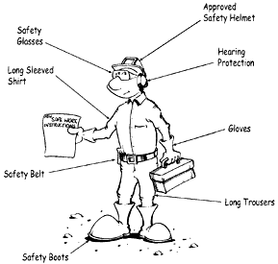
Supervisor Responsibilities
Analyze work to identify potential hazards in area of responsibility.
Maintain physical protections in work areas.
Reinforce employee training through performance feedback and, if needed, enforcement of safe work practices.

Slide 18
Specific Training Needs
HAZARD RECOGNITION
Training required in standards
Emergency response
Accident investigation
Emergency drills

Slide 19

Summary
Effective worker safety and health programs
Management commitment
Employee involvement
Worksite analysis
Hazard prevention and control
Safety and health training
  Reduce work related injuries and illnesses.
  Improve morale and productivity.
  Reduce workers’ compensation costs.

Slide 20
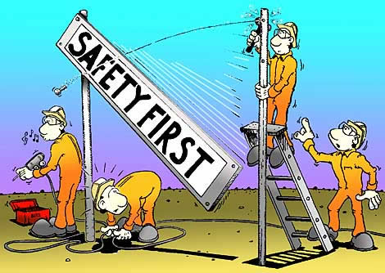
SAFETY FIRST

Slide 21

THANK YOU
NEW JERSEY SCHOOLS BUILDINGS and GROUNDS ASSOCIATION

