Slide 1
Stairways
and Ladders
Make sure you step
in the right direction.

Slide 2
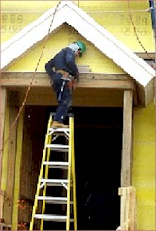
Hazards
Stairways and ladders cause many injuries and fatalities among construction and maintenance workers.
About half the injuries caused by slips, trips and falls from ladders and stairways require time off the job.
Improper use of the top rung of a step ladder

Slide 3
Slips, Trips and Falls
On Stairways and Ladders
There must be a stairway or ladder at points of access where there is an elevation break of 19 inches or more.
At least one point of access must be kept clear.
19 inches
BREAK IN ELEVATION

Slide 4


Handrail vs. Stair Rail
STAIR RAIL SYSTEM
HANDRAIL SYSTEM

Slide 5
Handrail and Top Rail Strength
Rails must be able to withstand a force of 200 pounds.

Slide 6
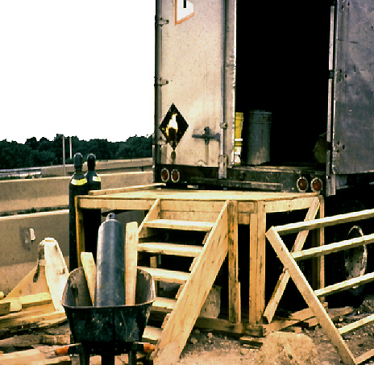
Handrails
Stairways with four or more risers must be equipped with at least one handrail.
The stairway to this platform has more than 4 risers and is not guarded.
The platform requires guarding.

Slide 7
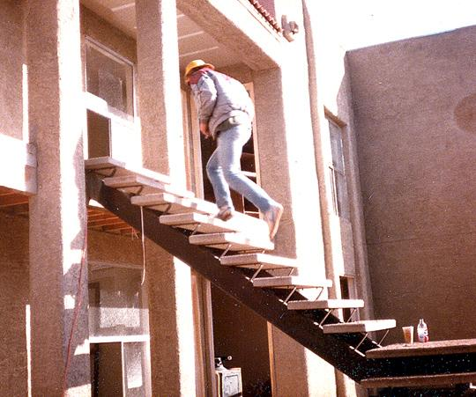
Stair Rails
Stairways with four or more risers or more than 30 inches high must have a stair rail along each unprotected side or edge.

Slide 8
STAIRS
Install between 30 and 50 degrees.
Must have uniform riser height and tread depth, with less than a 1/4-inch variation.
Uniform - 30 & 50 deg. angle

Slide 9
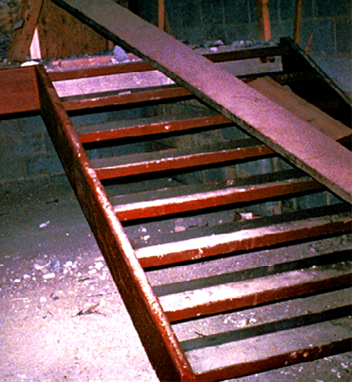
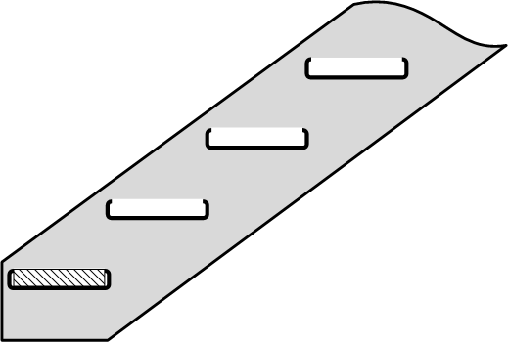
Temporary Stairways
Only use pan stairs if filled with filler material at least to the top edge of each pan.
FILLER
STRINGER
Pan
STAIR PAN

Slide 10
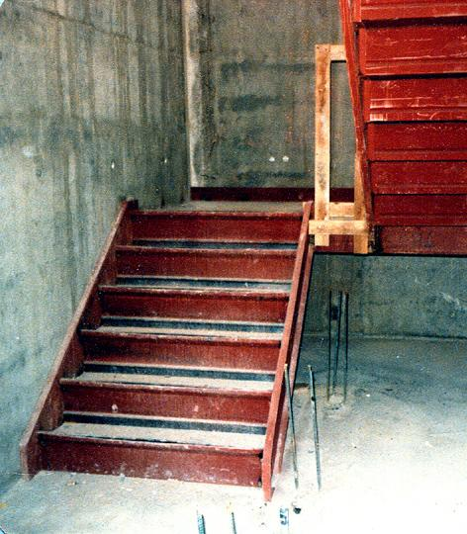
Stairway Landings
Stairway landings must be at least 30 inches deep and 22 inches wide at every 12 feet or less of vertical rise.
Unprotected sides of landings must have standard 42 inch guardrail systems.
Landing

Slide 11
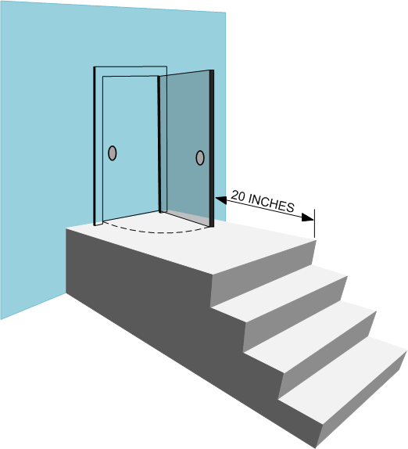
Platforms and Swing Doors
Where doors or gates open directly on a stairway, provide a platform that extends at least 20 inches beyond the swing of the door.

Slide 12
Dangerous Conditions
Fix slippery conditions before using.
Stairway parts must be free of projections which may cause injuries or snag clothing.

Slide 13
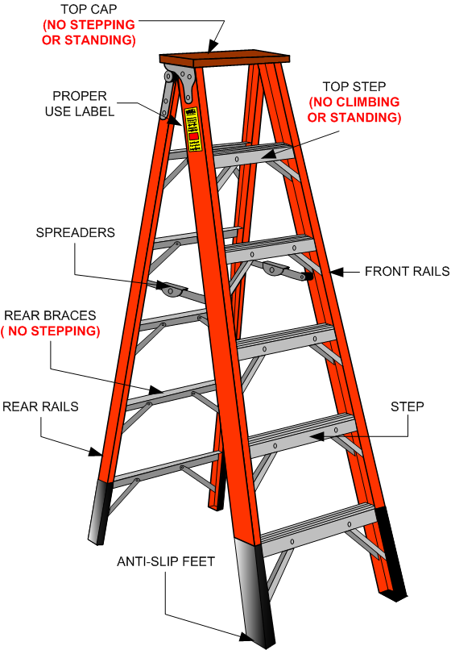
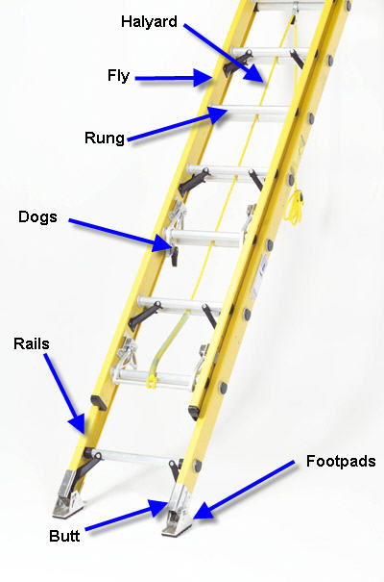
LADDERS

Slide 14
General Ladder Requirements
Ladders must be kept in a safe condition.
MUST DO
Keep the area around the top and bottom of a ladder clear
Ensure rungs are spaced 10 to 14 inches apart
Ensure rungs, cleats, and steps are level and uniformly spaced
Keep ladders free from slipping hazard

Slide 15
General Ladder Requirements
DON’T
Tie ladders together to make longer sections, unless designed for such use.
Use single rail ladders.
Load ladders beyond the maximum load for which they were built.
Load ladder beyond the manufacturer’s rated capacity.

Slide 16
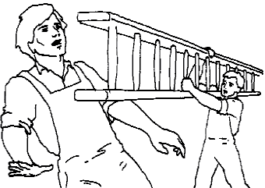
Transporting the Ladder
If carrying a ladder by yourself, keep the front high enough to clear someone’s head should they come around a corner.
Do not drop a ladder, place it.
When moving a ladder to a new location after it has been positioned vertically, take it down and set it up at the new location.

Slide 17
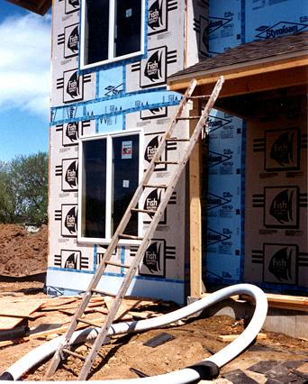
Securing Ladders
Secure ladders to prevent accidental movement due to workplace activity
Only use ladders on stable and level surfaces, unless secured
Do not use ladders on slippery surfaces unless secured or provided with slip-resistant feet
This ladder is not on a stable surface

Slide 18
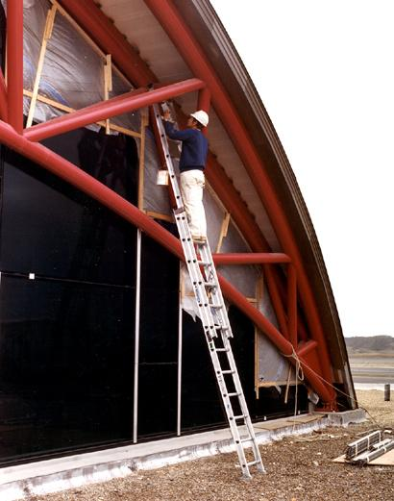
Portable Ladders
Inspect before use for cracks, dents, and missing rungs
Design or treat rungs to minimize slipping
Side rails -- at least 11 1/2 inches apart
Must support 4 times the maximum load

Slide 19
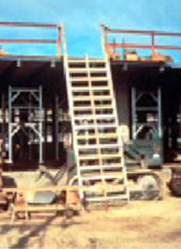
Double - Cleated Ladder
Use a double-cleated ladder ( with center rail) or 2 or more ladders:
  when ladders are the only way to enter or exit a working area with 25 or more employees.
  when a ladder will serve simultaneous two-way traffic.

Slide 20
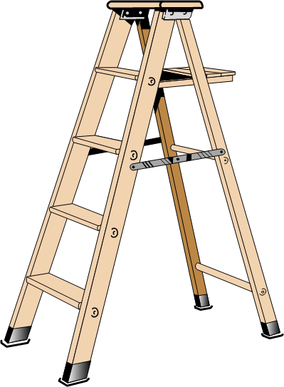
Painting Wood Ladders
paint wooden ladders
NEVER
use an opaque covering (like varnish) on a wood ladder

Slide 21
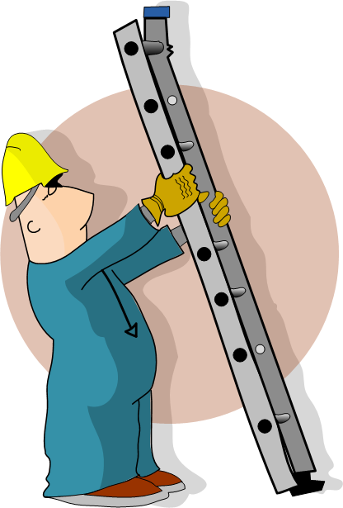

PLACING LADDERS SAFELY

Slide 22
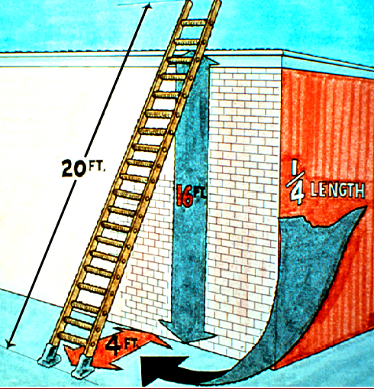
Ladder Angle
Non-self-supporting ladders:
  extension type that lean against a wall or other support
Position at an angle where the horizontal distance from the top support to the foot of the ladder is 1/4 the working length of the ladder

Slide 23
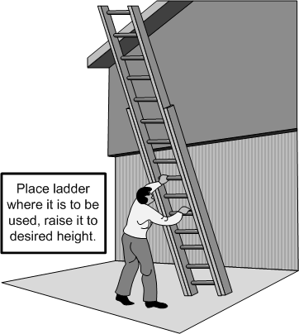
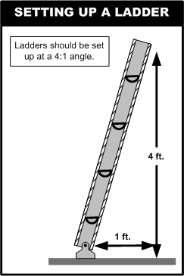
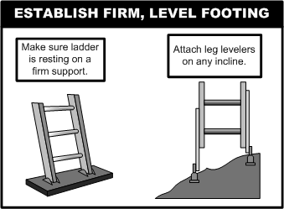

Slide 24
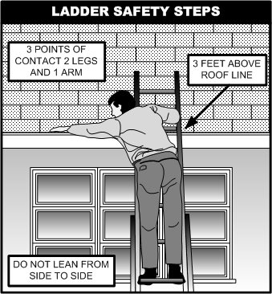
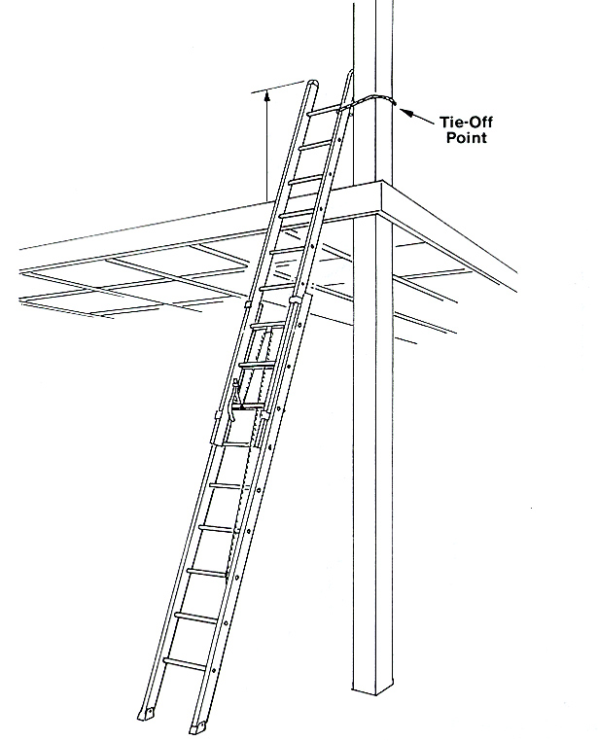
Ladder Rail Extension

Slide 25
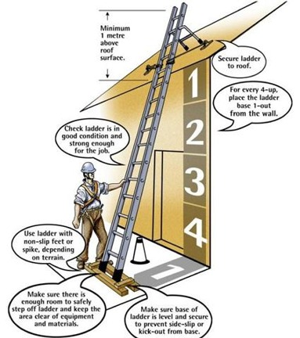
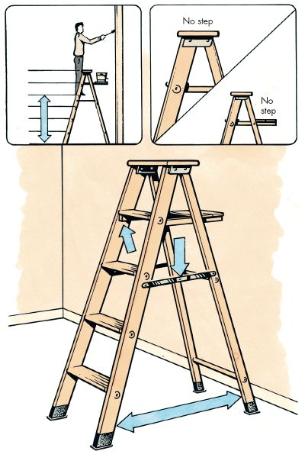
Ladder Placing

Slide 26
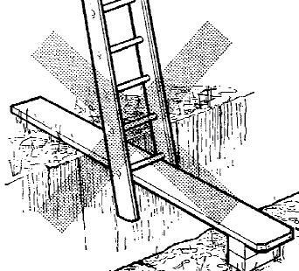
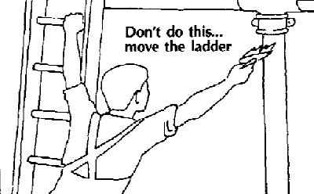
Other Requirements for Ladder Use
When two or more ladders are used together, they must be off-set with a landing or platform between them
Do not tie or fasten ladders together to provide longer sections

Slide 27
Important PEOSHA Regulations
The rungs and steps of fixed metal ladders manufactured after March 15, 1991, shall be corrugated, knurled, dimpled, coated with skid-resistant material, or otherwise treated to minimize slipping
Where the total length of a climb equals or exceeds 24 feet, fixed ladders shall be equipped with one of the following:
  Ladder safety devices
  Self-retracting lifelines and rest platforms
  A cage or well

Slide 28
Important PEOSHA Regulations
Ladder shall not be moved, shifted or extended while occupied.
Ladder shall have nonconductive side rails if they are used where the employee or the ladder could contact exposed energized electrical equipment.
Cross-bracing on the rear section of stepladders shall not be used for climbing.
Ladders shall be inspected by a competent person for visible defects on a periodic basis and after any occurrence that could affect their safe use.
Portable ladders with structural defects shall be tagged with “DO NOT USE” and withdrawn from service until repaired.

Slide 29
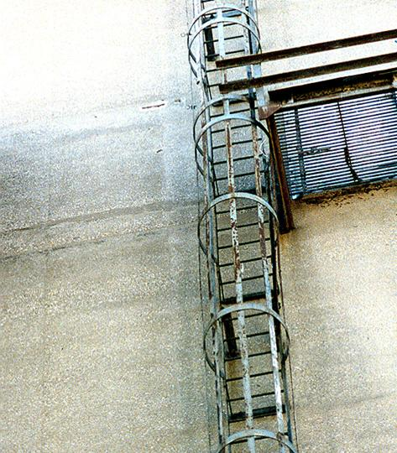
Tall Fixed Ladder Requirements
Equip a fixed ladder 24 feet or longer with either a;
  Ladder safety device,
  Self-retracting lifelines with rest platforms every 150 feet or less,
  Cage or well, and multiple ladder sections, each section not exceeding 50 feet.

Slide 30
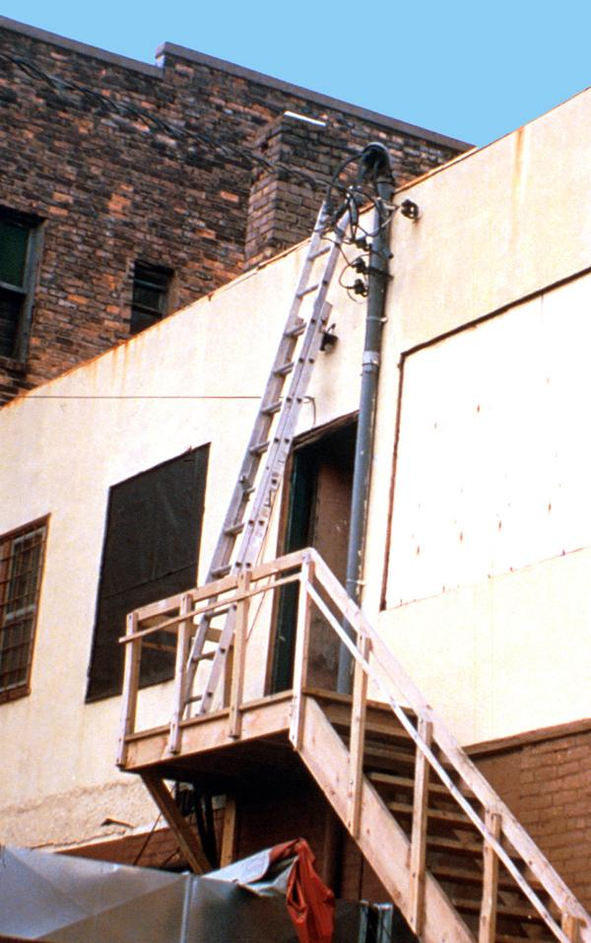
Near Energized
Electrical Equipment
If using ladders where the employee or the ladder could contact exposed energized electrical equipment, they must have nonconductive side rails such as wood or fiberglass.

Slide 31
The STEP LADDER

Slide 32
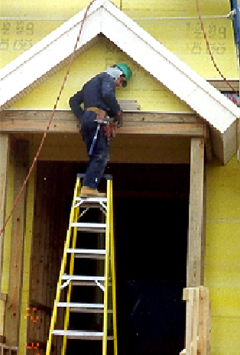
Top Step
Do not use the top or top step of a stepladder as a step.

Slide 33
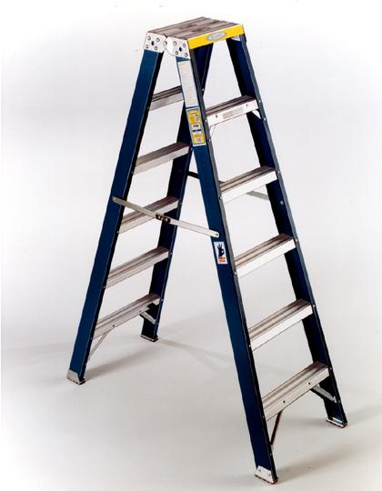
Cross Bracing
On this ladder the back rungs
are designed for use
Don’t use cross bracing on the rear of a stepladder for climbing,
  unless the rear of the ladder is designed for that.

Slide 34
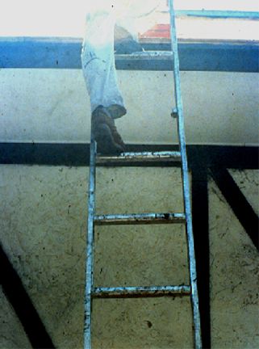
Damaged or Defective Ladders
A competent person must inspect ladders for visible defects, like broken or missing rungs
If a defective ladder is found, immediately mark it defective or tag it "Do Not Use”
Withdraw defective ladders from service until repaired
Missing rung

Slide 35
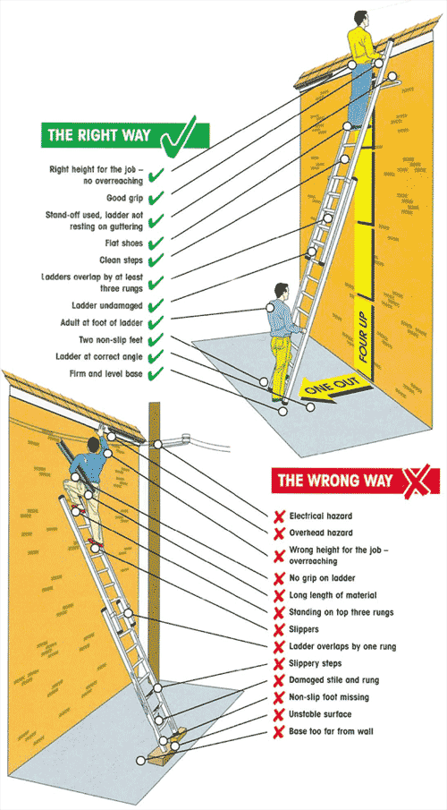
Climbing the Ladder
Face the ladder when going up or down
Use at least one hand to grab the ladder when going up or down
Do not carry any object or load that could cause you to lose balance

Slide 36


SUMMARY
Key Components for Stairway Safety
Treads
Rails
  Handrails
  Stair rails
  Guardrails
Landings and Platforms

Slide 37
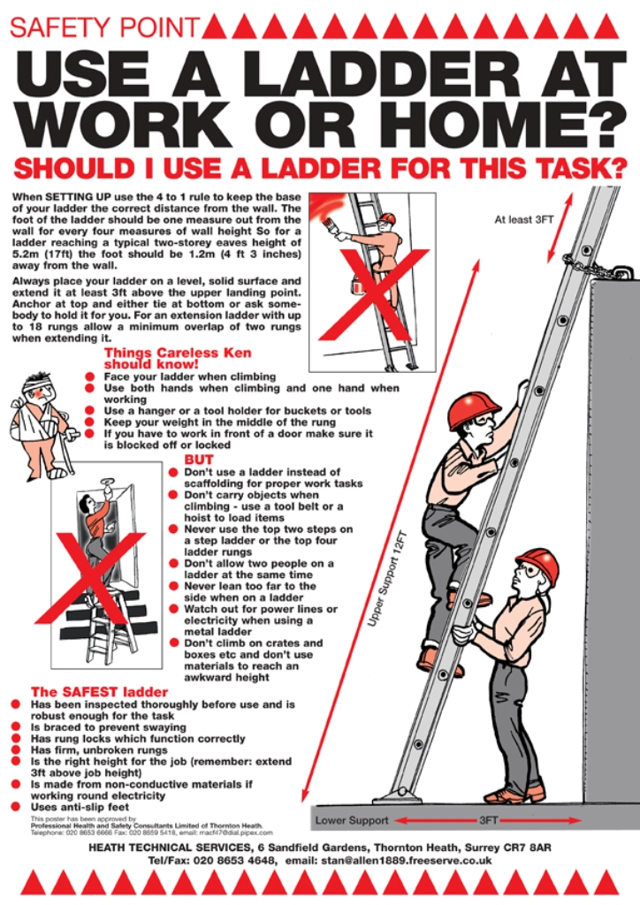
SUMMARY
Key Components for Ladder Safety
A competent person must inspect ladders.
Use the correct ladder for the job.
  Never lean a step ladder against a wall and climb it.
Use the correct angle, supports, treads, cross braces and rails.
Don’t overload the ladder.

Slide 38

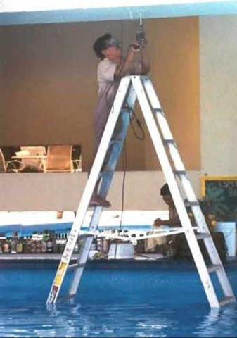
Don’t be STUPID!
BE SAFE

Slide 39


QUESTIONS

