Slide 1
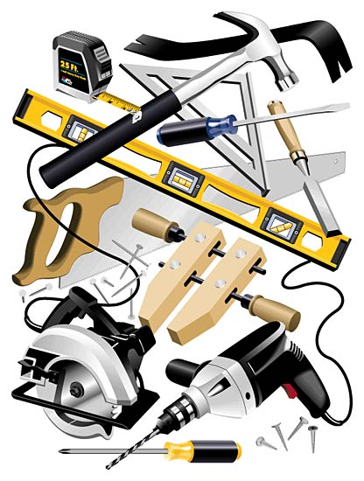
HAND and POWER TOOL SAFETY

Slide 2
Hazards
Workers using hand and power tools may be exposed to these hazards:
Objects that fall, fly, are abrasive, or splash.
Harmful dusts, fumes, mists, vapors, and gases.
Frayed or damaged electrical cords, hazardous connections and improper grounding.

Slide 3
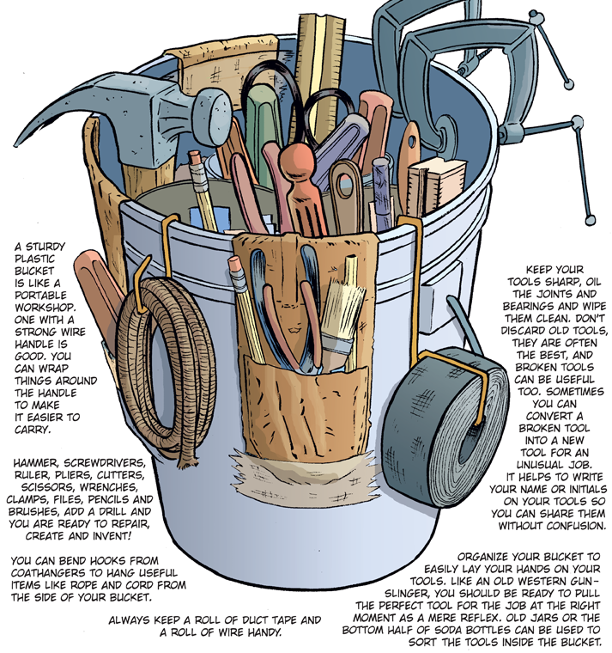
ANATOMY
of a
TOOL
BUCKET
KEEP
IT
NEAT

Slide 4
Basic Tool Safety Rules
Use the right personal protective equipment (PPE).
Operate according to manufacturers’ instructions.
Maintain regularly.
Use right tool for the job.
Inspect before use.
Use guards.

Slide 5
Hand Tool Hazards
Hazards are usually caused by misuse & improper maintenance.
Do not use:
wrenches when jaws are sprung,
impact tools when heads have mushroomed,
tools with loose, cracked or splintered handles,
a screwdriver as a chisel,
tools with taped handles – they may be hiding cracks.

Slide 6
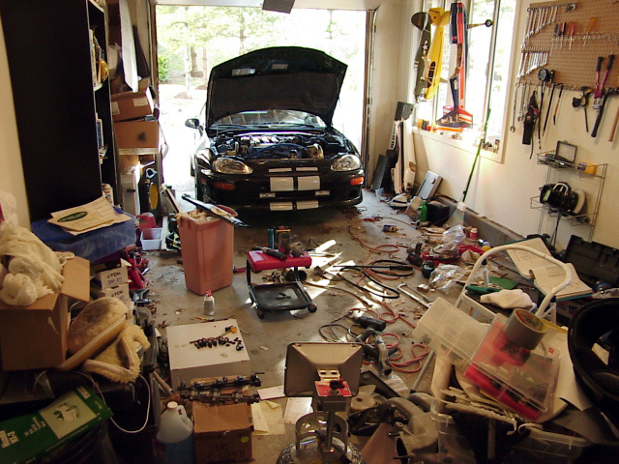
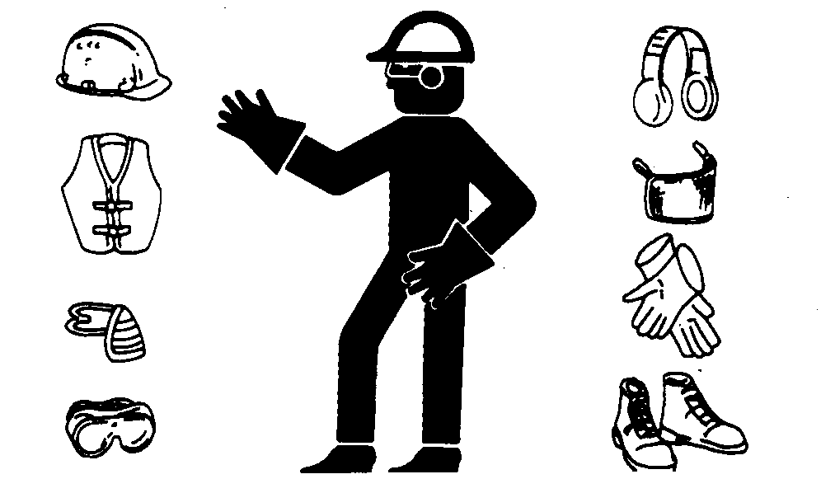
Hand Tools Protection
Use PPE, such as safety goggles and gloves.
Keep floors free from debris and tripping or slipping hazards.
Keep cutting tools sharp.

Slide 7
Tools don’t cause accidents

Slide 8
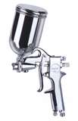
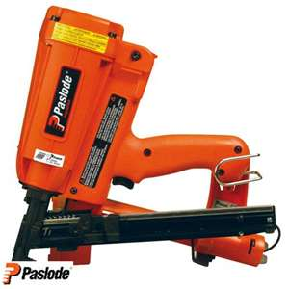
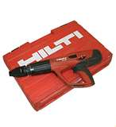
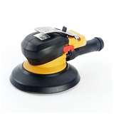
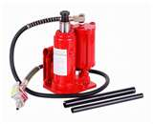
Power Tools
Extremely hazardous when used improperly!
Must be fitted with guards and safety switches.
Different types, determined by power source:
Electric
Pneumatic
Liquid fuel
Hydraulic
Powder-actuated

Slide 9
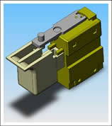
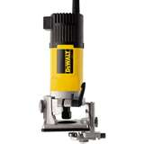
Switches
Hand-held power tools must be equipped with one of the following:
Constant pressure switch
shuts off power upon release
Examples: circular saw, chain saw, grinder, hand-held power drill.
On-Off Switch
Examples: routers, planers, laminate trimmers, shears, nibblers, scroll saws.

Slide 10
Power Tools Precautions
Disconnect tools when not in use, before servicing, cleaning, and when changing accessories.
Keep people not involved with the work away from the work.
Secure work with clamps or vise, freeing both hands to operate the tool.
Don’t hold the switch button while carrying a plugged-in tool.
Keep tools sharp and clean.
Consider what you wear – loose clothing and jewelry can get caught in moving parts.
Remove damaged electric tools & tag them: “Do Not Use”

Slide 12
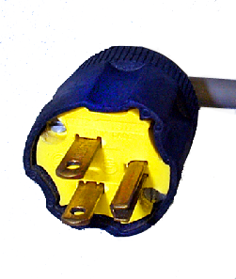
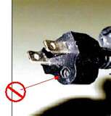
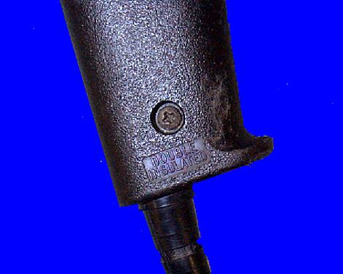
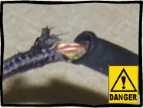
Power Tools Precautions
Electric Cords
Don’t carry portable tools by the cord.
Don’t use electric cords to hoist or lower tools.
Don’t yank cord or hose to disconnect it.
Keep cords and hoses away from heat, oil, and sharp edges.
To protect a worker from shock, these tools must:
have a 3-wire cord plugged into a grounded receptacle,
be double insulated,
be powered by a low-voltage isolation transformer.
Plug with a grounding pin
Double insulated markings

Slide 13
Electric Tools Good Practices
Operate within design limits.
Use gloves and safety shoes.
Store in a dry place.
Don’t use in wet locations unless approved for that.
Keep work areas well lit.
Ensure cords don’t present a tripping hazard.

Slide 14
PROTECT YOUR HANDS
Some tools are Irreplaceable

Slide 15
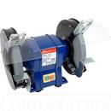
Abrasive Wheels and Tools
Equip with guards that:
Cover the spindle end, nut, & flange projections.
Maintain proper alignment with the wheel.
Don’t exceed the strength of the fastenings.
May throw off flying fragments.
Set guard so that a minimal amount of the wheel is exposed.

Slide 16
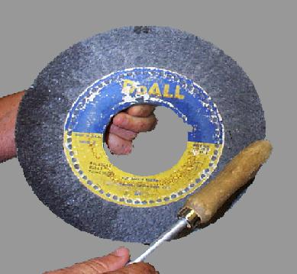
Inspecting Abrasive Wheels
Before mounting:
inspect closely for damage
perform sound- or ring-test to ensure free from cracks / defects
To test:
tap wheel gently with a light, non-metallic instrument
if wheel sounds cracked or dead, do not use it because it could fly apart

Slide 17
Abrasive Wheel Use
To prevent cracking:
fit the wheel on the spindle freely
tighten the spindle nut enough to hold the wheel in place without distorting the flange
Let the tool come up to speed prior to grinding or cutting
Don’t stand in front of the wheel as it comes up to full speed
Use eye and/or face protection
Ensure the spindle speed doesn’t exceed the maximum speed marked on the wheel

Slide 18
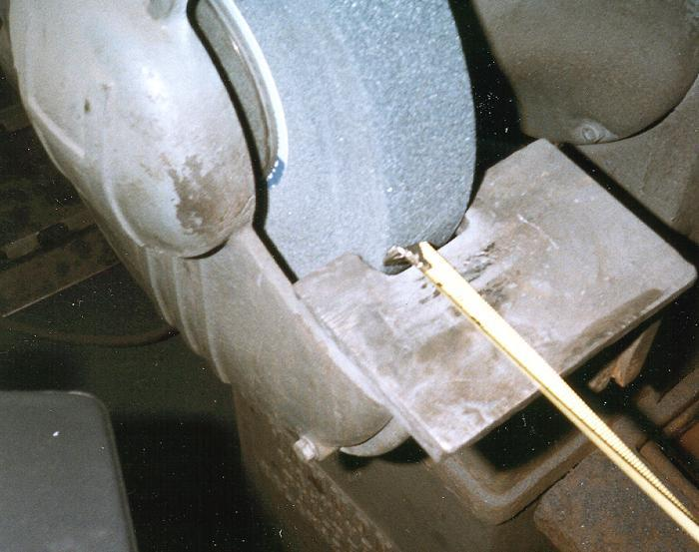
Abrasive Wheel Work Rests
Keep work rests not more than 1/8th inch from wheel surface
This prevents jamming the work between the wheel and the rest, which may cause the wheel to break
Don’t adjust wheel while it’s rotating

Slide 19
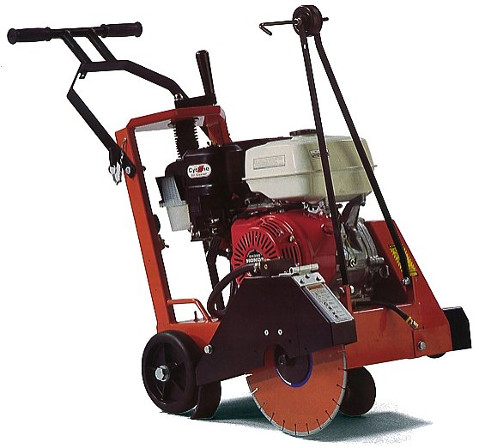
Guarding
Guard exposed moving parts of power tools.
Guard belts, gears, shafts, pulleys, sprockets, spindles, flywheels, chains, or other moving parts.
Never remove a guard when a tool is in use.

Slide 20
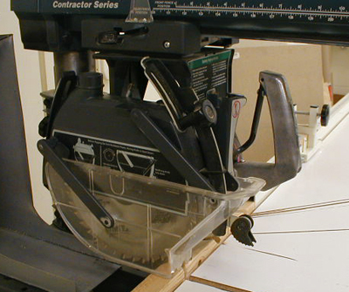
Guarding - Point of Operation
This shows a radial arm saw equipped with proper point of operation guards

Slide 21
Guarding Protection
Machine guards must protect the operator and others from:
Point of operation,
In-running nip points,
rotating parts,
flying chips and sparks.
Nip Point

Slide 22
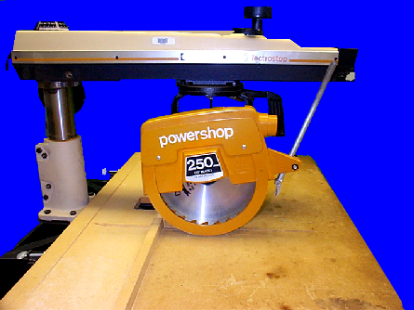
Radial Saw Guarding
Upper Guard
POINT OF OPERATION
Lower Guard
Radial arm saw equipped with an upper and lower blade guard

Slide 23
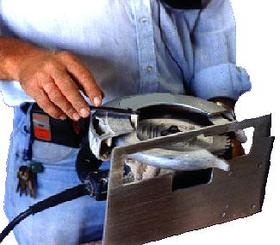
Guarding Portable Circular Saws
Guard these saws above and below the base plate or shoe. The lower guard must cover the saw to the depth of the teeth.
NEVER PLACE A CIRCULAR SAW DOWN WHILE THE BLADE IS TURNING BEFORE YOU CHECK THAT THE BLADE GUARD IS CLOSED.

Slide 24
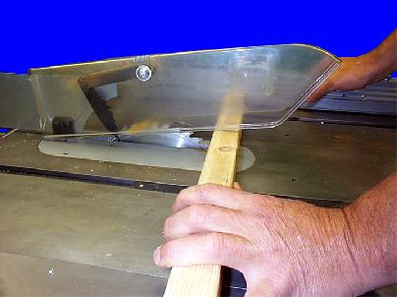
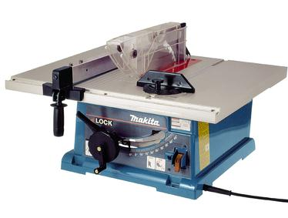
Table Saw Guarding
Hood guard
Use a hood for guarding

Slide 25
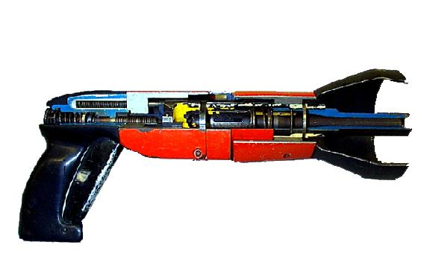
Pneumatic Tools
Powered by compressed air.
Includes nailer’s, staplers, chippers, drills & sanders.
Main hazard - getting hit by a tool attachment or by a fastener the worker is using with the tool.
Take the same precautions with an air hose that you take with electric cords.
Nail Gun -
Cut-Away View

Slide 26
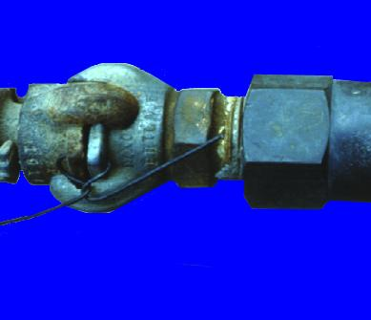
Pneumatic Tools - Fastening
Ensure tool is fastened securely to the air hose to prevent a disconnection.
Use a short wire or positive locking device attaching the air hose to the tool
Wire used to secure hose

Slide 27
Pneumatic Tool Connections
Unacceptable
Acceptable

Slide 28
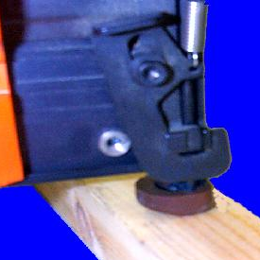
Pneumatic Tool Safety
Place a safety device on the muzzle to prevent the tool from ejecting fasteners, unless the muzzle is in contact with work surface.
Install a safety clip or retainer to prevent attachments, such as chisels on a chipping hammer, from being ejected.
Wear eye protection. Wear hearing protection with jackhammers.
Muzzle in contact
with work surface

Slide 29
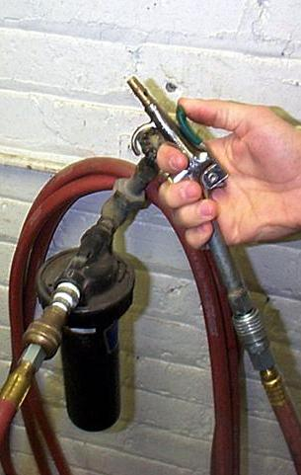
Compressed Air Cleaning
Don’t use compressed air for cleaning.
Exception - where reduced to less than 30 psi with effective chip guarding and PPE.

Slide 30
Liquid Fuel Tools
Usually gas powered.
Main hazard – fuel vapors.
Use only approved flammable liquid containers.
Before refilling a fuel-powered tool tank, shut down the engine and allow it to cool

Slide 31
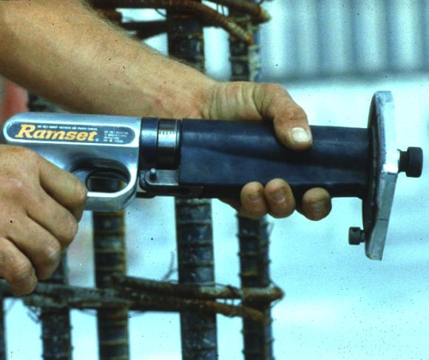
Powder-Actuated Tools
User must be trained and licensed to operate.
Test tool each day before loading to ensure the safety devices are working properly.
Wear suitable ear, eye & face protection.
Select a powder level that will do the work without excessive force

Slide 32
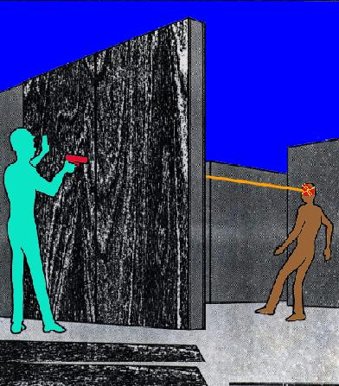
Fatal Fact
Employee killed when struck in head by a nail fired from a powder actuated tool.
Tool operator was attempting to anchor a plywood form in preparation for pouring a concrete wall

Slide 33
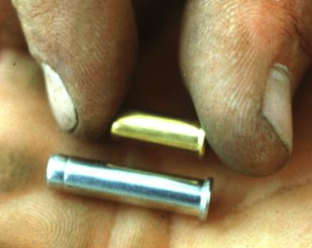
Easily Penetrated Material

Slide 34
Powder-Actuated Tool Safety Tips
Don’t use in explosive or flammable atmosphere.
Inspect tool before use to ensure:
it is clean,
that moving parts operate freely
the barrel is free from obstructions and has the proper shield, guard, and attachments.
Don’t load the tool unless using immediately
Don’t leave a loaded tool unattended
Keep hands clear of the barrel end
Never point the tool at anyone
Store unloaded in a locked box

Slide 35
Jacks
To set up a jack, ensure:
The base is on a firm, level surface,
It’s centered,
The jack head is placed against a level surface,
You apply the lift force evenly.
Lubricate and inspect jacks regularly.

Slide 36
Jacks - Capacity
The manufacturer's rated capacity must be marked on all jacks and must not be exceeded
All jacks must have a stop indicator that is not exceeded.

Slide 37
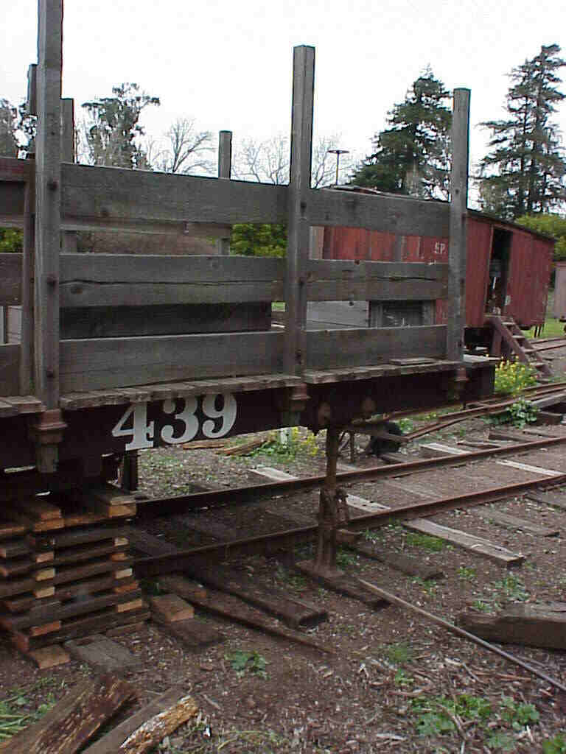
Jacks - Blocking
Handyman jack is provided a firm base by using the railroad tie.
The load is cribbed to prevent it from falling.

Slide 38
Summary
Hazards are usually the result of improper tool use or not following one or more of these protection techniques:
Inspecting the tool before use,
Using PPE (Personal Protective Equipment),
Using guards,
Properly storing the tool,
Using safe handling techniques.

