Slide 1
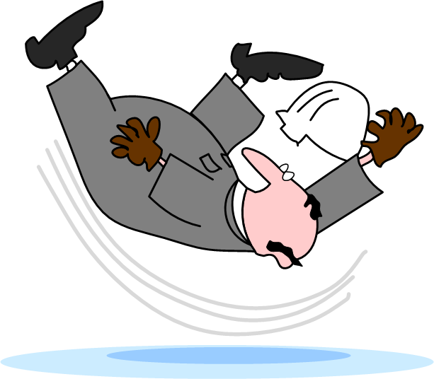
Walking on Ice & Snow

Slide 2
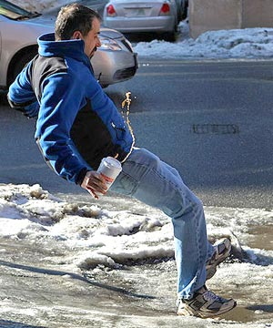
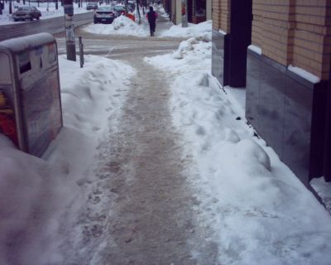
Walking on Ice & Snow, etc.
No matter how well the ice & snow are removed from streets & sidewalks, people will encounter slippery surfaces when walking outdoors in the winter.
Many cold weather injuries are the result of falls on ice-covered streets and sidewalks.
Getting around on campus in icy conditions calls for planning, caution, and a little common sense.

Slide 3
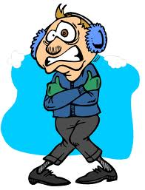
What to Wear
Dress warmly and wear boots with non-skid soles. (Avoid plastic and leather soles.)
Wear a bright scarf or hat or reflective gear so drivers can see you.
Keep warm, but make sure you can hear what’s going on around you.
Whatever you wear, make sure it doesn’t block your vision or make it hard for you to hear traffic.
During the day, wear sunglasses to help you see better and avoid hazards.

Slide 4
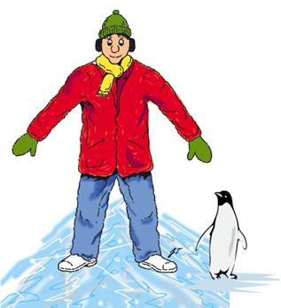
How to Walk
Plan ahead and give yourself enough time.
When walking on steps, always use the hand railings and plant your feet firmly on each step.
When walking on an icy or snow-covered walkway, take short steps and walk at a slower pace so you can react quickly to a change in traction.

Slide 5
How to Walk
Bending your knees a little and taking slower and shorter steps increases traction and can greatly reduce your chances of falling.
It also helps to stop occasionally to break momentum.
Approach cleared streets & sidewalks with caution. Look out for “black ice.”
Dew or water vapor can freeze on cold surfaces, forming an extra-thin, nearly invisible layer of ice that can look like a wet spot on the pavement.
It can happen early in the morning or in areas shaded from the sun.
A heavy backpack or other load can challenge your sense of balance.
Try not to carry too much—you need to leave your hands and arms free to better balance yourself.
Be prepared to fall and try to avoid using your arms to break your fall.
If you fall backward, make a conscious effort to tuck your chin so your head won’t hit the ground with full force.

Slide 6
How to Walk
When entering a building, remove as much snow and water from your boots as you can.
Notice that floors and stairs may be wet & slippery—walk carefully.

Slide 7
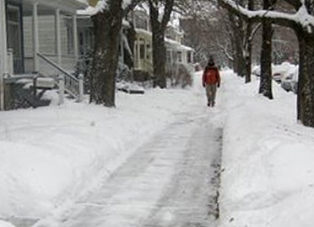
How to Walk
Use special care when entering and exiting vehicles. Use the vehicle for support.
Walk on sidewalks if possible.
If sidewalks are covered with snow & ice, one option is to walk along their grassy edges for traction.

Slide 8
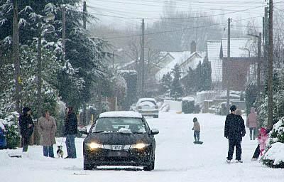
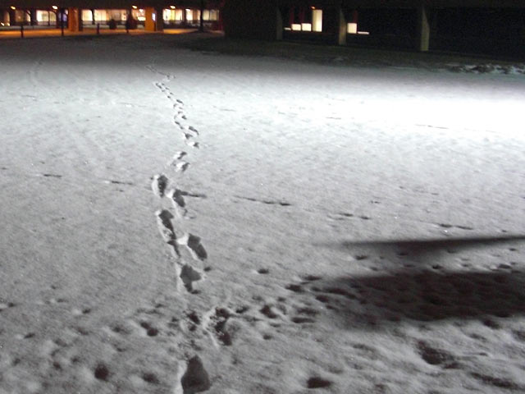
Where to Walk
If you must walk in the street, walk against the flow of traffic, as close to the curb as you can.
Taking shortcuts through areas where snow & ice removal is not feasible can be hazardous.

Slide 9
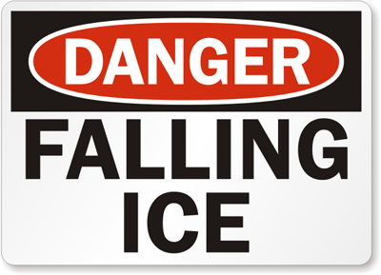
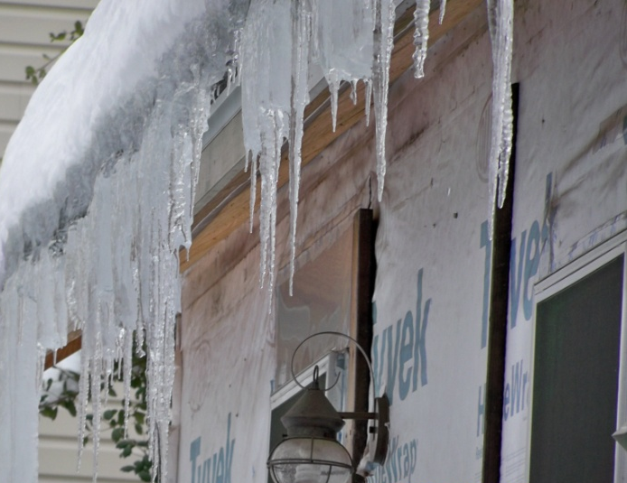
Avoid Areas with Falling Ice
As if there wasn’t enough danger of falling on ice, you must be aware of ice that might fall on YOU!
Watch out for: Icicles hanging from eaves, sheets of ice on sloping roofs, and tree branches covered with ice.
They can fall quickly and silently.

Slide 10
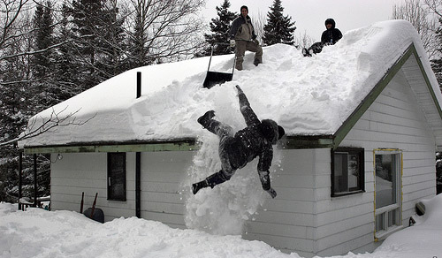
Avoid Areas with Falling Ice
If you are cleaning the roof to make it safer from falling ice and snow, BE VERY CAREFUL!

Slide 11
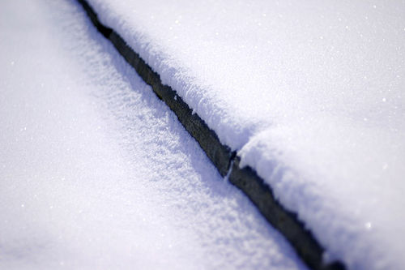
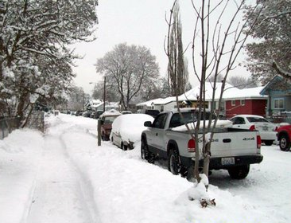
Dealing with Traffic
Before stepping off the curb, make sure all cars and trucks have come to a complete stop.
Due to poor road conditions, motorists may not be able to stop or slow down for pedestrians.

Slide 12
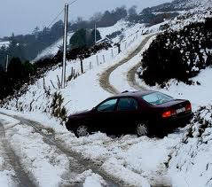
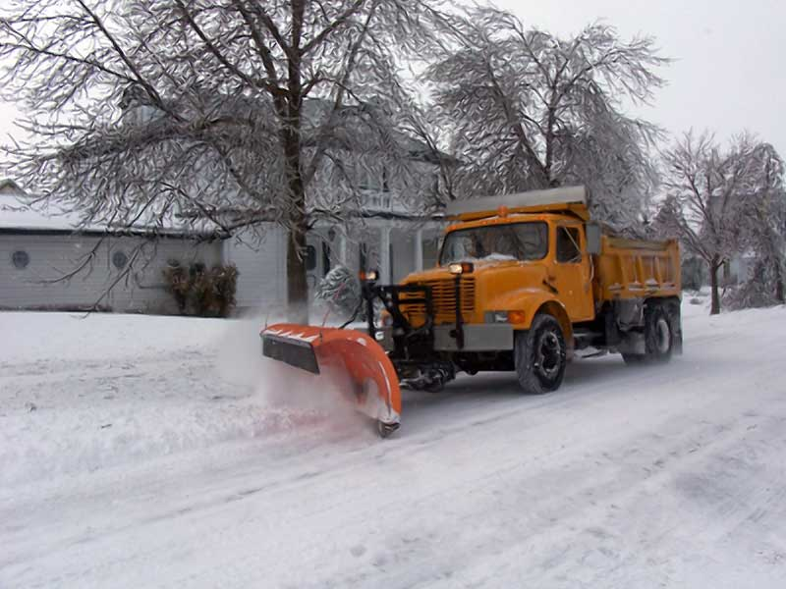
Dealing with Traffic
Be on the lookout for vehicles sliding in your direction.
Vehicles should yield to snow removal equipment in streets and parking lots.

