Slide 1

WORKING SAFELY
Why is working safely
important?

Slide 2


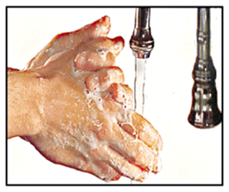
How do you work safely?
YOU MUST,
Follow safety instructions
Wash your hands
Wear PPP
Notes:
Ask participants for some examples of the safety rules in their work area
Note: You need to click the mouse to bring each example up on the slide.
Typical examples of safety rules could be:
staying on designated walkways
observing the hygiene signs
wearing protective clothing
If necessary, explain the term PPE and provide examples– this is also covered in a later slide

Slide 3
Why is working safely important?
Simply put,
PEOPLE DON’T GET HURT!
Notes:
An activity could be to select a couple of relevant safety rules and discuss why they are rules.
For example, ‘what might happen if people in the kitchen didn’t wash their hands regularly?’
Or
‘what might happen if we didn’t have designated walkways?’
Reiterate the message on the slide about people not getting hurt.
Using examples is always useful in training activities however it is important to make the example as relevant as possible to the experience of the participants. If there have been recent incidents of people being hurt because they have not followed the safety rules, they will be pparticularly useful.

Slide 4
What do you do if someone gets hurt at work?
Report injuries immediately to your Supervisor.
Follow the safety rules
Get help if needed.
Notes:
Prior to the session:
insert a picture of the team leader on the slide
if you use another term (like supervisor or job coach) or reports of injuries need to be made to someone else, change the text on the slide
Show participants a copy of the workplace injury notification form.
Discuss filling out workplace forms, why this needs to be done and who can help.

Slide 5


What does working safely mean?
Following the safety rules.
Wearing the right protective equipment.
Keeping the work area safe.
Notes:
An important training tip to remember is the more relevant the examples are, the more meaningful training is to the participants. There is also more chance of the material being remembered.

Slide 6




Slide 7

KNOWING ABOUT WORKPLACE HAZARDS
The best workers work safely!
Notes:
At the beginning of this session take a few minutes to reflect on the areas covered in the previous session.
Remind participants about safety rules and why working safely is important.

Slide 8


It’s your job!

Slide 9

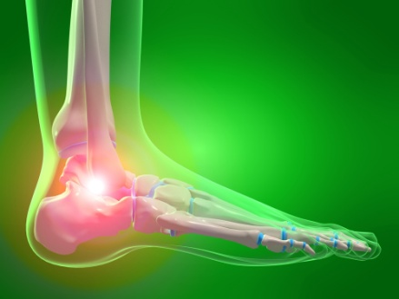
What are hazards?
A hazard is anything that could hurt you or make you sick.
Hazards can;
  CUT YOU
  TRIP YOU
  BURN YOU
  CRUSH YOU
  HURT YOUR HEARING
  HURT YOUR EYES
  MAKE YOU SICK
  CAUSE YOU PAIN
Notes:
Prior to the session make a list of hazards relevant to the work of the people who will be in the group.
Before displaying the answer to the main question, discuss with participants what they think a hazard is.
Ask them to give examples of some hazards in their workplace.

Slide 10
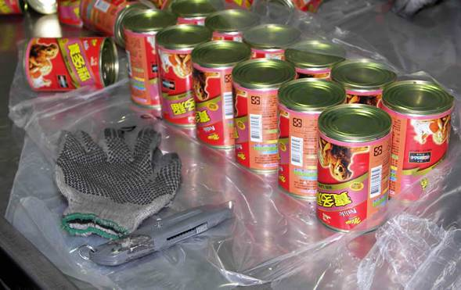
Find the hazard
Notes:
Before the session, change the picture in this slide to one of significant hazards in the participants’ work area.
Ask the participants to identify the hazards in each picture.
When the hazard has been identified work through the safe working behaviours and PPE required to reduce the hazard.
For example in the picture provided the hazard/s are:
box cutting knife blade exposed
The safe working behaviours are:
using appropriate PPE when using the knife
Tips for removing photographs and inserting new ones are included in the trainer’s guide.

Slide 11
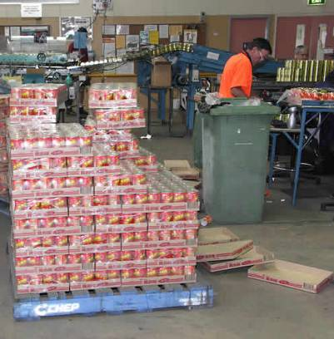
Find the hazard
Notes:
Before the session, change the picture in this slide to one of significant hazards in the participants’ work area.
Ask the participants to identify the hazards in each picture.
When the hazard has been identified work through the safe working behaviours and PPE required to reduce the hazard.
For example in the picture provided the hazard/s are:
Packaging left on the floor is a trip hazard
The safe working behaviours are:
Keeping the workplace tidy
Tips for removing photographs and inserting new ones are included in the trainer’s guide

Slide 12
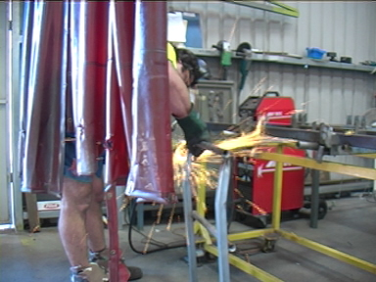
Find the hazard
Notes:
Before the session, change the picture in this slide to one of significant hazards in the participants’ work area.
Ask the participants to identify the hazards in each picture.
When the hazard has been identified work through the safe working behaviours and PPE required to reduce the hazard.
For example in the picture provided the hazard/s are:
noise
sparks
The safe working behaviours are:
using appropriate PPE
working behind welding screens
Tips for removing photographs and inserting new ones are included in the trainer’s guide.

Slide 13

SIGNS SAY ALOT!

Slide 14






Hazard signs
Your workplace has signs to remind you to be careful.
Notes:
Before the session, change the next group of slides so that they show the hazard signs that are displayed in the participants’ work areas.
As you show the slides:
ask the group to tell you what hazard each sign is warning of.
discuss how to avoid being hurt by these hazards.
For example, the Forklift hazard sign lets us know that a forklift is operating in the area. To avoid being hurt by a forklift we need to keep to designated walkways, walk and not run and keep alert.

Slide 15
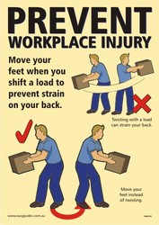
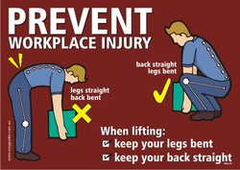
SAFE LIFTING POSTERS
Notes:
Ask participants
why it is important to use the right equipment when moving something
how things are lifted in their work area (i.e. what lifting equipment do they have?)

Slide 16
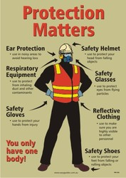

PPE POSTERS

Slide 17





WORK SAFE, BE SAFE!
IT’S YOUR RESPONSIBILITY

Slide 18


Keeping your workplace safe.
Notes:
Use the next series of slides to present safe working behaviours identified as those that should be targeted in your training.
Use the tips in the trainers guide to change the slides to identify the safe working behaviours in the participants’ workplace
At the beginning of this session take a few minutes to reflect on the areas covered in the previous sessions.
Remind participants about safety rules and why working safely is important.

Slide 19

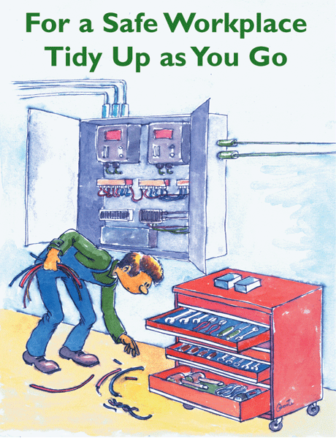
Notes:
Identify the machines used in the workplace with the participants
Discuss the safety checks you need to complete to be working safely
Have a list of basic safety checks for machines in the workplace, and a copy of the safety instructions for each machine.
Ask participants what could happen if the various safety checks aren’t done
As a follow up activity consider conducting a safety check with each participant at their individual work station. This activity could help reinforce the learning and/or provide you with an opportunity to go over the material again.

Slide 20
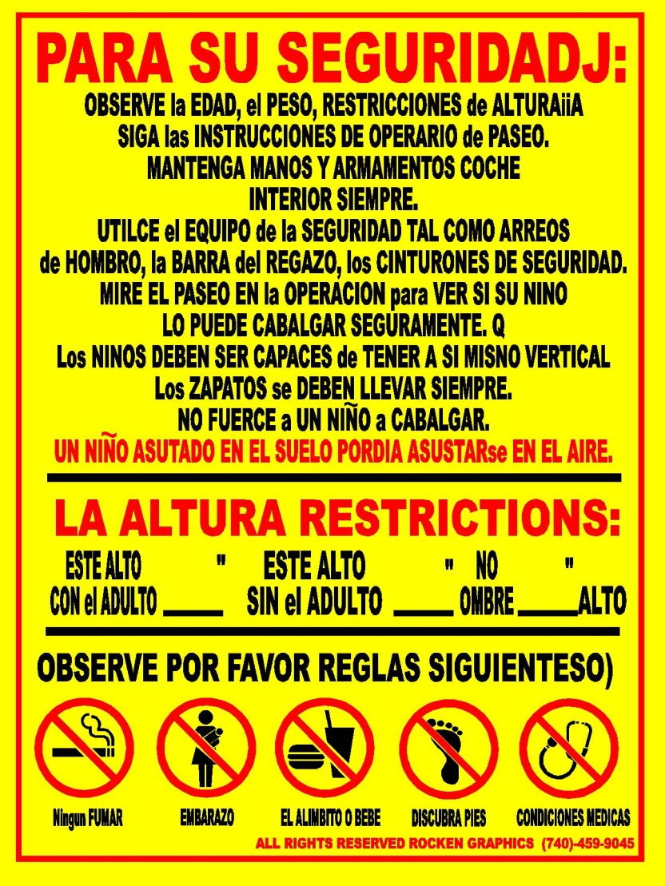
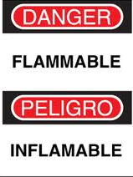


Don’t forget MULTILINGUAL.

