Slide 1
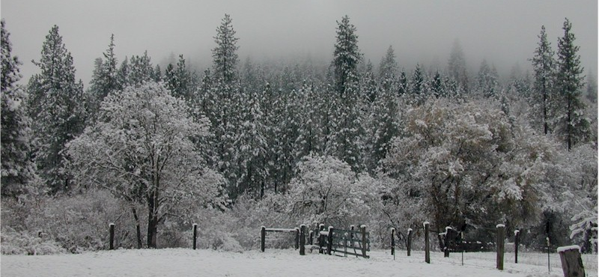
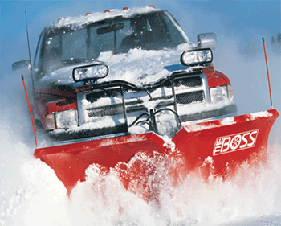
WINTER WEATHER SAFETY

Slide 2
Winter Weather Safety
Stay warm
Avoid slips and falls
Use care when shoveling snow
Operate snow blowers safely
Plowing safety
Safety when applying salt/antiskid
Summary

Slide 3
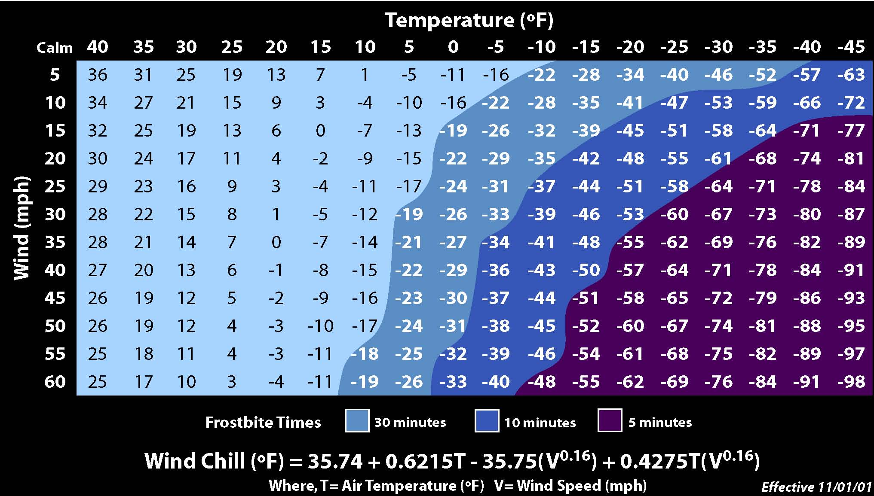
STAY WARM
WIND
COLD
FROSTBITE

Slide 4
WEAR THE RIGHT CLOTHING
Clothing should protect you from cold, wind, and precipitation and should also provide ventilation—be "breathable".
Protect head, feet, hands, and face. Keep dry.
Cover your head. Up to 40 percent of body heat can be lost when the head is exposed.
Footgear should be insulated to protect against cold and dampness.
Dress in layers, wearing warm, waterproof/resistant clothing.
An outer layer to break the wind and allow some ventilation (like Gore-Tex® or nylon).
A middle layer of wool or synthetic fabric to absorb sweat and retain insulation in a damp environment. Down is a useful lightweight insulator; however, it is ineffective once it becomes wet.
An inner layer of synthetic weave to allow ventilation. Synthetic materials are ideal because they keep you warm and dry.

Slide 5
FROST BITE
What Happens to the Body:
Freezing in deep layers of skin and tissue. Pale waxy-white skin colors. Skin becomes hard and numb; usually affects the fingers, hands, toes, feet, ears and nose.
What Should be Done?
Move the person to a warm dry area. Don’t leave the person alone.
Remove any wet or tight clothing that may cut off the blood flow to the affected areas.
DO NOT rub the affected area,
rubbing causes damage to the skin and tissue.
Gently place the affected area in a warm (105ºF) water bath and monitor the water temperature to slowly warm the tissue. Don’t pour warm water directly on the affected area because it will warm the tissue too fast causing tissue damage. Warming takes about 25-40 minutes.
After the affected area has been warmed, it may become puffy and blister. The affected area may have a burning feeling or numbness. When normal feeling, movement and skin color have returned, the affected area should be dried and wrapped to keep it warm. NOTE: If there is a change the area may get cold again, do not warm the skin. If the skin is warmed and then becomes cold again, it will cause severe tissue damage.
Seek medical attention as soon as possible.

Slide 6
HYPOTHERMIA (Medical Emergency)
What Happens to the Body:
Normal body temperature (98.6ºF) drops to or below 95ºF. Fatigue or drowsiness; uncontrolled shivering; cool bluish skin; slurred speech; clumsy movements; irritable, irrational or confused behavior.
What Should be Done? (land temperatures)
Call for emergency help (e.g. Ambulance or Call 911).
Move the person to a warm dry area. Don’t leave the person alone. Remove any wet clothing and replace with warm, dry clothing or wrap the person in blankets.
Have the person drink warm, sweet drinks (sugar water or sports type drinks) if they are alert. Avoid drinks with caffeine (coffee, tea, or hot chocolate) or alcohol.
Have the person move their arms and legs to create muscle heat. If they are unable to do this, place warm bottles or hot packs in the arm pits, groin, neck and head areas. DO NOT rub the persons body or place them in warm water bath. This may stop their heart.
What Should be Done? (water temperatures)
Call for emergency help (e.g. Ambulance or Call 911). Body heat is lost up to 25 times faster in water.
DO NOT remove any clothing. Button, buckle, zip and tighten any collars, cuffs, shoes and hoods because the layer of trapped water closest to the body provides a layer of insulation that slows the loss of heat. Keep the head out of water and put on a hat or hood.
Get out of the water as quickly as possible or climb on anything floating. DO NOT attempt to swim unless a floating object or another person can be reached because swimming or other physical activity uses the body’s heat and reduces survival time by about 50%.
If getting out of the water is not possible, wait quietly and conserve body heat by folding arms across the chest, keeping thighs together, bending knees, and crossing ankles. If another person is in the water, huddle together with chests held closely.
(from OSHA)

Slide 7
HOW TO PROTECT WORKERS
Recognize the environmental and workplace conditions that lead to potential cold-induced illnesses and injuries.
Learn the signs and symptoms of cold-induced illnesses/injuries and what to do to help the worker.
Train the workforce about cold-induced illnesses and injuries.
Select proper clothing for cold, wet and windy conditions. Layer clothing to adjust to changing temperatures. Wear a hat and gloves, in addition to underwear that will keep water away from the skin (polypropylene).
Take frequent short breaks in warm dry shelters to allow the body to warm up.
Perform work during the warmest part of the day.
Avoid exhaustion or fatigue because energy is needed to keep muscles warm.
Use the buddy system (work in pairs).
Drink warm, sweet beverages (sugar water or sports type drinks). Avoid drinks with caffeine (coffee, tea, or hot chocolate) or alcohol.
Eat warm, high-calorie foods like hot pasta dishes.

Slide 8
Workers Are at Increased Risk When…
They have predisposing health condition such as cardiovascular disease, diabetes, and hypertension.
They take certain medication (check with your doctor, nurse, or pharmacy and ask if any medicines you are taking affect you while working in cold environments.
They are in poor physical condition, have a poor diet, or are older.
(from OSHA)

Slide 9
Avoid slips and falls
Walking on snow or ice is especially treacherous and wearing proper footwear is essential.
A pair of well insulated boots with good rubber treads is a must for walking during or after a winter storm.
Wear ice cleats on icy sidewalks or streets.
When walking on an icy or snow-covered walkway, take short steps and walk at a slower pace so you can react quickly to a change in traction.
When you must walk in the street, walk against the traffic and as close to the curb as you can.
Be on the lookout for vehicles which may have lost traction and are slipping towards you. Be aware that approaching vehicles may not be able to stop at crosswalks or traffic signals.
Walk carefully inside buildings when you have wet boots. Brush snow off or remove wet boots. Walk carefully on wet floors inside buildings.
At night, wear bright clothing or reflective gear, as dark clothing will make it difficult for motorists to see you. During the daytime, wear sunglasses to help you see better and avoid hazards.

Slide 10
Use care when shoveling snow
The National Safety Council offers the following tips for safe shoveling:
Shovel fresh snow.
Freshly fallen, powdery snow is easier to shovel than the wet, packed-down variety.
Push the snow as you shovel.
It's easier on your back than lifting the snow out of the way.
Don't pick up too much at once.
Use a light shovel (e.g. aluminum). Use a small shovel, or fill only one-fourth or one-half of a large one.
Lift with your legs bent, not your back.
Keep your back straight. By bending and "sitting" into the movement, you'll keep your spine upright and less stressed. Your shoulders, torso and thighs can do the work for you.
Take it slow!
Shoveling (like lifting weights) can raise your heart rate and blood pressure dramatically; so pace yourself. Be sure to stretch out and warm up before taking on the task.

Slide 11
Use care when shoveling snow…
Do not work to the point of exhaustion.
If you run out of breath, take a break. If you feel tightness in your chest, stop immediately. Individuals over the age of 40, or those who are relatively inactive, should be especially careful.
Dress warmly.
Remember that extremities, such as the nose, ears, hands and feet, need extra attention during winter's cold. Wear a turtleneck sweater, cap, scarf, face protection, mittens, wool socks and waterproof boots.
If you have a history of heart trouble,
do not shovel without a doctor's permission.
Avoid shoveling after eating.
Do not smoke while shoveling.

Slide 12
Operate snow blowers safely
Snow blowers range from self-propelled to units mounted on tractors.
Inexperience causes accidents. Review the operator's manual before use. The manual can help you understand how the machine works and how to operate it safely.
Coming in contact with the turning blades inside the discharge chute is the most common cause of snow blower injuries.
Accidents occur most often when the discharge chute clogs with wet, heavy snow. You can't see the whirling blades down in the chute because snow covers the blades. If you use your hand or a stick to remove the clog, the blades could strike the stick or your hand. In either case, injury can occur.
Stop the engine before cleaning foreign objects or snow from the equipment. Do not insert your hand to clear it while the engine is running; turn it off and then clear it using a broom handle, stick, etc. Never leave the snow blower running unattended.

Slide 13
Never put you hand in the discharge chute.
Shut off equipment before making repairs or mechanical adjustments. Always shut off the engine and remove the spark plug wire to prevent injuries.
Clear the area of any debris before you begin snow removal. some machines can send snow flying 30 feet and small, solid objects, such as stones or ice, up to 75 feet. Direct snow away from people.
Do not exceed the snow blower's capacity
Clear snow up and down the face of slopes, not across the face.
Handle gasoline with care. Keep in mind these basic tips for handling flammable materials:
Use an approved fuel container for storage.
Don't remove the fuel cap or add gasoline to a running or hot engine.
Only fill the fuel tank outdoors.
Wipe up any spilled gasoline.
Keep both the snow blower and fuel away from open flames and sparks.
Clean off excess slush and lubricate the drive train prior to storage.

Slide 14
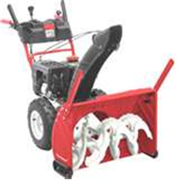
Snow blower trouble spots
TRANSMISSION CLUTCH
Accidental startup in-gear could cause injury.
ATTATCHMENT CLUTCH
Accidental engagement could cause sudden blade startup.
FUEL TANK
Gas explosion dangers from hot muffler or other ignition sources.
DISCHARGE CHUTE
MAJOR HAZARD
Amputation of hands & fingers from clearing clogged chute.
Exhaust
Can cause burns due to heat. Gas leaks or spills can cause explosions.
EXPOSED CHAINS & SPROCKETS
Moving parts can entangle fingers and clothes causing injury.
ELECTRIC CORD
Improper grounding, cutting & frayed cords can be HAZARDOUS.
AUGER/IMPELLER
Presents hazards to hands and feet because of clogging.

Slide 15
Snow Plow Safety
The snow plow and sweeper are most often mounted on the front of a power unit such as a small tractor, a pick-up truck or as special attachments for grounds keeping equipment.
They also can be mounted on the rear of a tractor. In each case, the ability to produce traction is usually the limiting factor to move snow.
To increase traction, use tire chains or add additional weight to the unit.

Slide 16
Snow plow driving safety
Wintertime driving poses many significant hazards
Keep truck or equipment in good condition.
Make sure that battery and ignition system, heater and defroster, windshield wipers, brake system, tires and exhaust system are in good condition.
Be sure the windshield wipers are functioning properly, all lights are in good working order, the tire treads are in good condition, and the tires are filled to the proper pressure.
Check fluid levels and top off before driving in hazardous conditions. Be sure the windshield wiper fluid, power steering and brake fluid, antifreeze, and engine oil are at the normal levels, and the engine has the proper weight of oil for winter driving.
Keep a full gas tank.
Clear snow from headlights and tail lights before beginning to drive so that you can see and be seen.
Carry emergency equipment such as radio or cell phone with fully charged batteries, flashlight, ice scraper, tire chains, jumper cables, flares, first aid kit, tools, windshield fluid, small shovel, sleeping bag, extra gloves and hats, drinking water, and food.

Slide 17
Snow plow safety (cont.)
Use extra caution when driving/plowing near pedestrians.
Slow down or stop when approaching pedestrians.
Maintain good steering capability.
Many times the front blade will have a digging action that may lift all the weight from the front steering wheels. This makes it difficult to steer effectively. Operators should reduce the amount of snow bite or add more weight on the unit's front.
Have several drop points for the snow.
Most blades and sweeps push the snow to one side. In wet, heavy snow the accumulation may not flow. Instead, it may stick and ball in front of the blade or sweeper. For these situations, have plenty of drop points and move the loads into the drop points as needed.
Take small bites that will flow across the blade surface.
Approach piles of snow at a reasonable speed. The impact of the blade on a pile of snow when approached at a fast speed can severely damage the machine's drive train and possibly injure or throw the operator from the machine.
Stay clear of obstacles
like curbs, stumps, posts, bridges and rocks that are close to embankments. Striking any of these objects could cause damage to the plow, machine, or truck.

Slide 18
Salt & Anti-skid safety
When spreading salt/antiskid:
Salt can be spread using a vehicle mounted spreader or a walk behind spreader.
Perform general preventive maintenance on the spreader before using. Don’t operate the salt spreader attachment without proper training.
Avoid lifting injuries- Use caution when loading the hopper to spreaders. Use proper lifting techniques. If using bags of salt, lift with knees (not back). Don’t lift bags above chest. Get help lifting bags if they weight more than 50 pounds. If possible, load salt into hoppers using mechanical equipment.
Vehicle safety- Use appropriate warning lights on vehicles when salting roadways and beware of other vehicles and pedestrians.
Walk behind spreaders- Walk carefully when spreading salt on slippery walks.
Don’t use hands to unclog the hopper or the spreader plate on vehicle mounted spreaders.
Wear appropriate clothing- winter coveralls, boots, gloves, etc.
Use salt wisely- Try to minimize spreading salt beyond paved surfaces to minimize damage to grass and plants.

Slide 19
How salt works

Slide 20
WORK SAFE
Be safe when applying salt & antiskid
SUMMARY
Use care when shoveling snow
WINTER SAFETY
Plow safely
Stay warm
Avoid slips and falls
Operate snow blowers safely

Slide 21
WORK SAFE – BE SAFE

